Slide 1
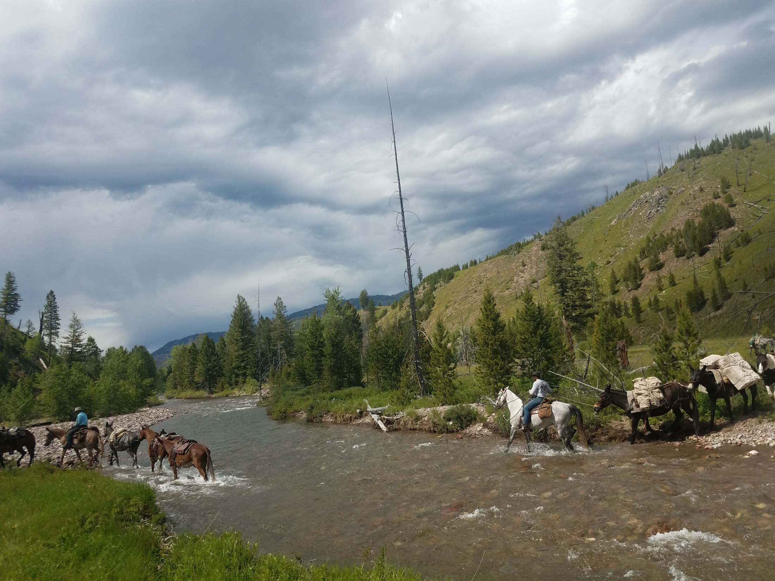
ROADLESS RULE REPEAL &
PROTECTING THE FUTURE OF OUR
PUBLIC LANDS

Slide 2
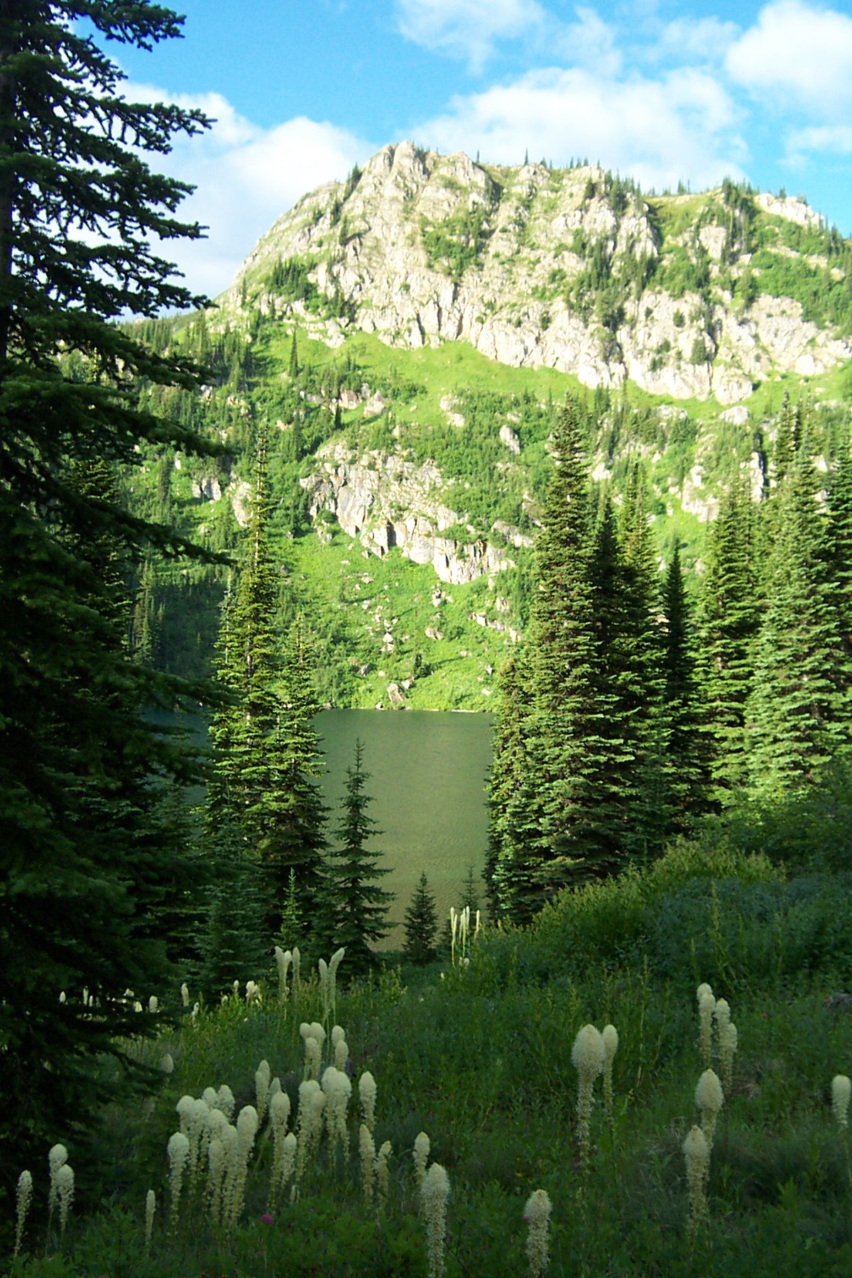
Roadless areas are not leftovers on a map. They ARE the last places where Americans can still experience quiet forests, clean water, abundant wildlife, and true backcountry travel.

Slide 3
What is the Roadless Rule?
The U.S. Forest Service is on the verge of making a devastating decision to remove the Roadless Area Conservation Rule (Roadless Rule), a bedrock policy safeguarding some of our last remaining natural, wild and intact landscapes in the United States. Enacted 25 years ago, the Roadless Rule protects roughly one-quarter of all national forests from road construction and large-scale industrial development. Exceptions can be made for fire protection or emergency situations. These protections have been instrumental in ensuring portions of the national forest system remain intact and continue to support natural ecosystems ensuring clean water, biodiversity and recreation.

Slide 4
What the Roadless Rule Actually Does
Adopted in 2001 after extensive public input.
Protects 58.5 million acres of National Forest land.
Limits new road construction and large-scale industrial development.
Important Clarification ✔ Does NOT create wilderness ✔ Does NOT close access ✔ Allows:
Hunting & fishing
Horse and stock use
Hiking & backpacking
Trail maintenance
Fire management
Recreation
Grazing
The rule protects land character — not restricts responsible use.

Slide 5
Consequences of Repealing the Rule
IF REPEALED, EXPECT:
More road construction will result in:
Habitat fragmentation.
Spread of invasive species.
Increased erosion.
Statistically, roads increase fire risk
Permanent loss of backcountry character.
Higher long-term management costs.
380,000 miles of USFS roads. 7 Billion $ backlog
Key Message
Roads are expensive to build and maintain.
Wild country is impossible to rebuild.

Slide 6
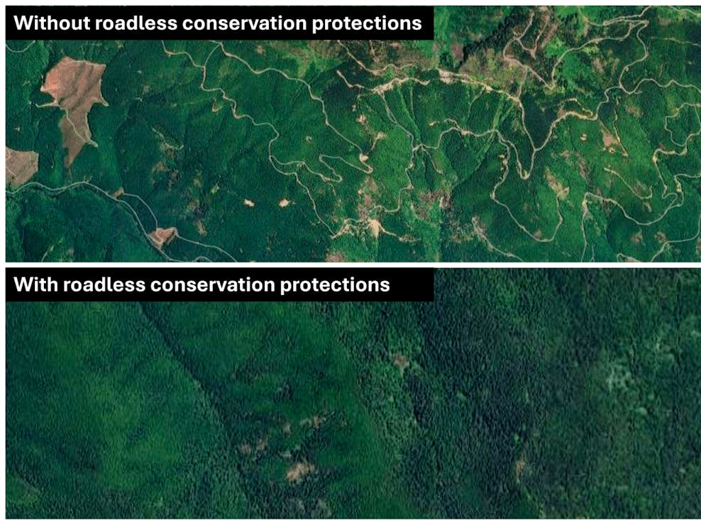

Slide 7
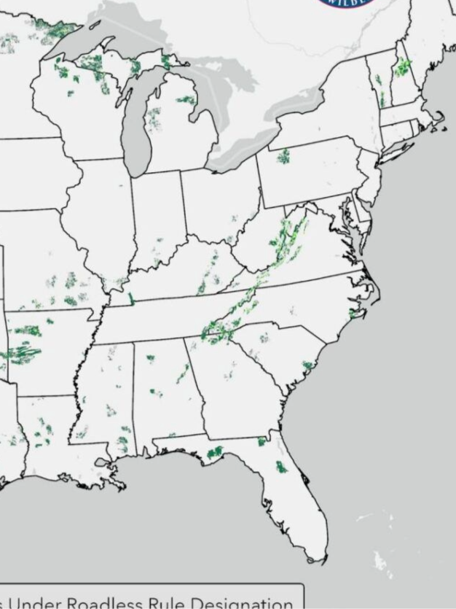
IN THE EASTERN STATES, ROADLESS AREAS ARE SMALLER, RANGING IN SIZE FROM 5000 TO 100,000+ ACRES.

Slide 8
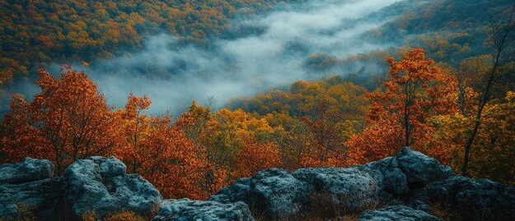
BECAUSE THEY ARE RARE AND FRAGMENTED IT MAKES THEM EVEN MORE CRITICAL AND IMPORTANT!

Slide 9
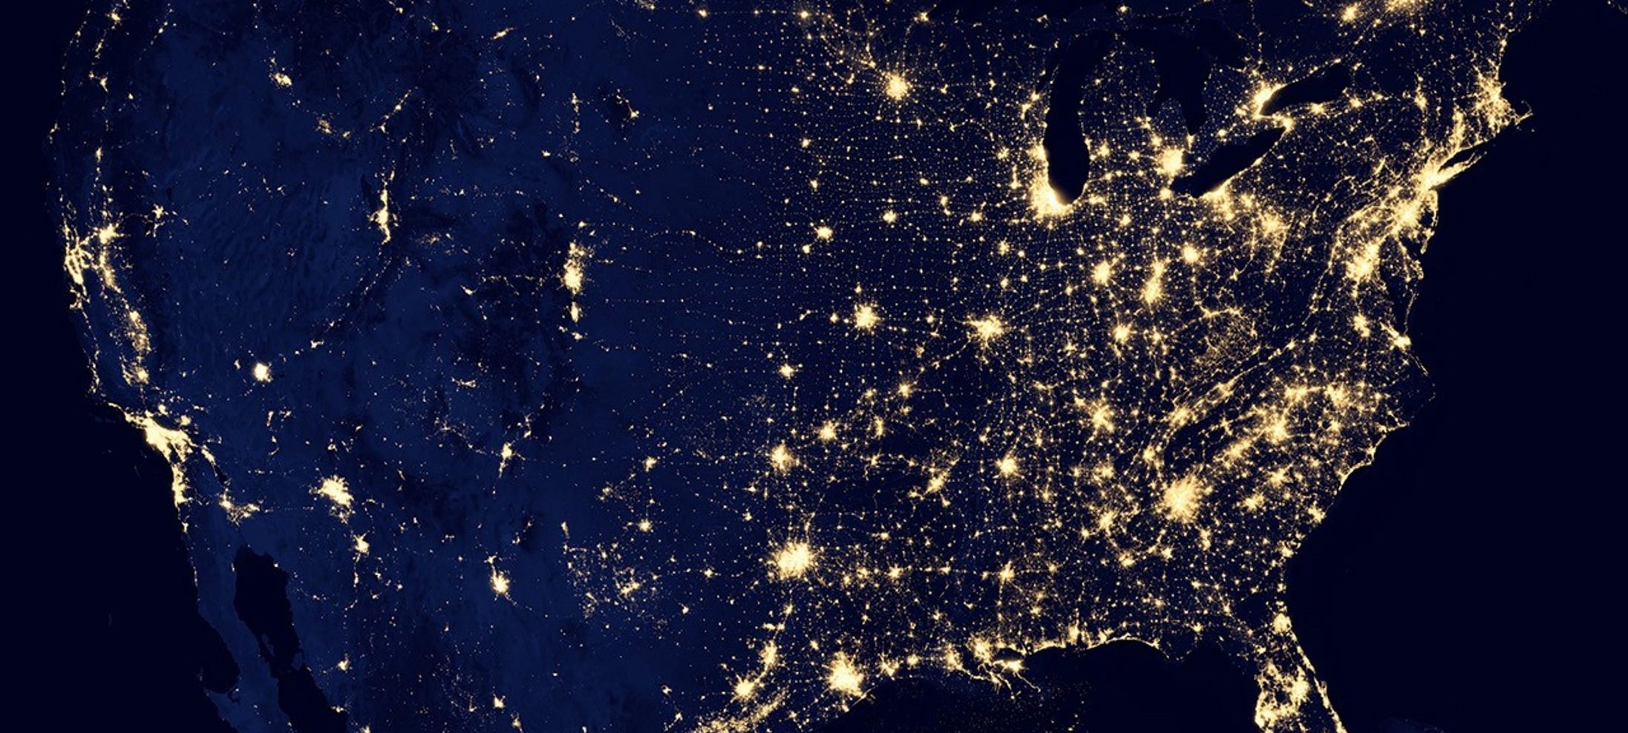
In the eastern United States, roadless public lands are not vast—they are rare, hard-won, and irreplaceable. These landscapes survived waves of clearing, logging, mining, and development that followed the era of Manifest Destiny. What remains today are the last quiet backcountry strongholds in a region where nearly every acre has felt the mark of human use.

Slide 10
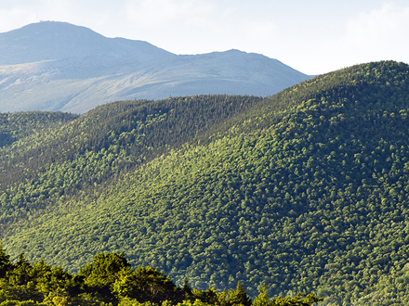
The White Mountain National Forest in New Hampshire and Maine is nearly 800,000 acres in size, containing about 148,000 acres of designated wilderness and approximately 368,000 acres of inventoried roadless areas.

Slide 11
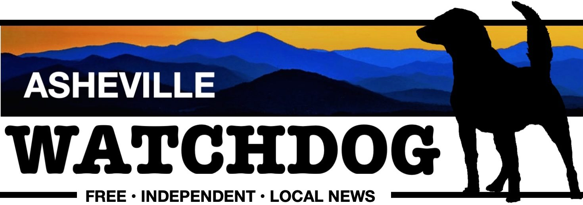
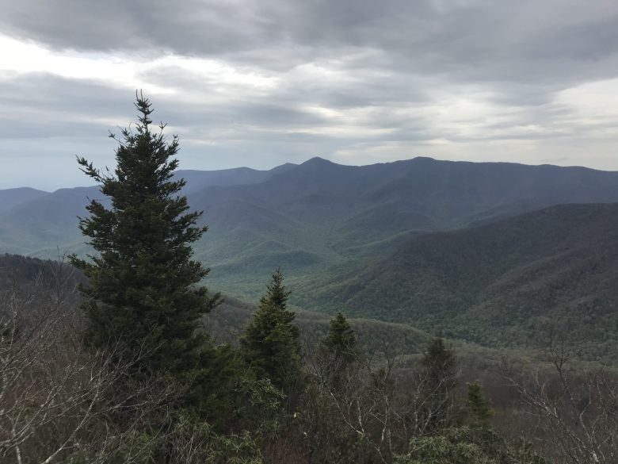
Environment
Federal rollback of Roadless Rule could imperil some of North Carolina’s last wild lands, experts say

Slide 12
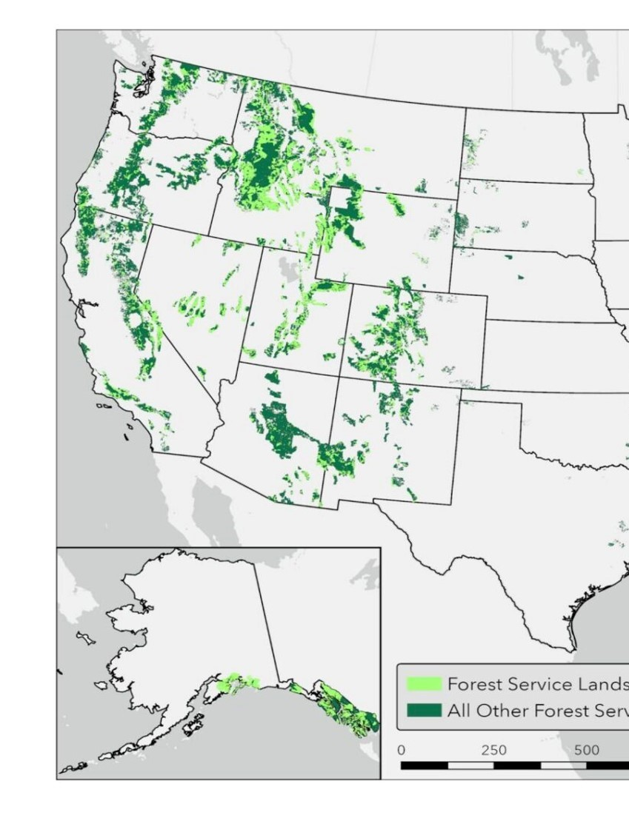
95% OF INVENTORIED ROADLESS LANDS ARE IN THE WESTERN UNITED STATES

Slide 13
Colorado: A In 2012, after years of bipartisan collaboration and public input, Colorado adopted its own Roadless Rule to protect its roughly 4.2 million acres of inventoried roadless areas. Like Idaho’s, Colorado’s rule remains in effect and insulated from rescission of the federal Roadless Rule. Following Secretary Rollins’ announcement, Governor Jared Polis reaffirmed that the state’s protections would stay intact—setting a strong example of how state-level policymaking can serve as a buffer in times of federal policy shifts.
Idaho: A State-Specific Roadless Rule Idaho, which ranks second only to Alaska in acres designated as inventoried roadless areas, was the first state to develop its own alternative to the 2001 federal Roadless Rule. Then-Governor (now Senator) Jim Risch initiated the process in 2006, and the Idaho Roadless Rule was finalized in 2008. It now safeguards approximately 9.3 million acres of roadless lands under a state-specific management framework.

Slide 14
State | IRA Acres | State | IRA Acres
Alaska | 14,779,000 | West Virginia | 182,000
California | 4,416,000 | South Carolina | 8,000
Colorado | 4,433,000 | Tennessee | 85,000
Idaho | 9,322,000 | Kentucky | 3,000
Montana | 6,397,000 | Georgia | 63,000
Nevada | 3,186,000 | Minnesota | 62,000
Wyoming | 3,257,000 | Indiana | 8,000
Washington | 2,015,000 | Utah | 4,013,000
New Mexico | 1,597,000 | Texas | 4000
Arizona | 1,174,000 | Nevada | 3,186,000 +/-
Virginia | 394,000 | South Dakota | 115,000
New Hampshire | 235,000 | Missouri | 25,000
North Carolina | 172,000 | North Dakota | 266,000
Vermont | 25,000
Michigan | 16,000
Minnesota | 62,000
Arkansas | 95,000
Alabama | 13,000
Louisiana | 7,000
Maine | 6,000
Mississippi | 3,000

Slide 15
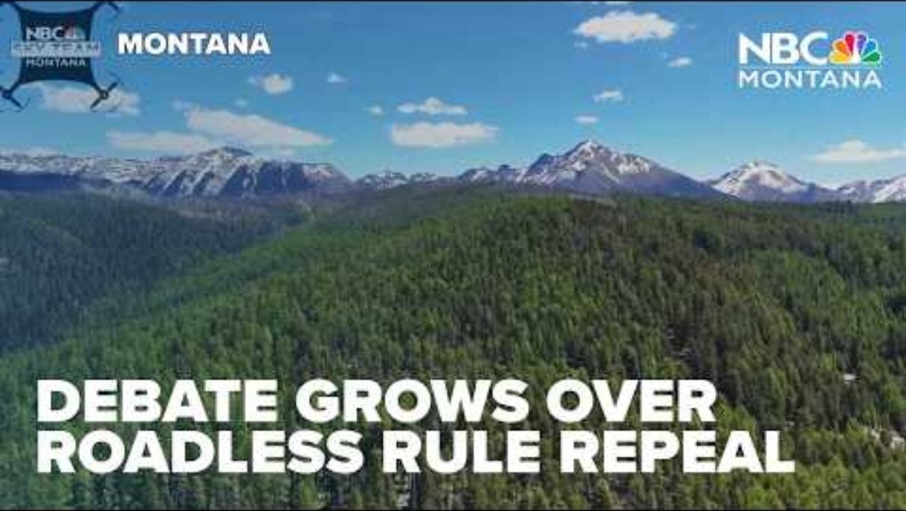
https://youtu.be/KJFJPLj3tAE

Slide 16
CURRENT CHALLENGE’S WORKING WITH FEDERAL LAND AGENCIES ON PUBLIC LANDS ISSUES
In the NBC News segment, they reached out to FS, but was referred to USDA in D.C. USDA PROVIDED THE RESPONSE
They say local control but then don’t allow local FS to comment.
IDAHO & MONTANA CONVENTION EXAMPLES
Don’t be offended (currently) if your local USFS or BLM seems, distant or detached. They are basically under a gag order, and their working environment is changing by the minute. They are not being told what is going on within their agency. Just trying to do their jobs.
Continue to reach out to your local Forest Service or BLM District. Build a relationship with your local Forest Supervisor, Area Manager, District Ranger and Recreation Manager.
It’s a difficult time, but as partners, we need to stay engaged and supportive.

Slide 17
YEAR | POPULATION
1852 | 24,000,000 | PEAK OF WESTWARD MOVEMENT
1960 | 179,321,000
2026 | 349,035,000
U.S. POPULATION

Slide 18
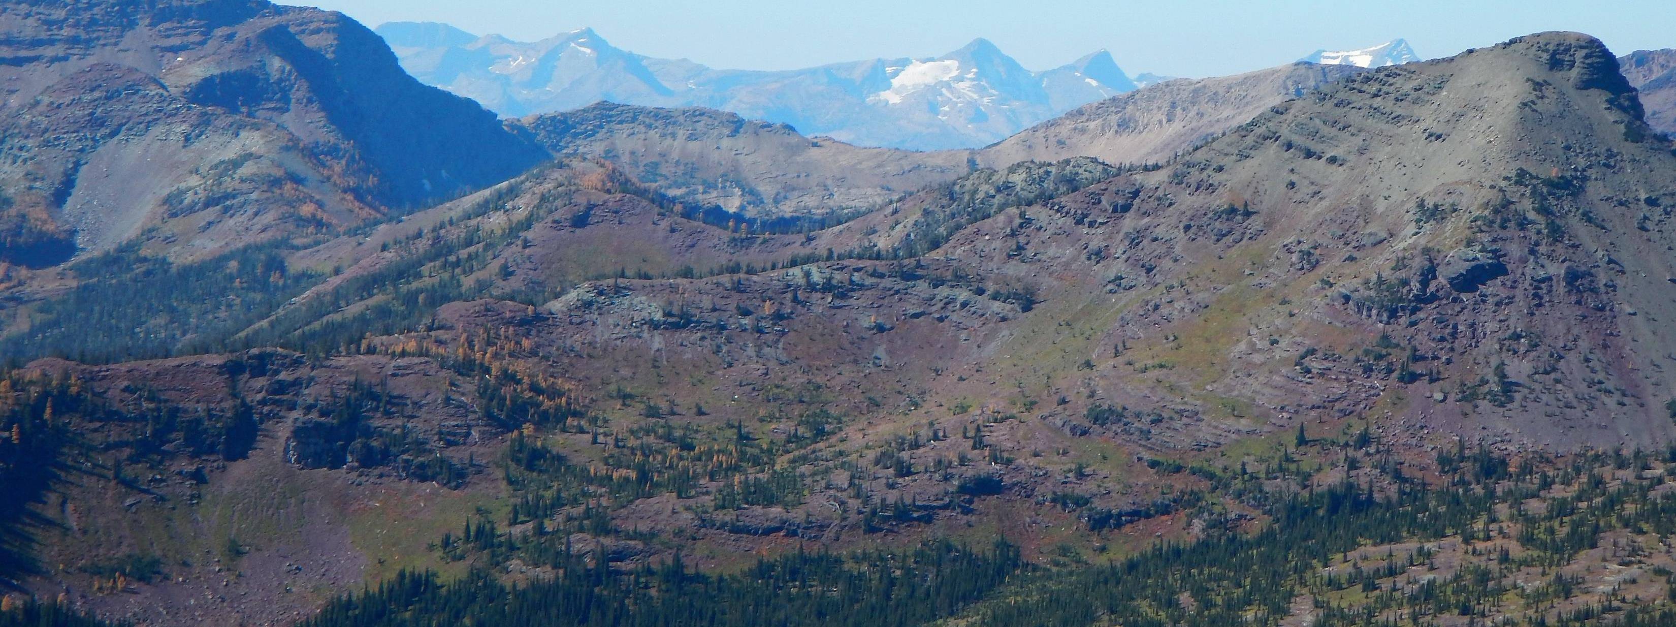

Public lands are not disposable assets—they are irreplaceable. Sell them, fragment them, or open them to unchecked development, and they are lost forever. We must stand now to keep them public, wild, and accessible.

Slide 19
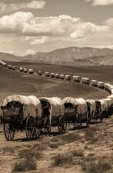
It’s easy to forget how short our memory really is. The great surge of westward expansion—driven by ideas like Manifest Destiny—reached its height only about 174 years ago. That’s barely more than a human lifetime or two.

Slide 20
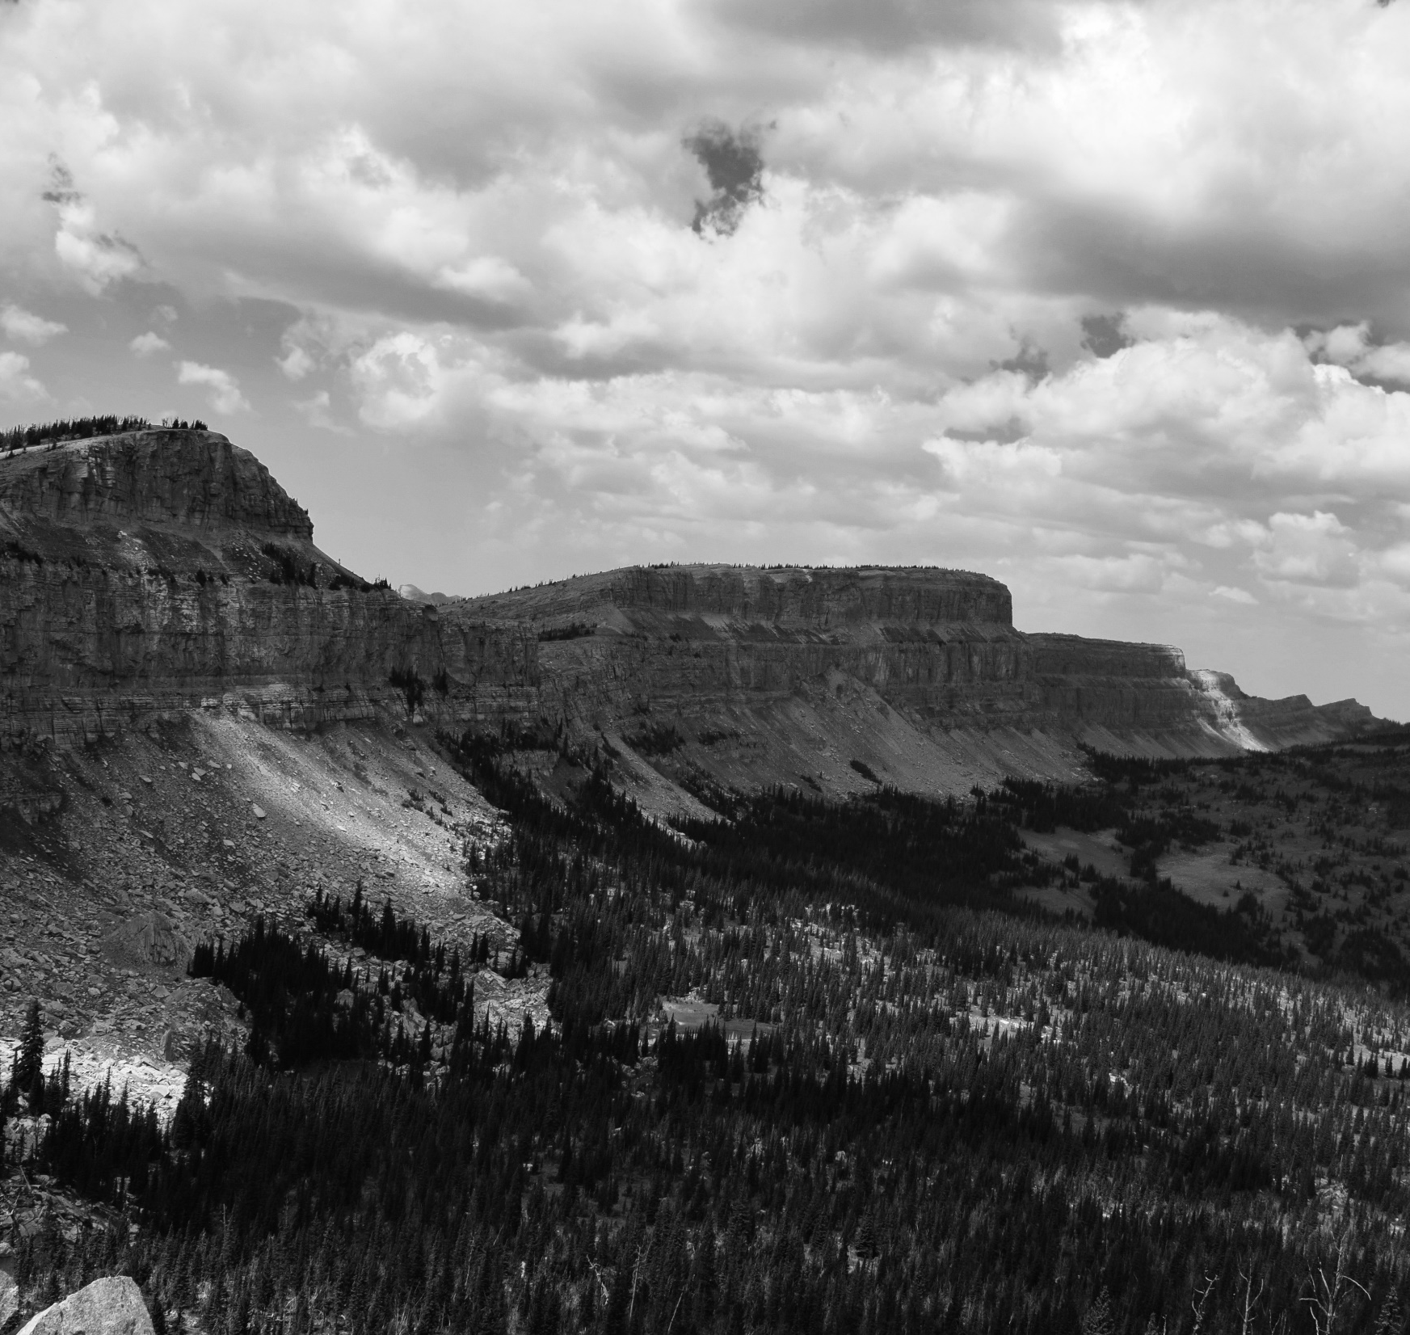
In that brief span, we’ve transformed vast, wild landscapes into farms, cities, roads, and industry. What remains of our public lands is not the excess—it’s the remnant.

Slide 21
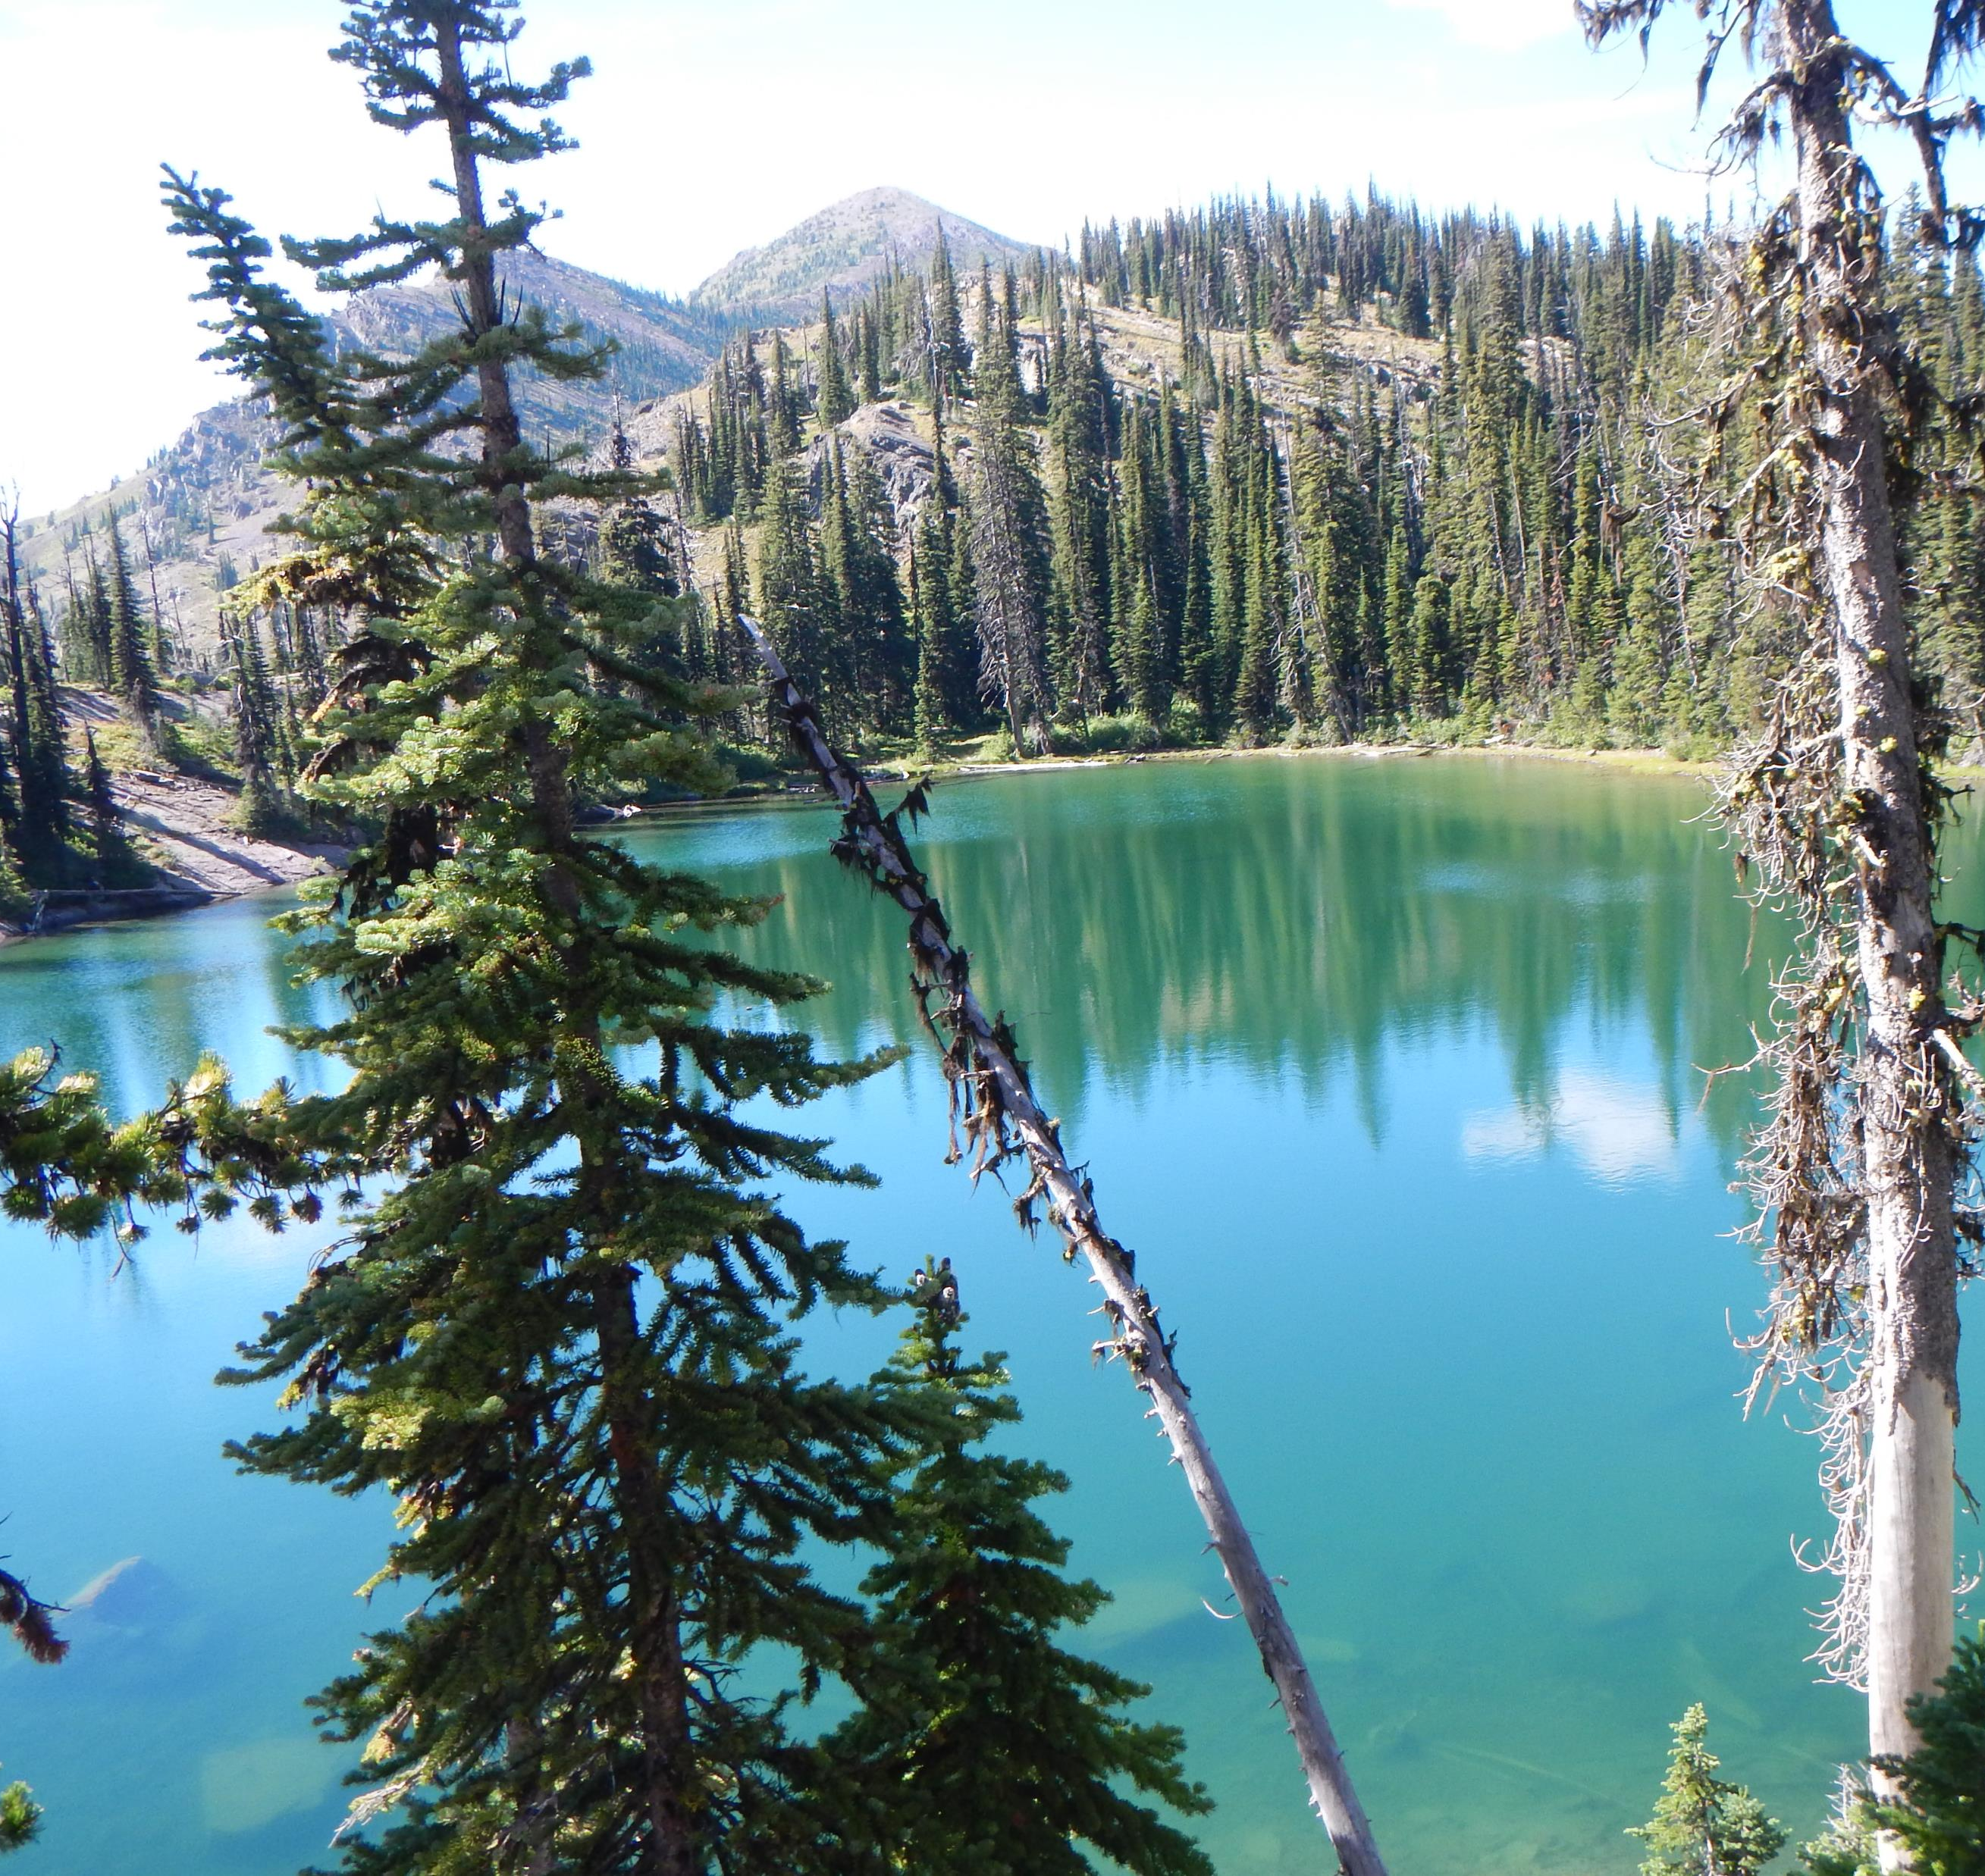
These lands are the last living connection to what America once was: unbroken, self-sustaining, and free. Once they’re fragmented or lost, they don’t come back in any meaningful sense. You can’t recreate natural landscapes with policy, and you can’t rebuild the deep ecological systems that took thousands of years to form.

Slide 22
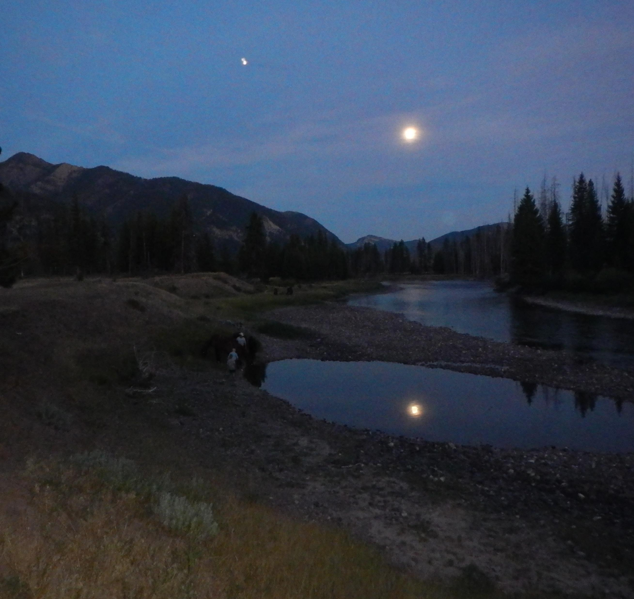
Protecting these remaining public lands isn’t about locking something up—it’s about recognizing that we’ve already taken almost everything else. In just 174 years, we’ve consumed the majority of what took millennia to evolve. What’s left carries disproportionate value: for wildlife, for clean water, for cultural heritage, and for the kind of solitude and challenge that define the American experience.

Slide 23
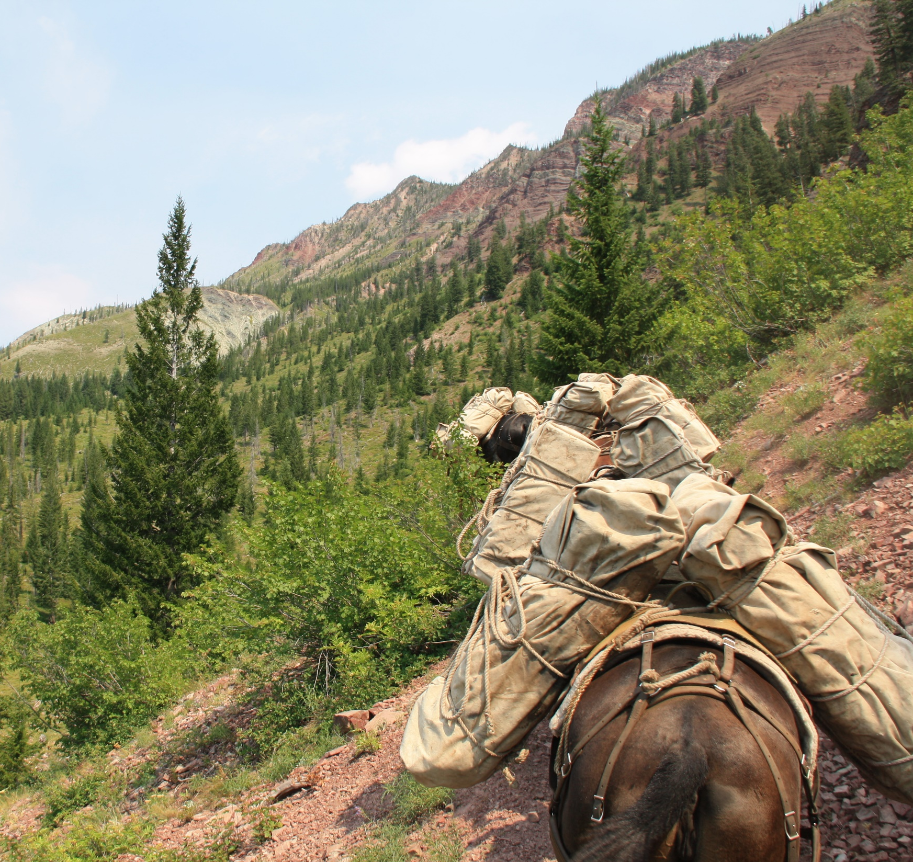
If we fail to protect these last places, we’re not just losing land—we’re closing the final chapter on a landscape that shaped a nation, and we’re doing it in the blink of a historical eye.
In short: We are not deciding what to do with abundant land—we are deciding whether the last of it will endure.

Slide 24
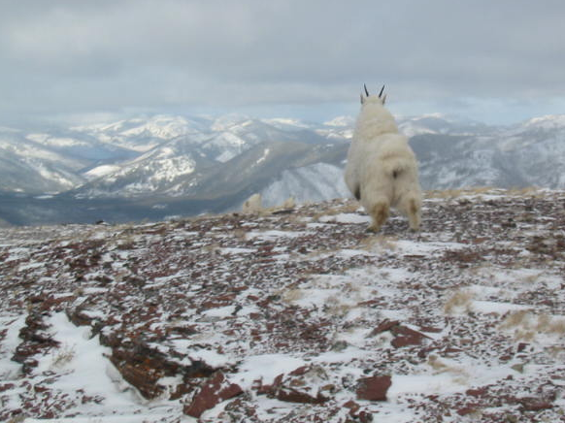
THANK YOU

