Slide 1

GOOD MORNING

Slide 2
UNFINISHED BUSINESS

Slide 3
Governance Policy Policy Title: Global Administration, Public Lands, and Fundraising Authority
Policy Title: Global Administration, Public Lands, and Fundraising Authority 2.0 Accountability and authority for public lands issues management, administration of Back Country Horsemen of America (BCHA), and fundraising oversight rests with the Executive Committee. The Executive Committee is the National Board of Director’s coordinator contact with those areas of operation. The NBD will instruct the Executive Committee through written policies that specify the ends to be achieved and limiting the means or situations and actions to be avoided. The NBD will allow any reasonable interpretation of these policies

Slide 4
2.3.3 Cross Country/Off System Travel Policy endorsing USFS, BLM, NPS, and US F&WS, and other agencies’ trail management using site­-specific basis rather than “blanket policy” regarding restrictions of off system travel with equines.
2.3.8 User Fees policy opposing user fees for use of, or access to, undeveloped and disbursed areas including wilderness areas.
2.4 The Executive Committee is NBD’s contact coordinator for work with Public Lands, Administration, and Fundraising oversight. The EC is responsible to ensure all linkage between BCHA publics and the NBD on national public lands, administration issues, and fundraising oversight are effective and reflect NBD policy. The EC will ensure that the “face” of BCHA to agencies, trail communities, and other BCHA publics is consistent, reliable, and provides effective and appropriate communications. The EC will provide assistance for coordination and communication of BCHA messages for state and local chapters.

Slide 5
SECTION: Policy Title: Chair’s Role
4.6.2.1.3 Quarterly summary of BCHA activities prepared and submitted for publication in the state and national newsletters in the monthly updates, when necessary.
4.6.4 Shall appoint all committee chairs
4.6.5 Shall appoint ad hoc committees as needed

Slide 6
Section: Policy Title: Treasurer’s Role
4.9 The Treasurer shall act as signatory on checks, approve or otherwise provide evidence of authorization of payment, for the accounts payable process.

Slide 7
Section: Policy Title: Standing Board Committees
4.12.1 Committee chairs can serve up to four consecutive years before a replacement is appointed, unless BCHA chair agrees to additional term(s); (exception, Executive Committee, they have their own terms and term limits as defined in 4.12.3.1.2).
4.12.6 Nominating Committee appointed by National Chair.
4.12.8 Partnership Committee Members may be appointed by the Chair as needed to represent BCHA at specific functions or in specific geographic locations. Members may consist of past chairs and must have long-term membership in BCHA, must be a former officer of the Board, and have knowledge of BCHA issues and public relations positions.

Slide 8
4.12.10 Volunteer Hours Committee
4.12.10.1 Volunteer Hours Committee appointed by National Chair.
4.12.11.3 The committee shall be composed of five persons who are members in good standing of BCHA, appointed by the BCHA Chapter Support Grants Committee Chairperson. The term of appointment will be one year, with reappointment possible for an additional year. These five persons will elect from within themselves a Chairman and a Recorder.
4.12.11.3.2 The Recorder of the committee is responsible for: ∙ Assisting Chairman in preparation of the agenda and support materials ∙ Taking minutes at each meeting of the Committee and distribute them to each member of the committee and to the BCHA Treasurer within 30 days of each meeting.
March - Receive Grant request Applications from BCHA State and Chapter Units April – The committee meets to prioritize and determine funding disbursement requirements.

Slide 9
4.12.12 Fundraising Committee
4.12.12.1 Create and sustain a directed fundraising program that supports BCHA’s mission statement and costs other than operational.
4.12.12.2 Conduct targeted campaigns, and coordinating with Media & Marketing committee, as necessary.
4.12.12.3 Increase donation base as necessary.
4.12.12.4 Work with BCHA’s Director of Public Lands in their pursuit and application of outside funding sources (i.e., grants, sponsors, federal funding, etc.).
4.12.12.5 Oversee the investment manager who maintains BCHA’s long-term investments that support BCHA’s mission.

Slide 10
4.12.13 Saw Committee
4.12.13.1 Chair is responsible for assisting certified BCHA trainers in coordinating trainings consistent with national Forest Service saw curriculum.
4.12.13.2 Must be familiar with national saw policy and updates that come out.
4.12.13.3 Must be familiar with FS saw database input and use. 4.12.13.4 Assist each BCHA area with finding and establishing two locations for trainings.
4.12.13.5 Communicate consistently and effectively with Forest Service districts/areas.
4.12.13.6 Attend Forest Service saw lead training.

Slide 11

STRATEGIC BUSINESS PLAN

Slide 13

Budget Approval

Slide 14
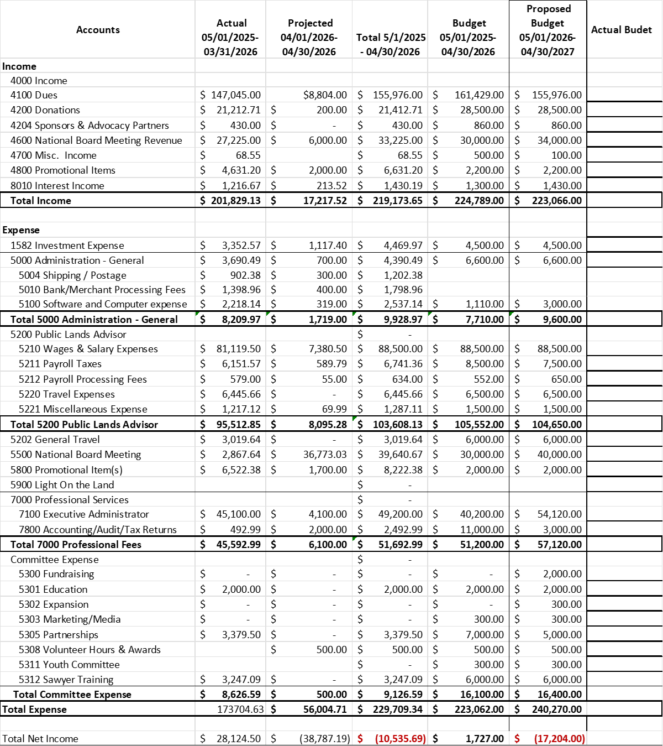

Slide 15
NOMINATIONS
Chairman Craig Ferdig, AZ
Vice Chairman Latifia Rodriguez, CO
Treasurer Heather Schultz, WY
Executive Committee Director Heather Cox, NC
Keith Holly, TN
Deb Spickermann, NM
Misty Valdez, TX
Executive Committee Non-Director Darrell Wallace, WA

Slide 16


Final Nominations & Elections

Slide 17
BANQUET & AUCTION TONIGHT
6:00 Reception
6:30 Dinner

Slide 18
State Accomplishments

Slide 19
Election Results

Slide 20
ELECTED 2026-2027
EXECUTIVE COMMITTEE MEMBERS
CHAIRMAN CRAIG FERDIG
VICE CHAIRMAN LATIFIA RODRIGUEZ
TREASURER HEATHER SCHULTZ
DIRECTOR
DIRECTOR
NON-DIRECTOR DARRELL WALLACE

Slide 21
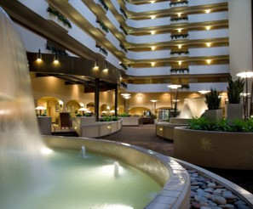
BCHA 2027 National Board Meeting
KANSAS CITY, MO
Embassy Suites, International Airport
April 11th – 14th , 2027

Slide 22
BANQUET & AUCTION TONIGHT
6:00 Reception
6:30 Dinner

