Slide 1

WELCOME 2026 National Board Meeting

Slide 2


Slide 4
Mission Statement
Back Country Horsemen of America is a 501(C) 3 non-profit organization dedicated to the following mission.
To perpetuate the commonsense use and enjoyment of horses in America’s back country and wilderness.
To work to ensure that public lands remain open to recreational stock use.
To assist the various government and private agencies in their maintenance and management of said resource.
To educate, encourage and solicit active participation in the wise use of the back country resource by horsemen and the general public commensurate with our heritage.
To foster and encourage the formation of new state Back Country Horsemen’s organizations.

Slide 6

DEPARTED
BCHA MEMBERS MEMORIAL

Slide 7
STATE OF BCHA
CRAIG FERDIG, BCHA CHAIRMAN

Slide 9
CHAPTER SUPPORT GRANTS COMMITTEE

Slide 10
AND THE GRANT
RECIPIENTS ARE…..

Slide 11
Chapter Name | Amount
Black Hills Chapter - South Dakota | $1,000
Southwest Chapter - Utah | $1,000
Selway-Pintler Chapter - MT | $1,000
West Alabama | $1,000
Sunflower Chapter - Kansas | $1,000
Jemez Chapter - New Mexico | $1,000
Lewis County Chapter - WA | $1,000
Cache Peak Chapter - ID | $750
Northern Chapter - CO | $1,000

Slide 12

Education Committee Report
Colleen Fisk, Alaska Delegate and Education Committee Chair
Committee Members: Mack Long, Tracy Tsu, Jackie Alexander, Lisa Ruth
Notes:
Colleen

Slide 13
Education Committee Responsibilities
4.12.2.1 The Education Committee is responsible for creating a curriculum of information and teaching resources which can be accessed by all members of BCHA for the distribution of standardized knowledge, processes, policies and practices throughout all levels of the organization across the Nation.
4.12.2.2 The Education Committee will periodically survey the organization...
4.12.2.1.3 The Education Committee Curriculum will support the three primary thrusts:
Organization and Administration
Members (Adult and Youth)
Public Outreach
Notes:
Colleen

Slide 14
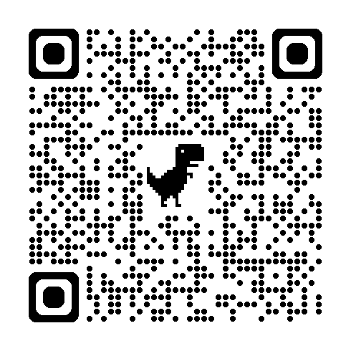
What we did in the last 12 months
Met 7 times across 4 time zones!
Published 5 Light on the Land videos (thank you Josie!
Helped with Volunteer hours webinar
Drafted ethics statement language
Led webinar for National Wilderness Stewardship Alliance (~70 attendees)
Directed reorganization of Light on the Land material on the website
Sent out survey in newsletter (please complete if you haven’t!)
Notes:
Colleen & Mack

Slide 15

How can horses and mules be Light on the Land?
Plan Your Trip
Use Trails Responsibly
Minimize Camp Impacts
Minimize Wildlife Impacts
Preserve the Integrity of Wilderness, Front Country, and Backcountry
Learn more: https://www.bcha.org/light-on-the-land/
Notes:
BCHA developed the leave no trace principles with LNT based on these “light on the land” principles established by first BCHA members. While many of our chapters use LNT still, we are also developing public educational materials that go beyond the LNT information about horses in the back and front country
Responsible travel with horses and mules
Protecting trails and wilderness
Colleen

Slide 16
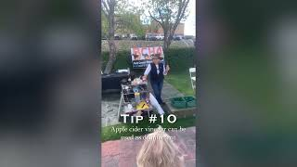
Light on the Land Video Series
Notes:
Light on the Land Playlist: https://www.youtube.com/playlist?list=PLaa4AvQSuPREFMVHMI09oRSN8HT3-ULF3
Camp cooking: https://youtu.be/en0P9oftCEc?si=ZF1Ln5MeqXupKiU8
Colleen

Slide 17
Questions?
BCHA.org/light-on-the-land

Slide 18
EXPANSION
Committee Chair Misty Valdez

Slide 19


BCHA
Fundraising Committee
Report
2025-2026

Slide 20
Goals for 2025-’26
Just get our feet back under us!
The future of BCHA - sustainability for another 50 years
Reignite Legacy fund to work towards getting it up to usable status
Rewrite Legacy Resolution to be better situated to use funds when the time comes
Implement Partner Sponsor(s) - big name, a truck brand, a trailer brand, Carhart, etc.
Lock in some solid grant funding/foundation moneys
Ideas flowing about how to streamline the National Board Meeting
Become a standing BCHA committee
Search and find - which we did - a GREAT group of folks to work with and I appreciate you all - Lisa, Leslie, Janet, Mark, Michelle, Heather, Shirley, Craig

Slide 21
Accomplishments
Created our Executive Summary and Plan for this year and future years
Created flyers for sponsor enticement
Updated our online profiles for donor transparency and confidence - Guidestar Platinum, Charity Navigator
Successful Giving TrailsDay campaign - thank you!
Visibility in BCHA Monthly Updates with Fundraising banner and articles highlighting the need for funding
Regularly scheduled fundraising committee calls - again, thank you!
Reached out ~15 corporate sponsor potentials - on several wait and see lists
Started the hunt for grants specific to saw, advertising and education
Reignited Legacy

Slide 22
Goals for 2026-’27
Corporate Sponsor pursuit
Grant writing pursuit
Tap into some federal funding channels learned about through Hike The Hill
Implement and follow through with communication and Executive Summary plan
Recruiting new national directors and others to help with ideas and funding follow through
Continue to monitor investments for Legacy funds for the future of BCHA
Continue with information published in BCHA Monthly Update
Make sure our chair letters are timed and subject oriented for maximum donations

Slide 23
WE NEED YOU
SEEKING COMMITTEE MEMBERS
PAY IS GREAT
BENEFITS ARE PHENOMENAL
THERE IS NO SHORTAGE OF GRATITUDE AND ACCOLADES
Meet us this evening in the atrium to educate us on what we should be doing!

Slide 24

2026 National Marketing and Media Report
Kansas City, MO
April 12-15, 2026

Slide 25
NOMINATION
COMMITTEE

Slide 26

Partnership Committee
Review & Recommendations
Committee Members:
Mark Himmel, Chairman
Darrell Wallace
Sherry Copeland
Latifia Rodriguez

Slide 27
Partnership Committee Governance Policies
4.12.8 Partnership Committee Members may be appointed by the Chair as needed to represent BCHA at specific functions or in specific geographic locations. Members must have long-term membership in BCHA, must be a former officer of the Board, and have knowledge of BCHA issues and public relations positions.
4.12.8.1 Purpose and duties:
• Represent, recommend and/or coordinate partnership activities beneficial to BCHA in furthering the mission and goals established by the NBD.
• Submit a report to NBD summarizing the annual activities of the Committee, including outline of proposed future activities and projects.
• Provide annual budget to NBD for Committee work. Review, approve, and monitor expenditures of the Committee.
• Approve resources and assignments of BCHA representative at events. BCHA Representatives must have demonstrated knowledge of BCHA Mission, Constitution, Governing Policy OR experience as Officer or Committee Chair OR positive experience representing BCH at State level AND the approval of at least two of the following: National Chairman, National Vice Chairman, or Public Lands Committee Chairman.
• Committee provides annual review to NBD of BCHA partnership with other organizations. The review provides history, level of participation, and benefit of given partnerships to BCHA.

Slide 28
“Submit a report to NBD summarizing the annual activities of the Committee, including outline of proposed future activities and projects.”
Saw Liaison Structure for USFS Saw Training & Certification – detailed presentation tomorrow
National Conservation Legacy Center Museum – initial lead with developing text and gathering data
Hike the Hill participation – 1 Full (virtual & in-person) & 1 Virtual only
Backcountry Hunters and Anglers – re-establish & elevate mutual working relationship
Review Partnerships with Agencies, Organizations, Associations and Groups
*Outline of proposed future activities and projects presented as Goals at end of presentation.

Slide 29
Federal Agency Partnerships and Agreements
United States Forest Service (USFS)
United States Department of Agriculture
Mission: The mission of the Forest Service is to sustain the health, diversity, and productivity of the Nation’s forests and grasslands to meet the needs of present and future generations.
Memorandum of Understanding (MOU) 12/2021 valid through 12/2026
Bureau of Land Management (BLM)
United States Department of Interior
Mission: The Bureau of Land Management's mission is to sustain the health, diversity, and productivity of public lands for the use and enjoyment of present and future generations.
Recreation for All: We will work to ensure that all families now and into the future have equal opportunity to hunt, camp, fish, hike and play on our public lands.
Memorandum of Understanding (MOU) 11/2024 valid through 11/2029
National Parks Service (NPS)
United States Department of the Interior
Mission: The National Park Service preserves unimpaired the natural and cultural resources and values of the National Park System for the enjoyment, education, and inspiration of this and future generations. The National Park Service cooperates with partners to extend the benefits of natural and cultural resource conservation and outdoor recreation throughout this country and the world.
General Agreement (GA) 12/2023 valid through 12/2028
U.S. Army Corps of Engineers (COE)
United States Department of Defense
Mission: Deliver vital engineering solutions, in collaboration with our partners, to secure our Nation, energize our economy, and reduce disaster risk.
Memorandum of Understanding (MOU) 02/2020 valid through 02/2029

Slide 30
“Committee provides annual review to NBD of BCHA partnership with other organizations. The review provides history, level of participation, and benefit of given partnerships to BCHA.”
The BCHA Chairman directed the Partnership Committee to expand the annual review to include an analysis to assess the level of return on investments (ROI) of the resources as related to working relationships with other Organizations, Associations and Groups.
The focus was to address two (2) components: Budget Implications and Value to BCH Members, Chapters & State Organizations.
This review is presented in the following components:
List of Organizations/Associations/Groups engaged 2025-2026
Report of Director of Public Lands & Recreation resource investment
Recommendation for 2026-2027 Proposed Budget Fees
Summary & Recommendations

Slide 31
Review of Director of Public Lands & Recreation - Partnership Resource Investment: Organizations/Associations/Groups Substantial Engagement 2025-2026 via Director of Public Lands & Rec.
American Horse Council (AHC)
Partnership for the National Trail System (PNTS)
National Wilderness Stewardship Alliance (NWSA)
American Trails
Coalition for Recreational Trails (CRT)
American Hiking Society (AHS)
The Wilderness Society (TWS)
Northwest Trails Roundtable
Equestrian Legacy Radio
Organizations/Associations/Groups Limited Engagement 2025-2026 via Director of Public Lands & Rec.
International Mountain Bicycling Association (IMBA) – Trails are Common Ground
Sierra Club – Recreation Issues Team
Backcountry Hunters and Anglers
Organizations/Associations/Groups with Engagement via other Organizations via Director of Public Lands
American Endurance Ride Conference (AERC) (via Hike the Hill)
Equine Land Conservation Resource (ELCR) (via AHC Annual Conference)
Pacific Crest Trail Association, Continental Divide Trail Association, Arizona Trail Association, Appalachian Trail Conservancy, Pacific Northwest Trail Association (bulk via Hike the Hill)

Slide 32
Summary and Recommendations
Research and review of reports, minutes and notes indicate the following concerns:
Current percentage of invested resource to Partners work is 60%-70% ($63,000-$74,000) of Dir. of Public Lands & Recreation budget
Appearance of “working for” verses “working with” when participating on efforts and issues
Lack of establishing direct benefit to, or being reflective of BCH Members, Chapters and State Organizations
Growing disparity between “Partner Collaboration” and “BCH Issue Engagement”
Single source representation with all Partners
BCHA rarely initiates issue action – usually participates as a “sign on”
While it is beneficial and remains important for BCHA to maintain working relationships with the array of Partners currently engaged, and continue to establish relationships with like-mission groups, it is equally important to ensure resources are directed for the benefit of the “whole” of the organization, remain non-political, and be reflective of the uniquely notable “bottom-up” organizational structure. The following are the Partnership Committee recommendations:
Implement a pull back on the resource investments with over-served Organizations, Associations and Groups.
Conduct a strategic evaluation of resources, tasks, skills, and actions required to facilitate BCHA needs and economics.
Determine and maintain best use of resources for most effective return on investments.

Slide 33
2026-2027 Goals & Recommendations
Compile information, materials, and data on Partner Agencies new organizational structures, operational directives & documents
Support Chapters and States in initiating & developing Partnerships and Agreements
Review & evaluate new proposed Partnership opportunities
Facilitate & coordinate Partnership service, activities and event representation as required
Extend U.S. Forest Service Memorandum of Understanding (expires 12/2026)
Continue support for Saw Liaison Structure for USFS Saw Training & Certification program

Slide 34
Proposed Budget Recommendation
$2,650.00 American Horse Council – continue membership at the Committee seat level with the diversity of the BCHA representative. Contribution to Economic Impact Study would be at the Boards discretion and is not included in this recommendation for proposed budget.
$250.00 Partnership for the National Trail System – continue membership with reduced (or eliminated) committee service.
$250.00 American Trails – continue membership
$250.00 Coalition for Recreational Trails – continue membership with membership fee support if requested. Contribution to support “DC Showcase Event” would be at the Boards discretion and is not included in this recommendation for proposed budget.
Total Proposed Budget Partner Fee Recommendation……………………..$3,400.00
Proposed Budget Recommendation – Saw Liaison Structure..$6,000.00

Slide 35
BCHA NOMINATION COMMITTEE REPORT
4.12.6 Nominating Committee appointed by National Chair (policy adopted 1997).
• Must consist of members from at least three state organizations.
• Eligible candidates for director positions are supplied by the Chair of the Nominations
Committee and included in NBM agenda.
• Slate of candidates will be presented on first day of NBM.
SLATE OF CANDIDATES
*Chairman Craig Ferdig, AZ
*Vice Chairman Latifia Rodriguez, CO
*Treasurer Heather Schultz, WY
*Executive Committee Director Heather Cox, NC
Keith Holly, TN
**Executive Committee Non-Director Darrell Wallace, WA
*Must be a member of the National Board of Directors
**Must be a member in good standing and must not be a member of the National Board of Directors

Slide 36

BCHA PUBLIC LANDS COMMITTEE
Mark Himmel, PLC Chair

Slide 37
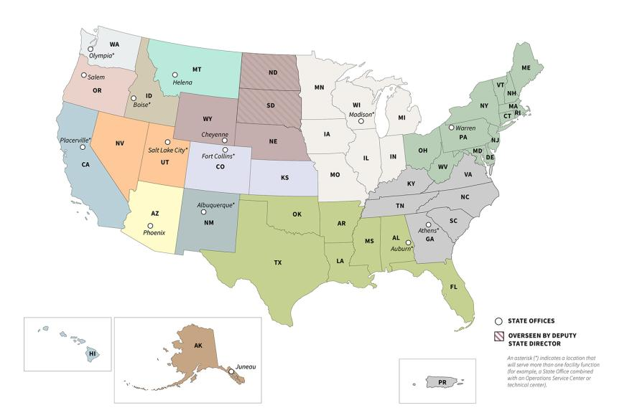

Slide 38
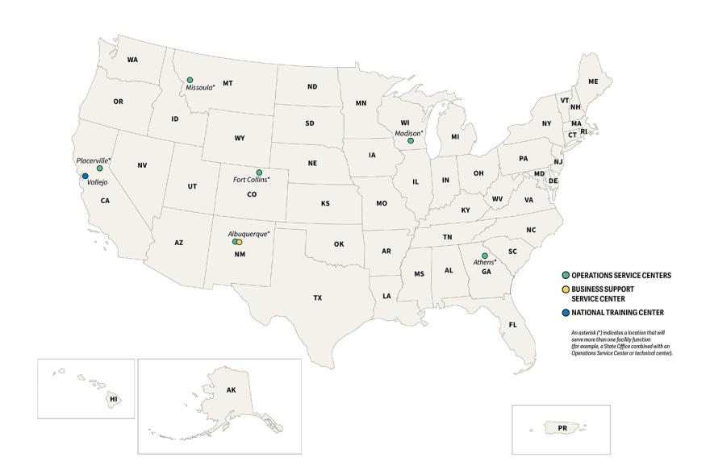

Slide 39
SAWYER

Slide 40
BCHA Sawers by State (FS Database)
Arkansas – 11 | Missouri – 15 | South Carolina - 16
California - 126 | Montana -103 | Tennessee – 6
Colorado – 37 | New Mexico -15 | Texas - 2
Georgia ? | North Carolina – 71 | Washington -379
Idaho – 73 | North Dakota -12
Kentucky ? | Oregon - 1

Slide 41
VOLUNTEER HOURS COMMITTEE

Slide 42
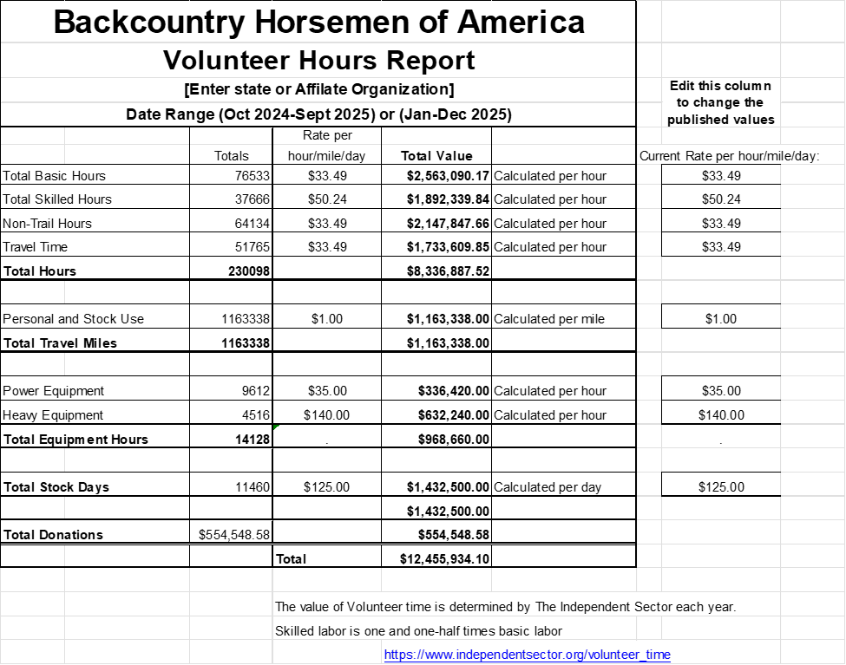

Slide 43
YOUTH COMMITTEE
Lexi Studebaker

Slide 44
How to join Come say hello! I will be here the rest of Monday, as well as doing a presentation on social media and what all comes with a Gmail account at 11:45 am on Tuesday. Feel free to contact me if you would like to be on the youth committee, have ideas, or need help with anything. My email is lstudebaker03@gmail.com and is listed on the BCHA website under the contact us page.
My name is Lexi Studebaker, and I am currently serving as the Youth Committee Chair for our organization. I am from Northeast Kansas and am an active member of the Sunflower chapter. I am currently studying agricultural and natural resource communications as well as natural resource and environmental sciences at Kansas State University, and I use these skills to help tell our volunteers’ stories. I am currently looking for people interested in member development and recruitment and I am excited to work with you all to build the next generation of backcountry horsemen!
Brief of what the Youth committee will work towards
Social Media Usage and Promotion!
Using social media for promotion and showing people what BCHA is all about through technology.
Outreach with youth and young adult organizations
Anything from 4-H to local conservation group (with a big, younger crowd)
Creating and incentive for youth to join (community, recognition, etc.)
Youth/new member development events and activities.
Beginner-friendly events, easy- to-understand, and affordable ways to learn how to help maintain our trails.

Slide 45

TREASURER REPORT

Slide 46
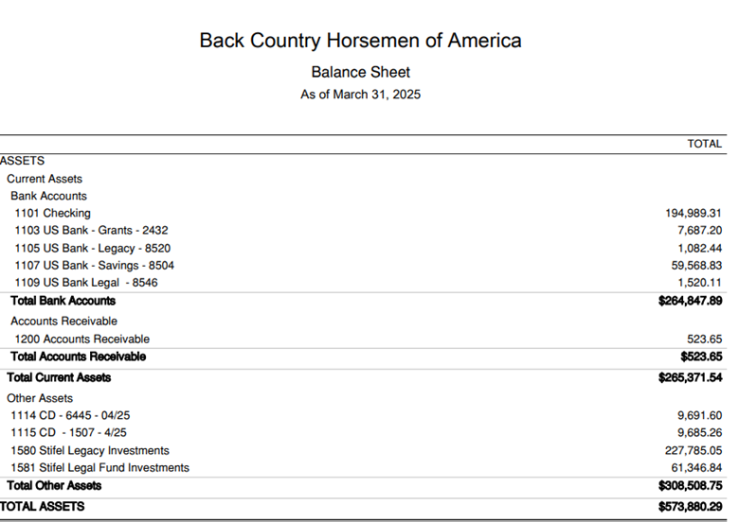

Slide 47
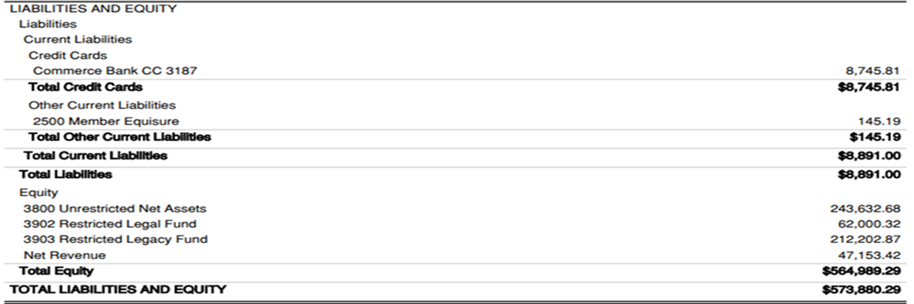

Slide 48
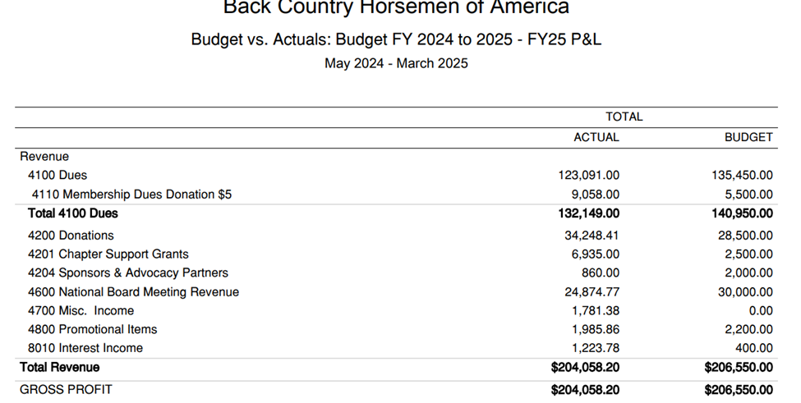

Slide 49
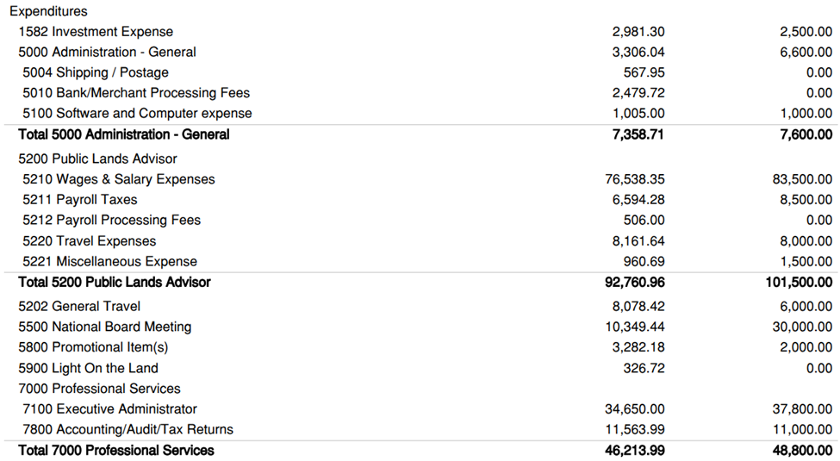

Slide 50
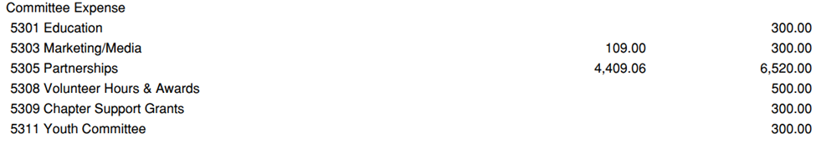
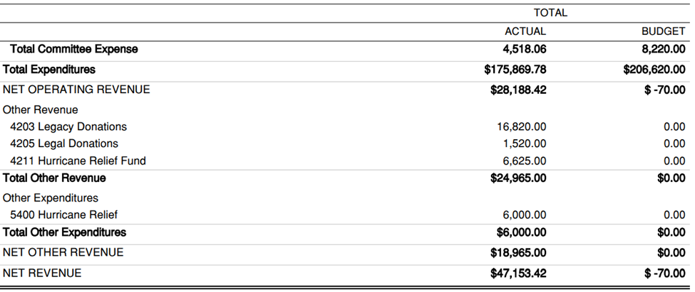

Slide 51
LUNCH TIME IN ATRIUM

Slide 52
EXECUTIVE
ADMINISTRATIVE
REPORT

Slide 53
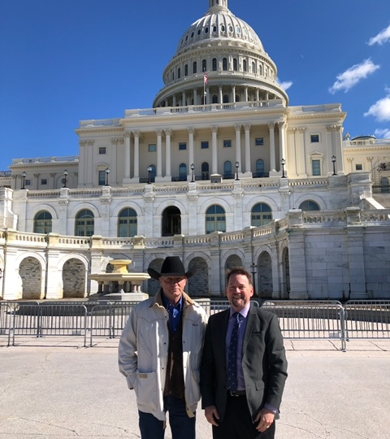
DIRECTOR OF PUBLIC LANDS

Slide 54
CONTRACT REVIEW
Director of Public Lands & Recreation
Randy Rasmussen
Executive Administrator
Lakeside Administrative Services; Michelle Wade

Slide 55
TREASURER REPORT ACCEPTANCE

Slide 56
Proposed Budget 2025-2026

Slide 57
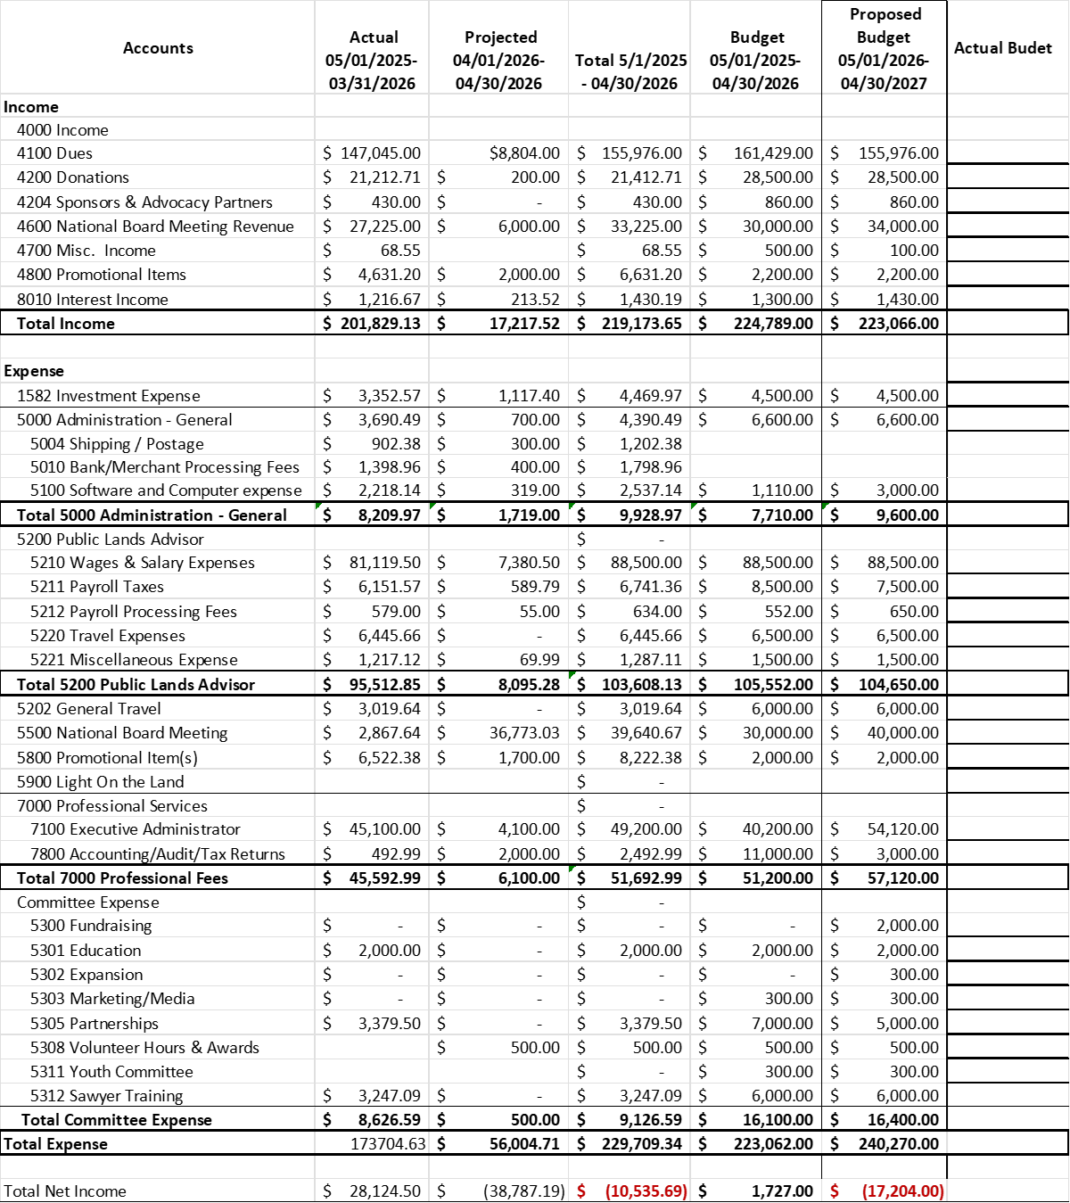

Slide 59
RESOLUTIONS

Slide 60


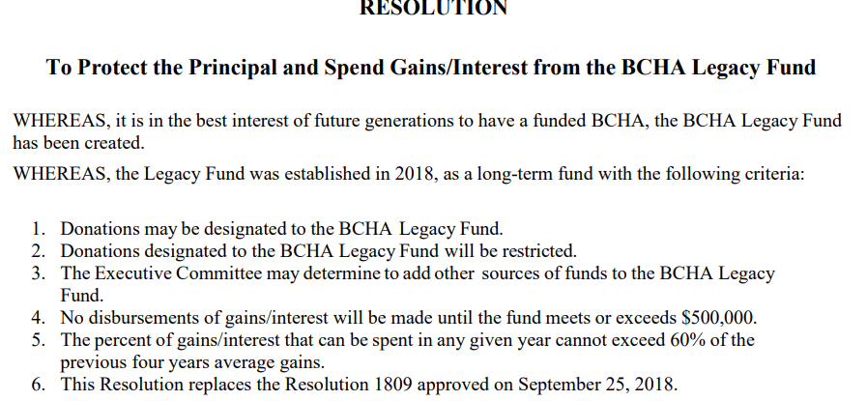
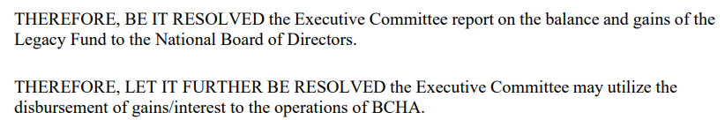

Slide 61
RESOLUTION FROM WYOMING
Resolution to Explore Supplemental National‑Level Membership Options While Preserving Chapter‑Based Membership as BCHA’s Primary Structure
Back Country Horsemen of America – National Board Meeting
WHEREAS, Back Country Horsemen of America (BCHA) is committed to preserving access to public lands, supporting responsible stock use, and strengthening the network of local chapters and state organizations that carry out this mission; and
WHEREAS, BCHA recognizes that some individuals wish to support the national organization’s work even if they are not currently able to participate in a local chapter or state organization; and
WHEREAS, BCHA seeks to strengthen its capacity to communicate with supporters through newsletters, email updates, and other informational resources; and
WHEREAS, BCHA acknowledges the potential value of offering additional pathways for individuals to engage with and support the national organization, provided such pathways complement and reinforce the importance of local chapter membership; and
WHEREAS, any national‑level membership option should be developed thoughtfully, with input from chapters, states, committees, and stakeholders to ensure alignment with BCHA’s mission and organizational structure;

Slide 62
RESOLUTION FROM WYOMING Continued
NOW, THEREFORE, BE IT RESOLVED, that the Back Country Horsemen of America National Board establishes a National Membership Exploration Committee to evaluate and develop options for a national‑level membership structure, including but not limited to an Optional National Supporting Membership category; and
BE IT FURTHER RESOLVED, that this committee shall:
Examine potential models for national‑level membership, including benefits, fee structures, and impacts on chapters and state organizations;
Consider mechanisms for online enrollment, payment processing, and communication with national‑level supporters;
Develop clear messaging that reinforces the continued importance of joining and actively participating in local chapters whenever possible;
Solicit input from state and chapter leaders to ensure transparency, collaboration, and broad organizational support;
Provide recommendations to the National Board for review and possible action at a future meeting;

Slide 63
RESOLUTION FROM WYOMING Continued
BE IT FURTHER RESOLVED, that the National Board affirms its commitment to supporting this committee’s work by ensuring access to staff assistance, communication tools, and other resources necessary for a thorough and inclusive evaluation;
BE IT FINALLY RESOLVED, that upon receiving the committee’s recommendations, the National Board will determine whether to establish a national‑level membership category, modify existing structures, or pursue alternative approaches that best support the mission and long‑term strength of Back Country Horsemen of America.

Slide 64
GOVERNANCE POLICY COMPLIANCE REVIEW

Slide 65
NEW BUSINESS

Slide 66
FIND A
COMMITTEE

