Slide 1
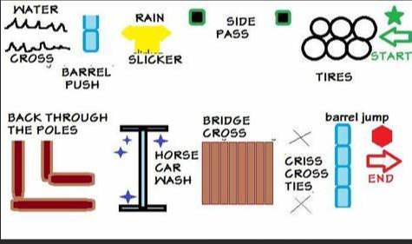
Trail Course
Estimated costs to build obstacles: $230-$380
We can investigate donations and design changes to reduce this cost as needed

Slide 2
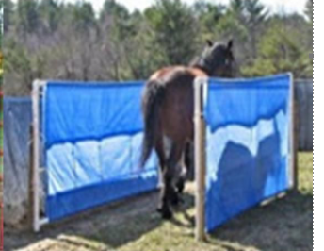
Squeeze Obstacle-simulates canyon trail or tight rock walls on both sides of a trail
Materials:
4-Jump standards -Jessi has a friend with a few sets of standards we can borrow. No Cost
4 Sand bags to weight down the base of the standards – we can probably make these but will budget $50
2 tarps 10x20 each $60
Bag of zip ties and/or nails to connect tarp to jump standards on each end $10
Clothesline to run top and bottom of tarp to stiffen it a bit in case it’s windy $10
Total estimated cost to build $130

Slide 3
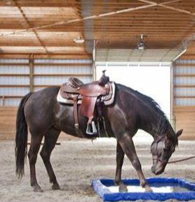
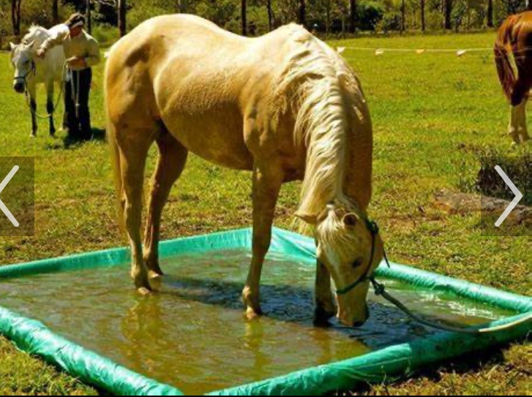
Water Crossing-simulates walking through wet trail or creek/river crossing
Price depends on how big we want this obstacle. Suggesting a square shape 8x8. This makes it easier for an inexperienced rider to have a horse approach from different angles and not trip over the sides. Experienced riders can walk through it easily too. We can add buckets of water when needed.
Estimated cost for materials:
20x20 tarp $25
4x4x8 posts $12x4 posts $48
Total estimated cost to build $75

Slide 4
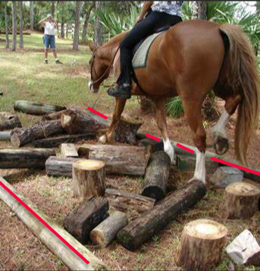
Pole or Wood Obstacle-simulates walking through treefall on the trail
2 ways to build:
We could get wood poles or PVC poles, but they are expensive.
Estimated cost for 8 Poles/Posts:
Jessi has ground poles for free, but they can not be cut $0
4x4x8 wood posts $ 12 each Estimated cost $96
PVC 4in diameter by 10ft $50 Estimated cost $400 (not viable)
We are concerned about using natural wood due to debris (old bark) left on the grounds to clean up-contract stipulations. But the obstacle would be better and cheaper if we could find wood pieces in various sizes and remove the bark. We could simplify and make this obstacle very inexpensive. No border needed, just random placement in straight wide line. The logs in red are not needed.
Estimated cost to build:
Natural logs $ 0
Total estimated cost to build $0- $100

Slide 5
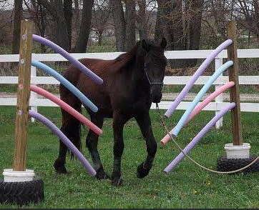
Pool Noodle Obstacle-Simulates walking through branches on trail
Estimated cost for materials:
Jessi can get a set of jump standards for $0 cost
2 sand bags to weight down the base of the standards – we can probably make these but will budget $25
10 pool noodles-Dollar store $30-$50
Total estimated cost to build $25-$75

Slide 6
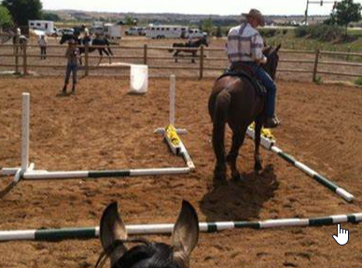
Ground Pole for Back Through-Side Pass-simulating queues needed on the trail to move your horse off your leg and seat
Estimated cost for materials:
Jessi has access to unlimited ground poles
Total estimated cost to build $0

Slide 7
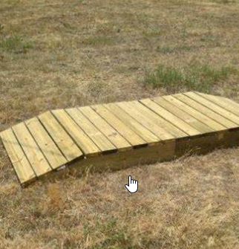
Bridge-simulates crossing bridges on the trails
We can get this from Randy ☺
Total estimated cost to build $0

Slide 8
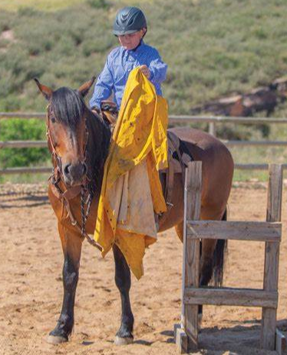
Remove raincoat from saddle and put on-simulating unexpected rain while on trail
This may be spooky for inexperienced horses and would need to be highly supervised. We could have them take it off a post to make it less challenging, but the horse would experience the sound and movement of the slicker
Estimated cost for materials:
We could find someone to donate a slicker
Total estimated cost to build $0

Slide 9
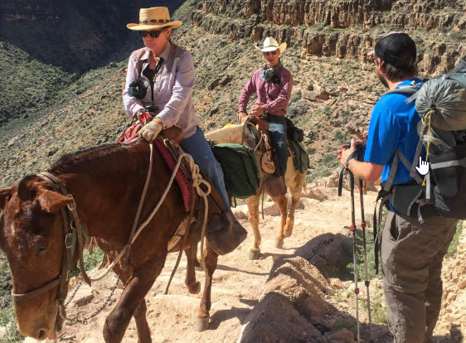
Passing Hiker on a Trail-simulates encounters that may happen on the trail
Opportunity to discuss trail etiquette, communication and space needed to pass
Estimated cost for materials:
Jessi has access to unlimited ground poles
Free hiker, backpack and dog
Total estimated cost to build $0

Slide 10
BBCH Trailer
Registration
Table
Small Bleachers?
Pack Demo
Enter
Food Truck

Slide 11
Supplies and Person to Build Obstacles: Blue- is confirmed Red- we have questions:
Squeeze- Molly purchased 2 tarps, zip ties, clothesline and will use 2 standards provided by Jessi- We need 4 Sandbags-Molly will put together Friday night
Water Obstacle- Molly purchased pond liner -We need 4 posts 4x4x8 Molly will try to get donated -Molly will build
Friday night
Wood Obstacle- Sarah has heating wood -Sarah will build Friday night
Noodle Obstacle- Sarah has noodles-Molly purchased 20in zip ties to connect to 2 standards provided by Jessi
We need 4 heavy sand bags to complete obstacle –Sarah will build Friday night
Back Through Obstacle- Jessi will bring poles –Molly will build Friday night
Bridge Obstacle- Randy providing bridge – Will Randy bring Friday night, is he on the Friday night volunteer list?
Raincoat Obstacle- We can hang it on the side of the arena or tie to rider’s saddle – We need an old raincoat (Molly can get one at Goodwill if no one has one. Molly will build Friday night
Meet on the Trail Obstacle with Bear- Sarah coordinating with hiker/dog/backpack and Bear donation?
Jessi confirmed she will deliver jump standards and ground poles for Friday night set up.
Molly spent $75 for material she noted purchased above
Sarah asking about additional ground poles that may be available to us
Are we sure that the skid steer Friday and Saturday for set up?
Because we have the volunteer lists, we can probably communicate with emails vs. having a volunteer meeting.
Can we get hats or scarves to give to volunteers to help attendees know who they can ask questions if they need help?

