Slide 1

Good Morning

Slide 2

Unfinished Business

Slide 3
STRATEGIC BUSINESS PLAN

Slide 4
OPERATIONS | Team Involved | Objective | Goal | Plan of Action
PUBLIC LANDS
ADVOCACY | Public Lands Advisor | To maintain current, and build new agency relationships that align or may impact our mission statement. | Post all agency MOU,agreement examples. | Existing agreements
PARTNERSHIPS | Partnership Committee | To maintain current and build Local, Regional and National Partnerships that align or may impact our Mission Statement. | Setup standard communications lines with designated scheduled updates; Maintain contact list | Engage stakeholders at all levels
LEGISLATION | Public Lands Advisor | To sustain a proactive awareness that allows for BCHA to take action to protect access and any other trail issues. | Comminucate with members effectly on legistion. | TBD
Public Lands Structure | Public Lands Regions | Increase dialog between Chapter and Public Lands Regional Chairman | Shorten the Timeline between incident or threat to National Level | Have ND in group meetings with their Regional Chairs, Explain the need for all States to be represented on calls
E bike litigation | Possible litigation | Prepare for litigation, identify funds or costly litigation , Unite with other effected groups | Successfully defend States | prepare to defend States in Lawsuits

Slide 5
EXECUTIVE ADMINISTRATOR | Executive Administrator and Officers | Administer to the business plan which aligns to BCHA Mission Statement. | Operate within annual financial goals in a sustainable, effective, economical, and efficient manner that supports Mission Statement. | Evaluate, monitor, and streamline processes. | On going process to identify and improve , reports to EC
WEBSITE | Media & Marketing | Maintain and improve an online Website that is an effective and easy to use tool for communication that supports Mission Statement | Increase website traffic so that it becomes key source of information/education for members and non-members who may be interested in BCHA | Goal: Create a survey to be sent out to all members with 3-5 questions, including an open comment section to gather opinions on how to improve the website. Survey approval by EC May. Send survey out by June 1. Give 5 days to get feedback. Completed 06/09/23 Goal: Update keyword/metadata Web search to make BCHA.org a stronger presence on website searches by July. Complete 06/19/23 Goal: Analyze results of survey, list out priorities and present to EC July meeting. Analysis ready to present – 7/01/23 Goal: Create specific goals with actions by Aug for updates to be completed by NBM 2024 | Done

Slide 6
 |  | FINANCIAL
Critical |  | ACCOUNTING | BCHA Officers guiding independent contractors | Support BCHA with a sustainable bookkeeping and tax services | Increase efficiencies and minimize # of accounting errors | Evaluate, monitor, and streamline processes. |  | On going review
High |  | CHAPTER SUPPORT GRANTS | Committee | Maintain a viable grant program that provides grant opportunities to chapter/states | Administer 12 grants a year with a plans to increase that amount yearly by 50% | Distribute funds April of each year. |  | On going
Critical |  | REVENUE | National Board of Directors | Maintain/Support a sustainable plan that will keep BCHA fully funded for next 50 years | Develop programs to increase dues revenue to cover increased operational costs | Identify and evaluate operational costs. | Dues Increase progressing | On going evualation of cost, making changes as needed
 |  |  |  |  | Platform and program support. | Identify needs and implement targeted fundraising.
 |  |  |  |  | Long Term Investments | Retain fiduciary investment manager and refine messaging of funds use. | quartly meetings with EC and review
Moderate |  | National Challenge cost share | National Directors/ EC | Partner with Forest Service for National Challenge cost share | Develop a plan with FS for National Challenge cost share to benefit the Membership base | Team to meet with FS bi-monthly to develop plan |  | First meeting held 3/19/24

Slide 7
Priority |  | SERVICE | Team Involved | Objective | Goal | Plan of Action | Deadline | Timeline 1 - Start
Critical |  | NATIONAL DIRECTORS | National Board, State Leadership & Administration | To have a communications plan that addresses all needs for information/education/new National Director onboarding per governing documents | Create a multi-platformed communications plan that keeps National Directors informed, engaged, and motivated. | Evaluate, monitor, and verify processes. | On going
High |  | TRAIL MAINTENANCE | Education | Have a training program that supports our mission and support those organizations that our mission supports | Create a multi-platformed, easy to access training programs, that states and chapters can use for individual members. | Assist states/chapters with training events |  | Assisted Missouri Saw training 2023
Moderate |  | VOLUNTEER HOURS | Committee | To have a volunteer hours program that advocates for our mission | Develop a consistent, easy to use spreadsheet that tracks all types of volunteer hours with associated explanation of use | Create Volunteer hours with Camtasia Video - Created video, COMPLETED | September 11
 |  |  |  |  | Create communication/educational plan about importance to mission. | Started on youth videos
Critical |  | Membership/ Expansion | National Directors/ EC | To increase the membership base of BCH | EC or committee gather a list of best practices to increase membership and distribute to States | Dialog with ND on what is working for membership recruitment

Slide 8
Priority |  | Education | Team Involved | Objective | Goal | Plan of Action | Deadline
Moderate |  | YOUTH COMMITTEE | Youth Committee | Sustain our long-term membership by educating and engaging youth about BCHA mission | Increase youth participation in events by 10% annually | Grant money must be used to entice young people to use the backcountry on horseback in the future Chapter Contact person Contact information $ amount Explain your youth project in detail- how does it meet the purpose of BCHA Number of young people expected to attend I will send a project report and pictures by 12/31 yes____ no____ The boxes to check off are: Does the project involve young people? Does it meet one of the purposes of BCHA? | Program has started Sept 1. Website has been update. Youth Grant review committee has been formed and has begun reviewing/accepting/declining grants. DISTRIBUTED ALL GRANT FUNDS!

Slide 9
ADVOCACY | Team Involved | Objective | Goal | Plan of Action | Deadline | Timeline 1 - Start
AGREEMENTS | Public Lands Committee | Stay at the forefront on public lands policy so that BCHA can address and strategize | Provide a quarterly update to National Directors/States/Chapters | Provide to the states Supporting BLM shared cost agreement |  | Waiting on BLM
Fundraising | Team Involved | Objective | Goal | Plan of Action | Deadline | Timeline 1 - Start |  | #REF!
FUNDRAISING | National Board and Executive Committee | Sustain a Directed Fundraising program that supports BCHA's mission statement and cost other than operational | Create a Directed Fundraising program that supports BCHA's mission statement and cost other than operational | Quarterly campaigns if needed |  | Implemented Chair letter 2023
Legacy | Investment manager | Maintain Long Term Investments that support BCHA mission | Increase donation base | Target campaign |  | 1st campaign 2024
 |  |  |  | Figure out our target market
 |  |  |  | 2. Strategies (how to work with each market)
 |  |  |  | 3. Baseline report/ survey
 |  |  |  | 4. Grant for youth projects
 |  |  |  | 5. Public lands aspect- teaming with public lands committee to engage youth to share knowledge of public lands management

Slide 11
Budget Approval

Slide 13
Final Nominations
& Elections

Slide 14
NOMINATION COMMITTEE REPORT
CANDIDATES
*Chairman Mark Himmel, MT and Dan Key, NM
*Vice Chairman Craig Ferdig, AZ
*Treasurer Kathy Young, WA
*Executive Committee Director (2 Positions) Brad Pollman, MT and Misty Valdez, TX
**Executive Committee Non-Director Dana Chambers, WA and Joanne Mitchell, TN
*Must be a member of the National Board of Directors
**Must be a member in good standing and must not be a member of the National Board of Directors

Slide 16
State Accomplishments

Slide 17
Election Results

Slide 18
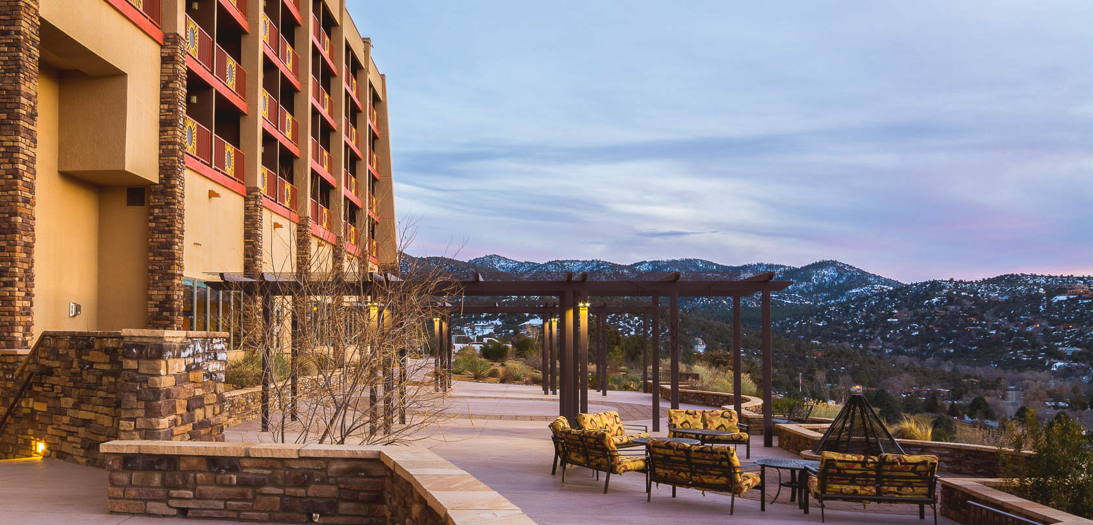
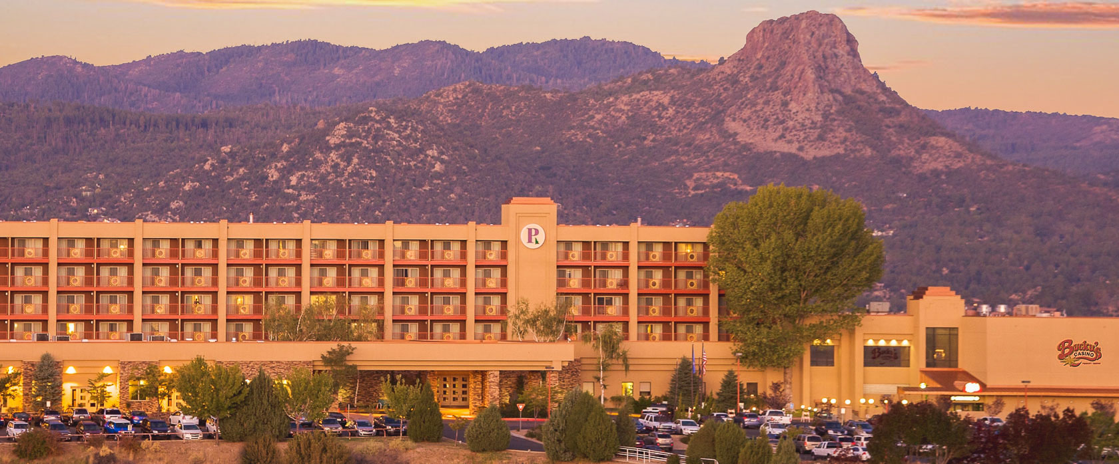
2025 National Board Meeting
PRESCOTT, ARIZONA

Slide 19
2026 National Board Meeting
SOUTH CAROLINA

