Slide 1

WELCOME
2024 National Board Meeting

Slide 2
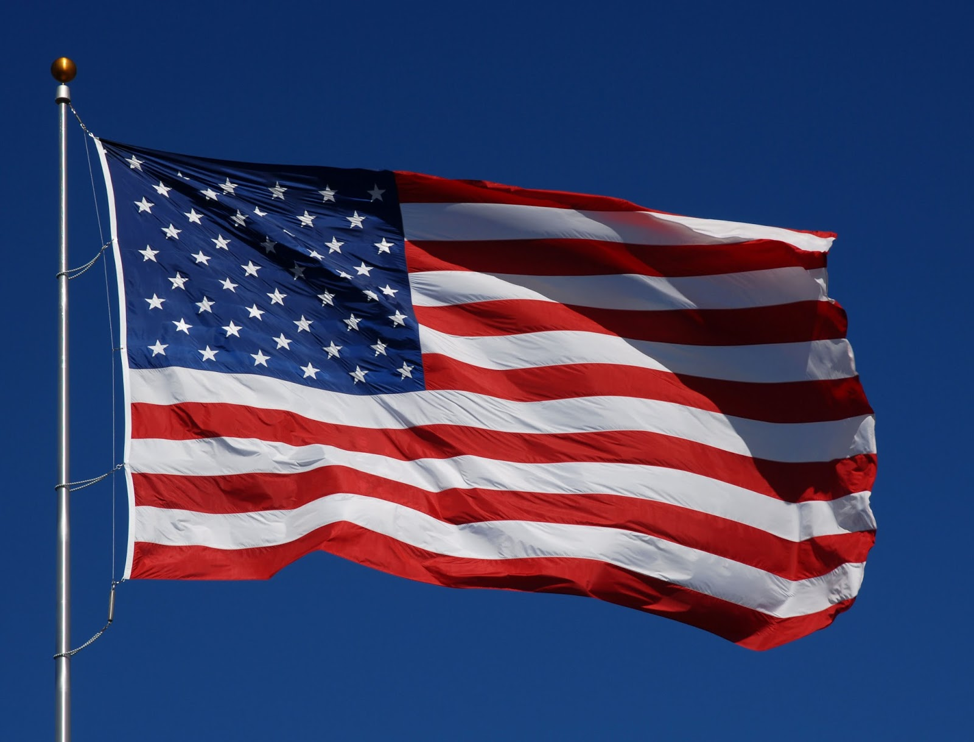

Slide 4
Mission Statement
Back Country Horsemen of America is a 501(C) 3 non-profit organization dedicated to the following mission.
To perpetuate the commonsense use and enjoyment of horses in America’s back country and wilderness.
To work to ensure that public lands remain open to recreational stock use.
To assist the various government and private agencies in their maintenance and management of said resource.
To educate, encourage and solicit active participation in the wise use of the back country resource by horsemen and the general public commensurate with our heritage.
To foster and encourage the formation of new state Back Country Horsemen’s organizations.

Slide 6

DEPARTED
BCHA MEMBERS MEMORIAL

Slide 7
STATE OF BCHA

Slide 9
CHAPTER SUPPORT GRANTS COMMITTEE

Slide 10
AND THE GRANT
RECIPIENTS ARE…..

Slide 11
Chapter Name | Amount
Wasatch Front Chapter BCHU | $1,000
Buffalo River Chapter BCHA | $500
Peninsula BCHW | $1,000
Capitol Riders BCHW | $900
Redwood Unit BCHC | $1,000
Wild Wonderful BCHA WV | $1,000
Black Hills BHD SD | $1,000
Tuttle Creek BCHKS | $1,000
BCHA PSJC St. Stephens - Alabama | $1,000
Sylamore BCH of AR | $1,000

Slide 12
2024 BCHA
EDUCATION COMMITTEE

Slide 13
Created Education Committee Portion of
BCHA Strategic Plan
Filed in BCHA Shared Drive
Linked in Education Resources Listing

Slide 14
Reviewed and updated Officer Training Modules
Substantial adds to the Treasurer Training module
New tools for Treasurers to use to present financial reports and Budget reports
Templates uploaded to Educational Resources listing
Updated Education Resources Listing

Slide 15
Other Activity
Organized and cleanedup Education Committee files.
Assisted members with access to BCHA Shared Drive contents
Hosted Zoom meetings for various Committees and State Meetings

Slide 16
2024 Budget Request
None

Slide 17
Future Activity Planned
Transfer Chairmanship to Colleen Fisk and Tracy Hsu as new Co-Chairs
Implement Light On The Land initiative

Slide 18

2024 National Marketing and Media Report
Casper, WY
Mar 25-27, 2024

Slide 19
History
Committee has always been given charge of communications (Newsletter, Website, and Social Media)
Records go back to 1997 show newsletter under newly formed Media & Marketing
M&M has been delegated to approve newsletter articles, solicit articles, and approve final print form of articles, responsible for find editor and printer

Slide 20
Marketing and Media Committee
Media Committee is comprised of members who preferably have skill or experience in public relations or communications.
  Purpose: Enhance the image of the BCHA through effective communication. Committee will develop strategies and multimedia tools to promote BCHA goals and objectives to membership, the general public, public land agencies, and legislators. Media Committee will partner with Education Committee for development and dissemination of public information.
  Chair responsible for overseeing and coordinating all activities of Committee. Duties
    Solicit articles for BCHA newsletter and other commercial publications
    Work closely with the Executive Administrator, newsletter editor, and webmaster
    Annual progress report and budget proposal for media activities at NBD meeting

Slide 21
2024
GOALS
June 29, 2023 Goals reported to EC
Goal: Create a survey to be sent out to all members with 3-5 questions, including an open comment section to gather opinions on how to improve the website. Survey approval by EC May. Send survey out by June 1. Give 5 days to get feedback. Completed 06/09/23
Goal: Update keyword/metadata Web search to make BCHA.org a stronger presence on website searches by July. Complete 06/19/23
Goal: Analyze results of survey, list out priorities and present to EC July meeting. Analysis ready to present – 7/01/23
Goal: Create specific goals with actions by Aug for updates to be completed by NBM 2024
Education Page – Draft
Create storage area to start moving files off of Google - Draft
Find National Advertisers for Newsletter – Approached Stihl and Tractor Supply
Rearranging Page Title for Alphabetical – In Progress
Market Sawyer Program – Proposed working with Stihl. They want to wait til 2024
Research Password Page – Researching
Light On Land Logo - Contest Started

Slide 22
2024 Poll Results
Suggested improvement areas
  Improved Website
  Quick Search
  Trail Information
  All Platform Use
  Navigation
  Updated Content/Benefits
  Chapter Locator inconsistencies with address
  Google Search Improvement

Slide 23
2024 Accomplishments
Key Phrases and SEO (Search Engine Optimization
Light on The Land Logo
Archived Old Articles – 47
Rearranged Page
Created new Youth Page
New Video on Home Page
New “Volunteer Sheet Directions” on Drive
Researched alternate Website technology
Cleaning up Google Drive
Draft updates created or Education page
Weekly updates to Chapter Locator (Remember to highlight updates in Yellow)

Slide 24

GrowthZone – A Potential Solution to Everthing
Package Total
Do more with software designed for your association.
Software Subscription (annual) : $8364
Implementation Fee (one-time): $2999
Year 1 Total: $11363
These were initial pricing from vendor and we have not looked at detailed payment options at this point

Slide 25
NOMINATION
COMMITTEE

Slide 26
NOMINATION COMMITTEE REPORT
4.12.6 Nominating Committee appointed by National Chair (policy adopted 1997).
• Must consist of members from at least three state organizations.
• Eligible candidates for director positions are supplied by the Chair of the Nominations
Committee and included in NBM agenda.
• Slate of candidates will be presented on first day of NBM.
SLATE OF CANDIDATES
*Chairman Mark Himmel, MT and Dan Key, NM
*Vice Chairman Craig Ferdig, AZ
*Treasurer Kathy Young, WA
*Executive Committee Director (2 Positions) Brad Pollman, MT and Misty Valdez, TX
**Executive Committee Non-Director Dana Chambers, WA and Joanne Mitchell, TN
*Must be a member of the National Board of Directors
**Must be a member in good standing and must not be a member of the National Board of Directors

Slide 27

Partnership Committee
Review & Presentation
Committee Members:
Sherry Copeland
Craig Ferdig
Jacque Alexander
Mike Kinsey

Slide 28
Partnership Committee Governance Policies
4.12.8 Partnership Committee Members may be appointed by the Chair as needed to represent BCHA at specific functions or in specific geographic locations. Members must have long-term membership in BCHA, must be a former officer of the Board, and have knowledge of BCHA issues and public relations positions. 4.12.8.1 Purpose and duties:
• Represent, recommend and/or coordinate partnership activities beneficial to BCHA in furthering the mission and goals established by the NBD.
• Submit a report to NBD summarizing the annual activities of the Committee, including outline of proposed future activities and projects.
• Provide annual budget to NBD for Committee work. Review, approve, and monitor expenditures of the Committee.
• Approve resources and assignments of BCHA representative at events. BCHA Representatives must have demonstrated knowledge of BCHA Mission, Constitution, Governing Policy OR experience as Officer or Committee Chair OR positive experience representing BCH at State level AND the approval of at least two of the following: National Chairman, National Vice Chairman, or Public Lands Committee Chairman.
• Committee provides annual review to NBD of BCHA partnership with other organizations. The review provides history, level of participation, and benefit of given partnerships to BCHA.

Slide 29
Organization / Association Partners
.

Slide 30
American Horse Council (AHC)
Founded 1969
MISSION: The American Horse Council works daily to advocate for the social, economic and legislative interests of the United States equine industry.
Benefit: AHC legal and legislative advocate professionals provide support as “our office in DC” and AHC is the only equine organization with a seat on Outdoor Recreation Roundtable
Randy serves as Chairman of AHC Recreation, Trails & Land Use Committee.
BCHA Governance Policy 3.4.1.4 “…….provide for National Equestrian Trails Advocacy by participating in American Horse Council’s Recreation Trails Committee”
Budget fee requested: $2,650.00 (qualifies for committee seat)

Slide 31
Partnership for the National Trail System (PNTS)
Founded 2001
Mission: To empower, inspire and strengthen public and private partners to develop, preserve, promote and sustain the national scenic and historic trails.
Benefit: PNTS is a critical forum for multi use National Scenic & Historic Trail organizations where BCHA is the only equine-related organization; PNTS is convenor of Hike the Hill and National Trails Workshop.
Randy serves as Chairman of PNTS Membership Committee.
Budget fee requested: $250.00

Slide 32
National Wilderness Stewardship Alliance (NWSA)
Founded 2010
Vision: America’s wilderness and wild places will be stewarded for generations to come through an enduring partnership of public agencies, community-based organizations, and volunteer stewards; and that the benefits of wilderness and wilderness stewardship will be shared equitably.
Benefit: NWSA provides annual Trail Stewardship Grants and Co-convenes the annual National Wilderness Workshop
Randy completed service on NWSA Board 12/31/23.
Budget fee requested: $270.00

Slide 33
Leave No Trace Center for Outdoors Ethics (LNT)
Founded 1994
Mission: Using the power of science, education and stewardship, Leave No Trace is on a mission to ensure a sustainable future for the outdoors and the planet.
Benefit: LNT is complementary to BCHA Light on the Land program and many BCHA members are LNT Master Stock Trainers
Budget fee requested: $150.00

Slide 34
American Trails
Trails Move People Coalition
Founded 1988
Mission: Our mission is to advance the development of diverse, high quality trails and greenways. Through collaboration, education, and communication, we raise awareness of the value of trails.
American Trails, through our Trails Move People (TMP) coalition, allows for robust engagement of diverse organizations across the trail user spectrum on a variety of topics and issues related to trails. Agreement on all issues may not be possible, but TMP will provide a forum for such discussions, and allow the trails community to speak loudly with a unified voice on the issues that resonate with the TMP coalition.
Mylon Filkins (BCH California) is listed as an Advisor
Benefit: American Trails is the national umbrella organization for all trail users and Convenes biannual International Trails Conference
Budget fee requested: $100.00

Slide 35
Coalition for Recreational Trails (CRT)
Google search found no independent website.
From American Trails website:
The Coalition for Recreational Trails (CRT) is an alliance of national and regional trail-related organizations across a broad spectrum of interests representing motorized and non-motorized communities. Its members work together to build awareness and understanding of the Recreational Trails Program, which returns federal gasoline taxes paid by off-highway recreationists to the states for trail development and maintenance.
Mission: Continuing and enhancing the RTP at the state and federal level; Educating policy makers and the public about the RTP’s accomplishments; and Ensuring that the return of federal gasoline taxes to the program is equitable, that the allocation of those funds among the states reflects current fuel-usage data, and that the utilization of those funds is efficient, effective, responsive and accountable.
Benefit: CRT is the only entity that lobbies for the enhancement and expansion for the Recreational Trails Program and Convenes the annual RTP Awards Ceremony on Capitol Hill.
Budget fee requested: $500.00

Slide 36
American Hiking Society (AHS)
Founded 1976
Mission: Empowering all to enjoy, share, and preserve the hiking experience.
We envision a world where everyone feels welcome in the American hiking community and has permanent access to meaningful hiking, including urban, frontcountry, and backcountry opportunities.
We will achieve this vision by empowering all communities to enjoy, share, and preserve the hiking experience; advocating for the protection and expansion of hiking spaces; fostering trail stewardship; and collaborating with partners whose strengths are complementary.
Advocate: American Hiking works with Congress, federal agencies, and partners on policy issues and legislation to ensure funding for trails, preservation of public lands, and protection of the hiking experience.
Benefit: AHS spearheads national trails community’s annual appropriations request to Congress

Slide 37
International Mountain Bicycling Association (IMBA)
Founded 1988
Mission: To create, enhance and protect great places to ride mountain bikes.
Randy serves on the IMBA Steering Committee for Trails are Common Ground.
Benefit: IMBA is a publicly visible leader in trail etiquette education for all trail users

Slide 38
American Endurance Ride Conference (AERC)
Founded 1972
Values: In addition to promoting the sport of endurance riding, the AERC encourages the use, protection, and development of equestrian trails, especially those with historic significance. The founding ride of endurance riding, the Western States Trail Ride or “Tevis Cup,” covers 100 miles of the famous Western States and Immigrant Trails over the Sierra Nevada Mountains. These rides promote awareness of the importance of trail preservation for future generations and foster an appreciation of our American heritage.
Benefit: AERC membership includes many cross-over with BCHA memberships

Slide 39
Equestrian Land Conservation Resource (ELCR)
Founded 1996
Mission: The Equine Land Conservation Resource leads in the protection and conservation of lands for the horse and horse-related activities.
Vision: A future in which horse lands have been conserved so that America’s equine heritage lives on and the emotional, physical and economic benefits of mankind’s bond with the horse remain accessible to all.
Benefit: ELCR is BCHA’s counterpart in terms of protecting equine access on private lands and ELCR member alerts frequently reference BCHA’s work for the entire equine community.

Slide 40
The Wilderness Society (TWS)
Founded 1935
Mission: Uniting people to protect America’s wild places.
Benefit: TWS provides tremendous support for BCHA pivotal platforms (i.e. National Forest System Trails Stewardship Act, litigation with the Tahoe National Forest authorization of E-Bikes, etc.)

Slide 41
Corporate / Business Partners
.

Slide 42
.
Equestrian Legacy Radio
Trailmeister
Promote horses, music and the western and equestrian lifestyle
Heard around the World……Streaming Live and On Demand 24/7…..You can listen to all of our shows Here and on Spotify, iHeart Radio, Apple Podcast, iTunes and other streaming platforms.
BCHA is afforded guest spot the first Thursday of each month on the platform Saddle Up America.
TrailMeister is your free online resource for horse trails, horse camps, and all of the information you need for a successful and uneventful ride.
Here you’ll find accurate trail information including current weather, real directions, and the straight scoop on the area that has been verified by the area’s land managers.
TrailMeister was created for YOU: the avid, active, or aspiring horse rider. Whether you trail ride as part of your horse training program, as conditioning for competition, or trail ride exclusively because you love being out in nature as much as we do, TrailMeister is for you.
BCHA is promoted at clinics, seminars, etc. TrailMeister promotes BCHA mission and principles in videos and articles on experiences in the backcountry.

Slide 43
Federal Agencies
*Denotes currently maintained agreements

Slide 44
National Parks Service (NPS)*
United States Department of the Interior
Founded 1916
Mission: The National Park Service preserves unimpaired the natural and cultural resources and values of the National Park System for the enjoyment, education, and inspiration of this and future generations. The National Park Service cooperates with partners to extend the benefits of natural and cultural resource conservation and outdoor recreation throughout this country and the world.

Slide 45
U.S. Forest Service (USFS)*
United States Department of Agriculture
Founded 1905
Mission: The mission of the Forest Service is to sustain the health, diversity, and productivity of the Nation’s forests and grasslands to meet the needs of present and future generations.

Slide 46
U.S. Army Corps of Engineers (COE)*
United States Department of Defense
Authorized 1812
Mission: Deliver vital engineering solutions, in collaboration with our partners, to secure our
Nation, energize our economy, and reduce disaster risk.

Slide 47
Bureau of Land Management (BLM)
United States Department of Interior
Founded 1946
Mission: The Bureau of Land Management's mission is to sustain the health, diversity, and productivity of public lands for the use and enjoyment of present and future generations.
Recreation for All: We will work to ensure that all families now and into the future have equal opportunity to hunt, camp, fish, hike and play on our public lands.

Slide 49
Expanded Article:
Trails Community Advocacy Secures Consistent Funding in Challenging Environment
Trails Community Expresses Appreciation for Level Trail Line Item Funding in Difficult FY24 Funding Climate, Calls for Increased Funding for Federal Land Management Agencies in FY25
Silver Spring, MD — Because of the efforts of the trails community including organizations, advocates, and user groups, funding for trail-specific line items in the Fiscal Year 2024, Interior and Related Agencies appropriations will largely remain level year over year, when many other programs and overall land management funding is facing steep cuts.
While trails and public lands still don’t receive anywhere close to the funding fully needed to fulfill staffing, conservation, or maintenance mandates, the trails community recognizes the position of congressional appropriators and staff to make difficult funding decisions in the current climate. We express our appreciation that the value and importance of trails was recognized in this process to the extent that circumstances allowed.
While the topline cuts to federal land management agencies, insufficient staffing levels, and the zeroing out of funding for the Active Transportation Infrastructure Investment Program within the Department of Transportation will negatively impact the experience of all trail users, the trails community remains dedicated to supporting robust funding for federal land management agencies going forward and ensuring that conservation and recreation receives the funding it desperately needs and deserves.
The following organizations had this to say about the passage of the FY24 minibus appropriations bill, including Interior and Related Agencies.
“Through year long advocacy efforts, like Hike the HillⓇ and letters of support from 207 organizations, American Hiking is proud to lead efforts that secured consistent funding for trails year over year.” said Tyler Ray, Senior Director of Programs and Advocacy, American Hiking Society “In this difficult environment, while additional funding for land management agencies and trails are needed, Congress recognized the role that trails play for hikers and all recreationists and helped to ensure that trails can be open and accessible to all.”
“The American Trails community would like to thank appropriators and legislators for their efforts in maintaining funding levels for key trails and outdoor recreation programs within the Federal land management agencies in what has proven to be one of the most challenging budgeting environments in recent history. This continued funding ensures all Americans have the opportunity to re-create themselves (read “recreate”) on our public lands.” said Mike Passo, Executive Director, American Trails
“In a difficult appropriations environment, Congress has prevented significant reductions to funding for trails, park, and forest operations. While we believe these funding levels are still below necessary levels, we appreciate the support of the A.T. and our public lands system, particularly the encouragement to increase administrative funds for the Appalachian National Scenic Trail, “said Brendan Mysliwiec, Director of Federal Policy at the Appalachian Trail Conservancy. “The ATC urges Congress to approach the President’s FY25 budget request with a greater degree of urgency so that clear direction to and support for the A.T.’s Cooperative Management System is provided in a timely manner.”
“On behalf of the thousands of volunteers who give everything to maintain and keep trails open throughout our public lands, we greatly appreciate the efforts of the House and Senate appropriations committees,” said Mark Himmel, Chairman of Back Country Horsemen of America. “Trails and outdoor recreation comprise a winning bipartisan issue because everyone loves America’s great outdoors. In this spirit, the trails community will continue to work with champions in Congress to enhance access to public lands for everyone.”
“We are thrilled to see that the House and Senate Appropriations Committees provided level funding for federally managed trails. Recreational access to public trails is vital to a myriad of various outdoor recreational enthusiasts. Thank you to the American Hiking Society and all the other trail related organizations that continue to work together to advocate for continued federal support for our public trails.” said Holley Groshek, Executive Director, Equine Land Conservation Resource
“On behalf of the members and users of the Florida National Scenic Trail, I thank the House and Senate Appropriations Committees for their efforts to maintain funding levels for our trail and others across the country in FY 2024 and look forward to working on the FY 2025 appropriations” said Royce Gibson, Executive Director, Florida Trail Association
“Given the difficulties Congress faces in funding the government, we are pleased to see the House Committee on Appropriations and the Senate Committee on Appropriations recognize the importance of outdoor recreation and our nation’s trails. By sustaining current year’s funding levels from FY23, Congress has proven it is serious about investing in our federal public lands, and that investment will lead to more opportunities for people to experience the outdoors.” said Todd Keller, Director of Government Affairs, International Mountain Bicycling Association
“The National Wilderness Stewardship Alliance extends much appreciation to House and Senate Appropriators for recognizing the importance of funding our nation’s trails amidst a challenging funding environment that saw cuts across land management agencies,” said Joelle Marier, Executive Director of National Wilderness Stewardship Alliance. “This funding supports crucial programs that put boots on the ground and engage thousands of volunteers in trail stewardship, keeping trails accessible and safe for all to enjoy.”
“Many thanks to House and Senate appropriators for holding the line on trails funding for the 2024 budget under difficult circumstances,” said Mark Larabee, Advocacy Director for the nonprofit Pacific Crest Trail Association, which marshals thousands of dedicated volunteers and raises millions in private donations to maintain and help manage the Pacific Crest National Scenic Trail. “Americans need and deserve great outdoor recreation spaces. But federal budgets have not kept pace with the need. Fully staffed and well-funded land management agencies are essential to fulfilling the complex conservation, maintenance, and management responsibilities of our great public lands and trails.”

Slide 50
2024-2025 Goals
Expand and continue collaboration with identified organizations
Compile data of Partnership funding benefits utilized by States and Chapters
Support Chapters and States in initiating and developing Partnerships
Review and evaluate new proposed Partnership opportunities
Facilitate and coordinate Partnership activities and event representation as required

Slide 51
Budget Proposal
American Horse Council 2,650.00
Partnership for the National Trail System 250.00
National Wilderness Stewardship Alliance 270.00
Leave No Trace 150.00
American Trails – TMP Coalition 100.00
Coalition for Recreational Trails 500.00
Hike the Hill Participation* 2,600.00
* Two (2) Virtual Only & One (1) Add’l In-Person
Total Budget Proposal $6,520.00

Slide 52

BCHA PUBLIC LANDS COMMITTEE (PLC)
Brad Pollman, PLC Chair

Slide 53
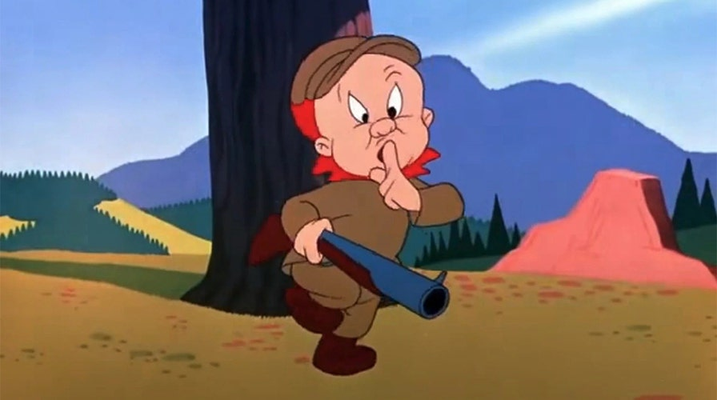
Public Lands … the secret is out!

Slide 54
PUBLIC LANDS COMMITTEE (PLC)
Relationships with Land Managers
TIMING IS EVERYTHING!

Slide 55
PUBLIC LANDS COMMITTEE (PLC)
Tools to use for a successful Partnership
with the governing agencies of our public lands
VOLUNTEER AGREEMENTS
CHALLENGE COST SHARE AGREEMENTS

Slide 56
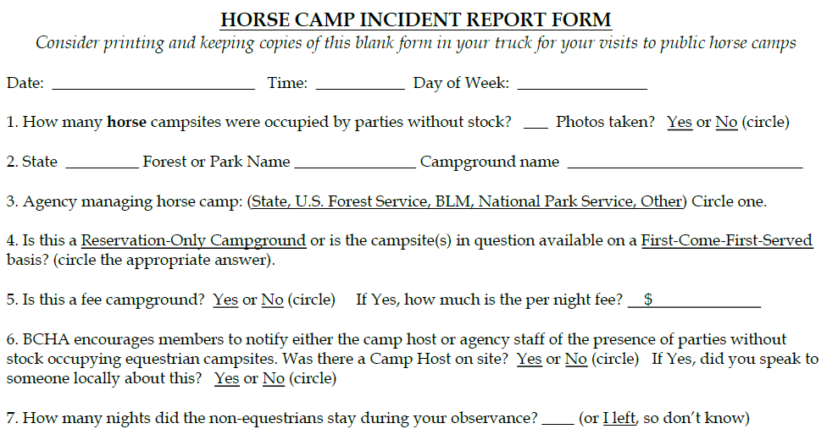

Slide 57
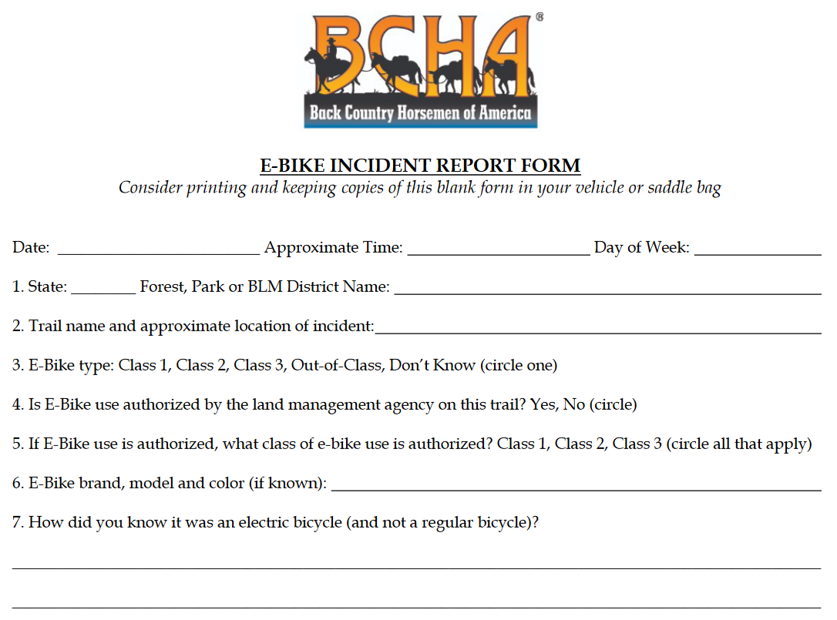

Slide 58
VOLUNTEER HOURS COMMITTEE

Slide 60
YOUTH COMMITTEE

Slide 61
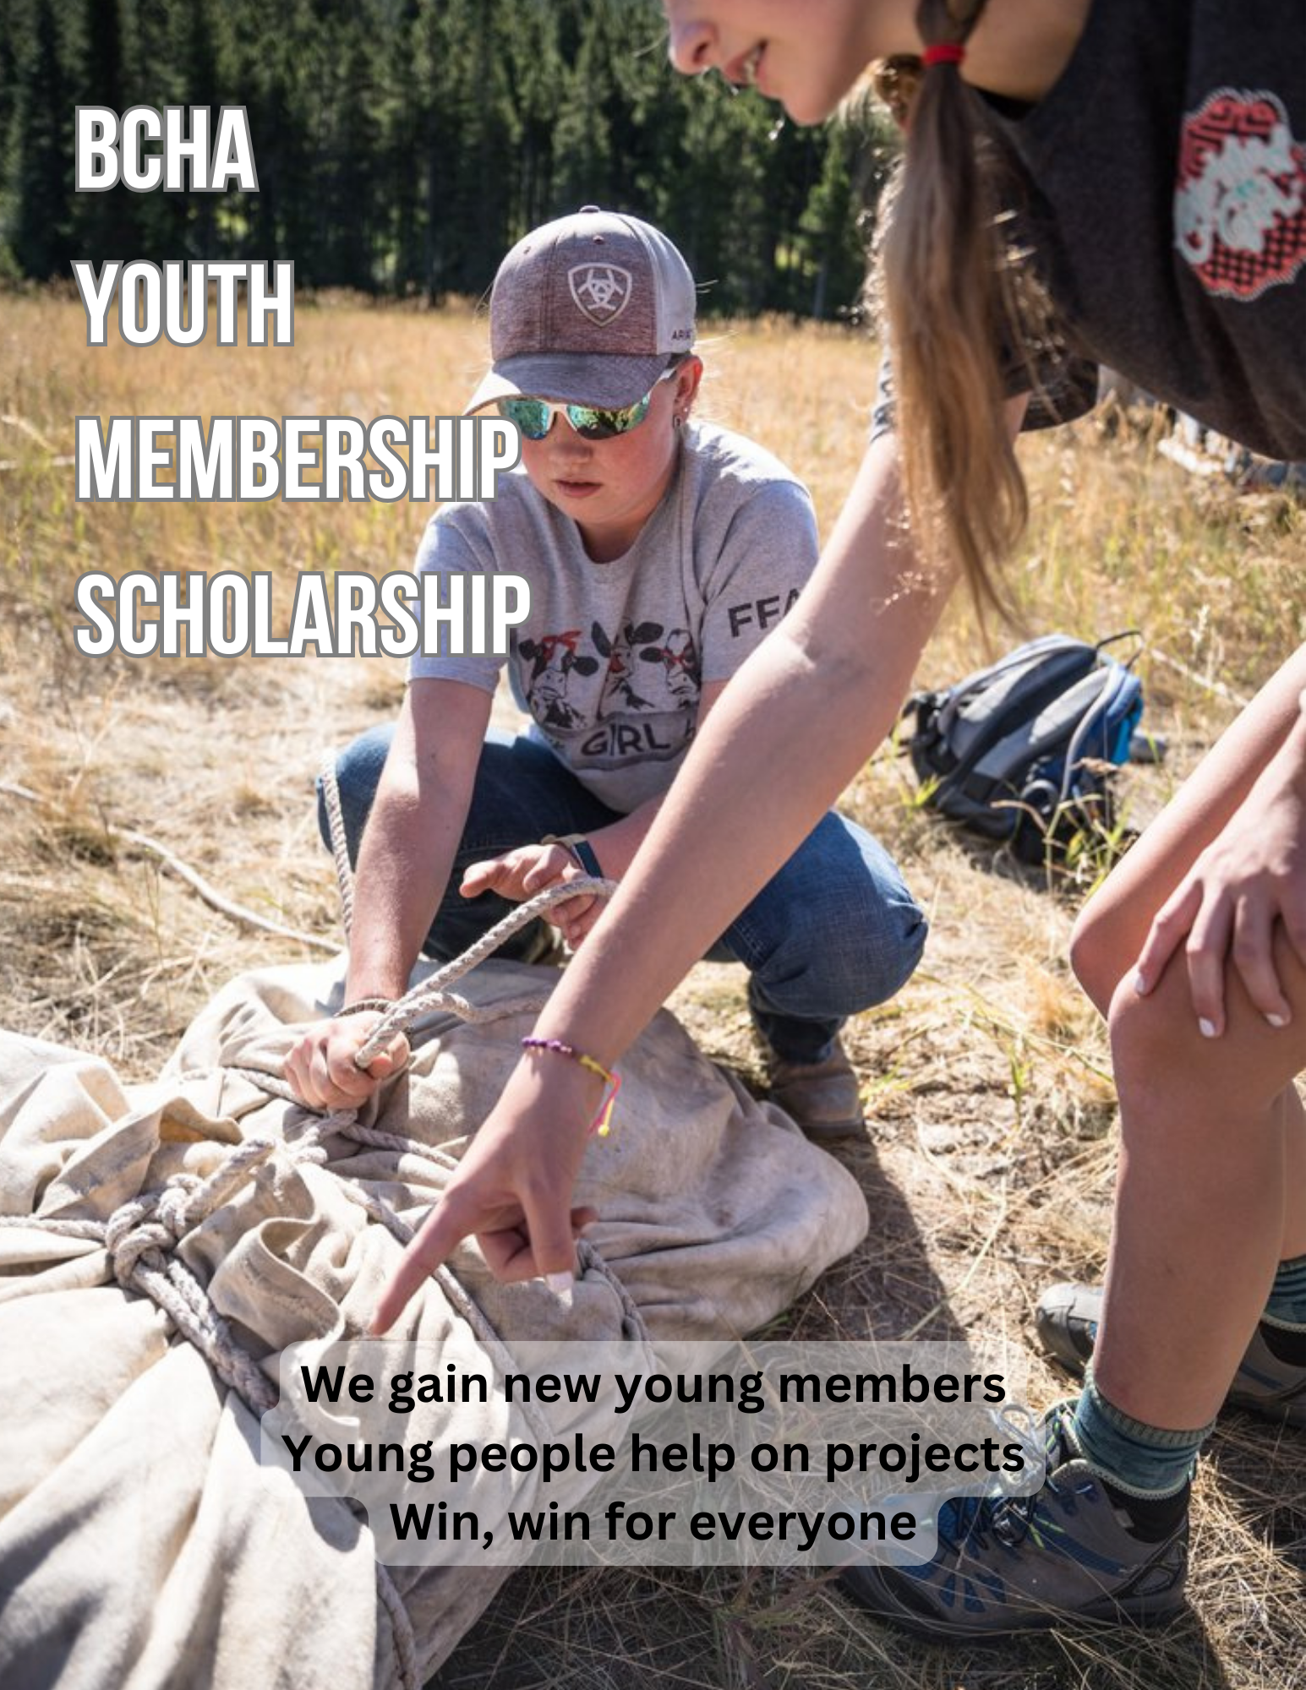

Slide 62
TREASURER REPORT

Slide 64
EXECUTIVE ADMINISTRATIVE REPORT

Slide 65
DIRECTOR OF PUBLIC LANDS REPORT

Slide 66
CONTRACT REVIEW
Director of Public Lands
Randy Rasmussen
Executive Administrator
Lakeside Administrative Services; Michelle Wade

Slide 69
DUES INCREASE RATIFICATION

Slide 70
“COLA”
Resolution
Findings and
Recommendations
(COLA) RESOLUTION
NATIONAL DIRECTORS MEETING 2023
BACK COUNTRY HORSEMEN OF AMERICA
(From Wind River BCH)
WHEREAS: Since the founding of the Back Country Horsemen in 1973 the organization has been financed primarily by the support from membership dues.
AND WHEREAS: Said dues can only be raised at the national board meeting after a lengthy process to approve a small change in the amount.
THEREFORE: Be it resolved that the National Board of Directors of BCHA at the 2023 National Board meeting create a working committee to investigate amending the current BCHA by-laws to allow dues to be raised periodically based upon a “cost of living” adjustment.
THEREFORE: Be it resolved the working committee have their findings ready for presentation at the 2024 National Board meeting.
Approved and submitted by BCH State of Wyoming
Approved by the National Board of Directors 4/2023
Submitted by:
BCHA Past National Chairmen Working Group

Slide 71
The working committee’s investigation found the following:
Changing the mechanism for instituting dues increase based on “Cost of Living” would not be advised and should remain solely with the National Board of Directors.
Additional investigation, and consultation with Wyoming representation, determined the objective of the resolution was to ultimately decrease the time frame for BCHA to receive increased dues.

Slide 72
Based on Constitutional review and discussion, the working committee offers the following to expedite dues increase implementation:
Recommendation:
At a National Board of Directors Meeting at which the National Board of Directors approve dues increase, an additional National Board of Directors Meeting must be scheduled (per ARTICLE VII, Section 5) to ratify the proposed dues increase.
Suggestions:
The additional meeting should be held via Zoom and allow sufficient time for Chapters and State Organizations to take required actions and implement necessary changes within the calendar year.

Slide 73
Comparative time frame based on the current dues increase proposal:
Existing process: Expedited process:
April 2023 National Board of Directors approves dues increase
April 2024 States ratify increase at National Board Meeting
January 2025 States implement and collect increased funds
January 2026 BCHA receives increased funds
April 2023 National Board of Directors approves dues increase
TBD 2023 States ratify via Zoom National Board Meeting
January 2024 States implement and collect increased funds
January 2025 BCHA receives increased funds

Slide 74
GOVERNANCE POLICY COMPLIANCE

Slide 75
NEW BUSINESS

Slide 76

5:30PM Mixer at the Bar
7:00PM Meet a Committee Night

