Slide 1
2024 National Marketing and Media Report
Casper, WY
Mar 25-27, 2024

Slide 2
History
Committee has always been given charge of communications (Newsletter, Website, and Social Media)
Records go back to 1997 show newsletter under newly formed Media & Marketing
M&M has been delegated to approve newsletter articles, solicit articles, and approve final print form of articles, responsible for find editor and printer

Slide 3
Marketing and Media Committee
Media Committee is comprised of members who preferably have skill or experience in public relations or communications.
Purpose: Enhance the image of the BCHA through effective communication. Committee will develop strategies and multimedia tools to promote BCHA goals and objectives to membership, the general public, public land agencies, and legislators. Media Committee will partner with Education Committee for development and dissemination of public information.
Chair responsible for overseeing and coordinating all activities of Committee. Duties
Solicit articles for BCHA newsletter and other commercial publications
Work closely with the Executive Administrator, newsletter editor, and webmaster
Annual progress report and budget proposal for media activities at NBD meeting

Slide 4
2024
GOALS
June 29, 2023 Goals reported to EC
Goal: Create a survey to be sent out to all members with 3-5 questions, including an open comment section to gather opinions on how to improve the website. Survey approval by EC May. Send survey out by June 1. Give 5 days to get feedback. Completed 06/09/23
Goal: Update keyword/metadata Web search to make BCHA.org a stronger presence on website searches by July. Complete 06/19/23
Goal: Analyze results of survey, list out priorities and present to EC July meeting. Analysis ready to present – 7/01/23
Goal: Create specific goals with actions by Aug for updates to be completed by NBM 2024
Education Page – Draft
Create storage area to start moving files off of Google - Draft
Find National Advertisers for Newsletter – Approached Stihl and Tractor Supply
Rearranging Page Title for Alphabetical – In Progress
Market Sawyer Program – Proposed working with Stihl. They want to wait til 2024
Research Password Page – Researching
Light On Land Logo - Contest Started

Slide 5
2024 Poll Results
Suggested improvement areas
Improved Website
Quick Search
Trail Information
All Platform Use
Navigation
Updated Content/Benefits
Chapter Locator inconsistencies with address
Google Search Improvement

Slide 6
2024 Accomplishments
Key Phrases and SEO (Search Engine Optimization
Light on The Land Logo
Archived Old Articles – 47
Rearranged Page
Created new Youth Page
New Video on Home Page
New “Volunteer Sheet Directions” on Drive
Researched alternate Website technology
Cleaning up Google Drive
Draft updates created or Education page
Weekly updates to Chapter Locator (Remember to highlight updates in Yellow)

Slide 7
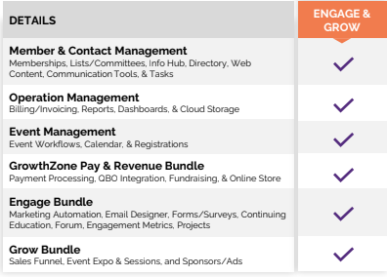
GrowthZone – A Potential Solution to Everthing
Package Total
Do more with software designed for your association.
Software Subscription (annual) : $8364
Implementation Fee (one-time): $2999
Year 1 Total: $11363
These were initial pricing from vendor and we have not looked at detailed payment options at this point

