Slide 1


Back Country Horsemen of America
Volunteer Hours Reporting
Guidelines

Slide 2

Overview
Volunteer Hours are Important
Volunteerism is one of the most important activities Back Country Horsemen can use in our effort to perpetuate enjoyable common sense use of horses in the backcountry.
Volunteerism earns horsemen a seat at the table where decisions concerning access to public lands by pack and saddle stock users are made.
Individual volunteer efforts support the
Back Country Horsemen of America
mission statement.
Volunteer service by BCHA is
consistently underreported.

Slide 3
Overview
Volunteer Hours are Important
  Volunteering helps keep trails open for all users.
  It puts BCHA and horsemen in a positive position when engaging with other user groups.
  It shows BCHA and horsemen are a good neighbors within the community.
  Volunteer hours are our clout. Without them our organization wouldn’t be what it is now.
  Legislators and land managers know that our volunteer hours are an asset.
  Volunteering gives credibility to Back Country Horsemen in discussions with land managers.

Slide 4
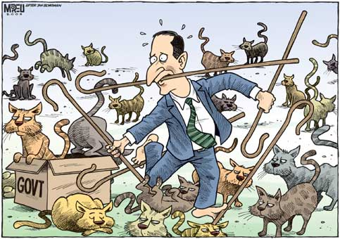
Reporting
Volunteer Hours Coordinator
Each BCHA state organization must have a Volunteer Hours Coordinator designated to facilitate the reporting of the efforts made in the state.
Every chapter within each state organizations should also have a Volunteer Hours Coordinator appointed to record the efforts the their members.
BCHA has provided an MS Excel spread-
sheet to facilitate and standardize the
volunteer hours reporting process.
It is important to record all the
resources devoted to a project:
  Volunteers time
  Transportation costs
  Livestock use
  Other supplies and resources
It’s a lot like herding cats!

Slide 5
Project Worksheets
At the chapter, the Project Sheet is the most important element to the Volunteer Hours Coordinator (VHC).
The Project Sheet is where the VHC records the efforts made by the chapter members.
Use the Project Sheet to:
  Record the efforts of individual members.
  Record the resources used on the project.
  (Transportation, Livestock & Equipment)
  Segregate projects by agency.
  (USFS, BLM, NPS, State etc.)
  Create as many Project Sheets as required.
  (Name your project sheets)
The Project Sheet is designed to allow the state or chapter the option to track the volunteer effort of individuals for awards or recognition.

Slide 6
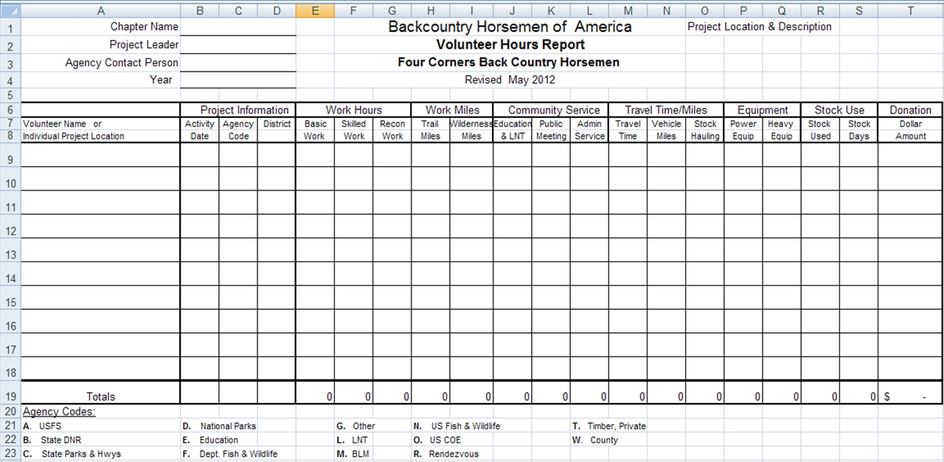
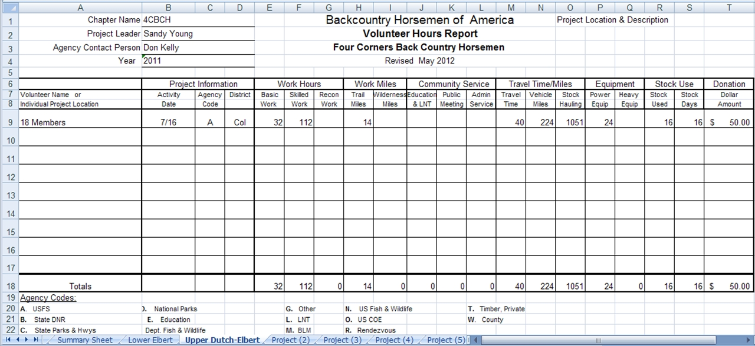
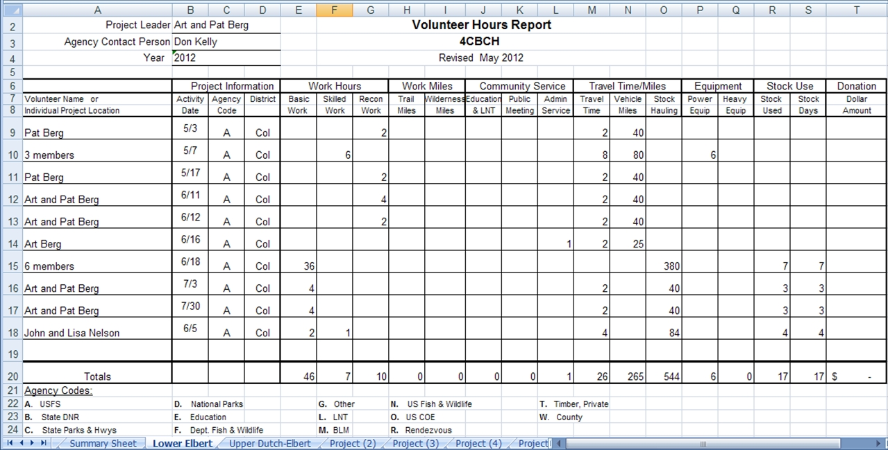
Project Worksheets (cont’d)

Slide 7
Guidelines for Reporting
Trail Work
Record trail work hours under the agency for which you spent the time. Work can be skilled or basic.
Basic:
  General Trail Maintenance (cut, lop, clear, drainage)
  Prep work for skilled work
Skilled:
  Packing
  Carpentry
  Teamster
  Search and Rescue
  Trail survey
  GPS mapping
  Chainsaw operation
  Organizing for major work parities
Recon:
  Hours ridden in advance planning for a trail project.

Slide 8
Guidelines for Reporting
Trail Work that Counts
  Trail clearing and Trailhead clean up, road clean up
  Trail work on public land or open private lands
  Onsite support or food prep for work parties
  Campground host if agency requested/required
  Planning and Prep work for future work parties
  Report hours ridden for advance planning a trail project to determine the level of effort required as Recon Hours.
What Doesn't Count:
  Cleaning up after yourself on the trail or at the trailhead.
  Trail work on private property not open to the public

Slide 9
Guidelines for Reporting
Report trail mileage cleared
  Report actual trail miles worked on.
  Distinguish between miles cleared in wilderness and non-wilderness areas.
  Use either a GPS system or use a “best guess system” of the distances cleared.
  If a portion of a trail has been previously cleared, but needs to be worked again, that section should be counted each time it is worked.
What Doesn't Count:
  Report the total mileage only once for the project; not for each member of the work party.

Slide 10
Guidelines for Reporting
Community Service
  Education & LNT
    Educational Clinics open to the public (e.g. Horsemanship and packing skills).
    Leave No Trace (LNT) Education.
  Public Meetings and BCH Public Representation.
    Time spent attending or presenting at public meeting relating to BCH Activities or issues.
    Time attending Forest planning, travel management or other agency meetings
  Administrative service
    Time spent planning or coordinating projects with agencies or within the chapter or with government agencies.

Slide 11
Guidelines for Reporting
Education/LNT
Record Leave No Trace (LNT) education projects under the agency “ L ” and other Educational projects under the agency “ E ”
  Clinics, Seminars, Rendezvous – Planning Teaching and Hosting (working, judging and setup) public clinics.
  Presenting or writing articles regarding LNT or other educational topics.
  Education Booths – Public display or representation of the BCHA interaction with the public.
  Chainsaw/Crosscut Saw certification training (including prerequisite First Aid, CPR, etc.) for both student and instructors
  Hosting an informational clinic for your chapter
  Speaking at another organization.

Slide 12
Guidelines for Reporting
What Doesn't Count:
  Participation at a clinic as a student. Not to be confused with training required for saw certification etc. which does count.
  Attendance without partaking in the efforts to help put on the event.

Slide 13
Guidelines for Reporting
Public Meetings and BCHA Representation
  Active participation at public meetings including; USFS, BLM, DNR, National Parks, State, County and City.
  Active participation at conferences, meetings, seminars, relating to BCH Purpose and Objectives.
  Parades
  Fund raisers that provide benefits to the public
  (e.g. Tack sale, poker ride etc.)
  Time spent publicly representing the BCHA in a productive manner as part of a chapter or group effort (e.g. Volunteering at a homeless shelter, manning a booth at a public event, etc.)

Slide 14
Guidelines for Reporting
What Counts:
  Active participation in these activities; which includes:
    At meeting, speaking, interacting, taking notes for an upcoming newsletter or meeting.
    Time preparing for or planning an event.
    Time spent preparing or manning a display booth representing BCHA, State or local chapter.
What Doesn't Count:
  BCH chapter, state and national board meetings are not considered public meetings
  Parade prep time
  Raffles, bake sales, etc.

Slide 15
Guidelines for Reporting
Administrative Service that Count:
  Planning clinics or workshops.
  Planning events that are open to the public
  Volunteer Hours Record Keeping
  Newsletter Editor Hours
  Research for articles, or writing of an article to be published in a newsletter
What Doesn't Count:
  BCH chapter meetings
  State and national board meetings

Slide 16
Guidelines for Reporting
Travel Time & Mileage
Time
  Actual hours spent by participants going to and from projects, educational events or public meetings
Mileage
  Personal Vehicle Miles
    Actual vehicle miles driven to and from projects, educational or public meetings and return – only driver can claim miles.
  Stock Hauling Miles (equipment hauling also)
    Actual miles using a truck and/or trailer to haul animals AND/OR Heavy equipment etc. for projects – only driver can claim miles.
  Report either stock hauling or personal miles but not both.

Slide 17
Guidelines for Reporting
Equipment
Power Equipment
  Actual hours of use of personally owned or rented power equipment on projects (e.g. Chainsaws, weed whackers, mixers, etc.)
Heavy Equipment
  Actual hours using heavy equipment on projects. (e.g. Tractors, Post Drivers, Backhoes, etc.)
  Prepping heavy equipment and loading it before you use it counts as skilled labor.
  Hourly Rates are determined by BCHA in conjunction with the government agencies.

Slide 18
Guidelines for Reporting
Stock Use
Stock Used
  Number of saddle and pack stock used to complete a project.
Stock Days
  The number of saddle and pack stock used times the number of days used on the project. For Example:
    1 animal used for 1 day is reported as 1 stock days.
    2 animals used for 1 day is reported as 2 stock days.
    2 animals used for 3 days is reported as 6 stock days.
  If an animal is used for part of a day, report as 1 stock day regardless how long it was actually used.
  Stock days are what count for volunteer service.

Slide 19
Guidelines for Reporting
Donations
  Donations of money or material from:
    Chapter treasury
    Personal or business accounts.
  For Example:
    Nails
    Lumber
    Fuel for chainsaw or other equipment
    Gravel
    Other materiel purchased by members or the chapter
  REMEMBER: If there are questions concerning the eligibility of any volunteer effort contact the BCHA VHC for help and advice.

Slide 20

Summary Worksheet
The Summary Sheet is where the VHC summarizes the efforts made by the chapter members for a report to the State organization and BCHA.
Use the Summary Sheet to:
    Summarize the effort of chapter members
    Copy information from the totals row of the Project Sheets to a row on the Summary Sheet
    Compile the annual report for the State
    The State VHC uses these reports to compile a state report to Back Country Horsemen of America.
    The State VHC submits their report to the
    BCHA Volunteer Hours Committee chairman.

Slide 21
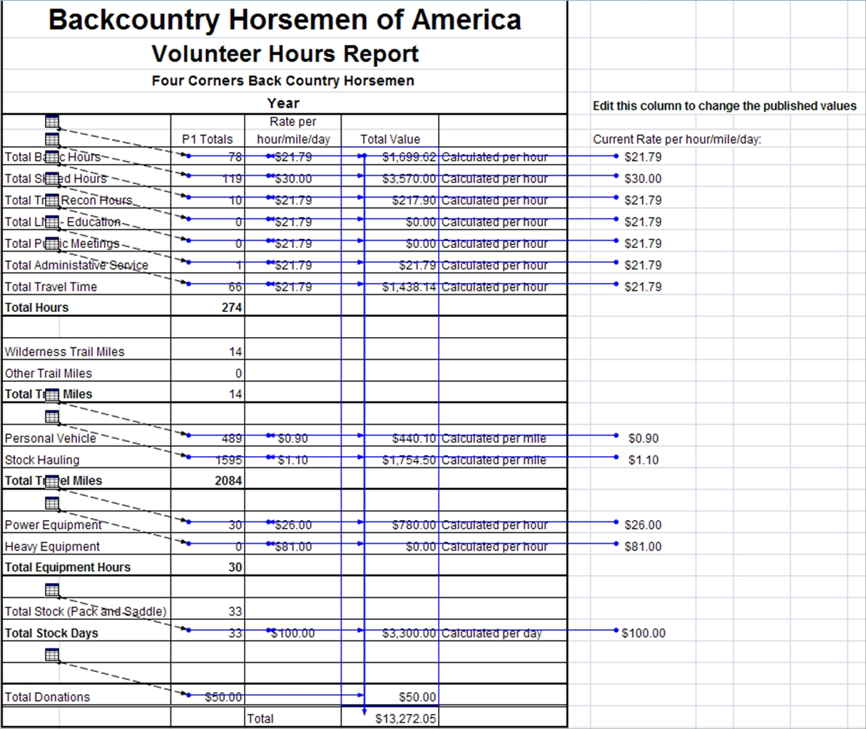
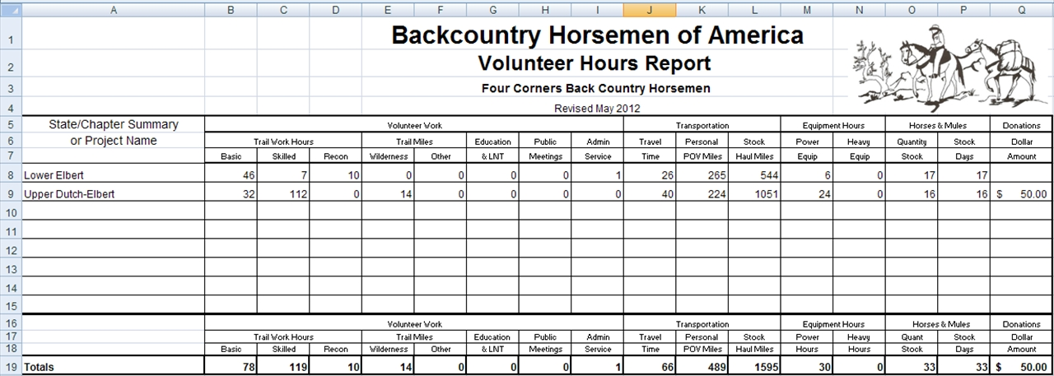
Summary Worksheet

Slide 22
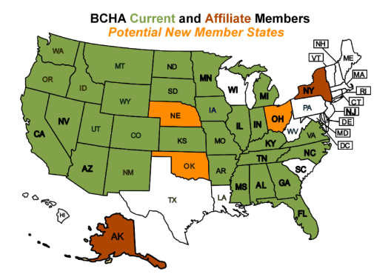
Flow of Information
To make reporting effective, information must be:
Accurate as possible
Reliable
Consistent
Chapter Report to ➔ State VHC
State VHC compiles reports sends to ➔ BCHA VHC
BCHA Volunteer Hours Committee ➔ National Board

Slide 23
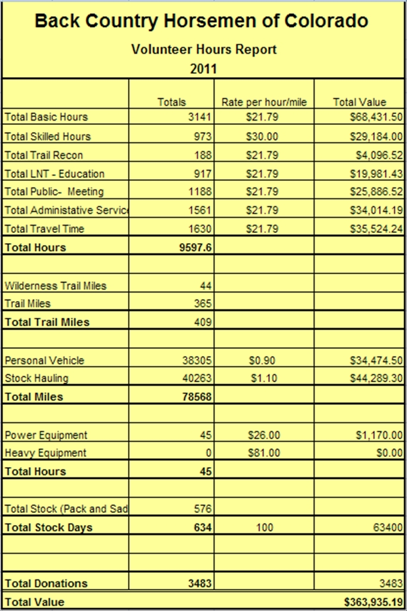
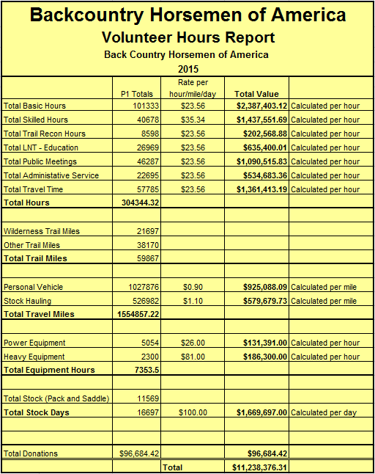
Volunteer Hours Report
2015
BCHA Volunteer Contribution
$11,238.376.31

Slide 24

Questions?
Where do I get the Back Country Horsemen of America Volunteer Hours Workbook and reporting Guidelines?
  From Back Country Horsemen of America website:
  http://www.bcha.org/get-involved/volunteering/hours/
  For more information contact the BCHA Volunteer Hours Committee: volunteer@bcha.org
  The value of volunteer time is determined each year from: https://www.independentsector.org/

