Slide 1
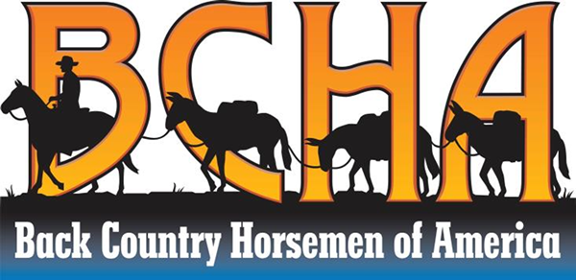
Strategic Plan 2014-2018

Slide 2
Who Are We?
Our service starts with our members—people who work tirelessly with their state and local chapters to solve some of our toughest challenges in keeping trails open for recreational use.
We act responsibly: We respect the land and other trail users. Our passion for pack and saddle stock and and our perseverance support volunteer efforts to preserve and maintain trails for all types of users.
We make a difference: We make an investment in horse and mule power to ensure you, your children, and many generations to come can enjoy the wonder, beauty, and joy of unspoiled landscapes and viewscapes.
As in this photo, our BCHA members can be found in your community and side-by-side with everyone (such as USFS & CCC) who is committed to accessible trails for recreation.

Slide 3
What Do We Do?
Our member association Back Country Horsemen of America (BCHA) builds capacity to enhance the efforts of our state and local chapters. The BCHA Foundation turns generous donations into matching grants that fund the work of our members and partners.
“Huge blocks of public lands were set aside for public use…no longer is the Forest Service able to do it all…we are the worthy enabler working with partners.”
– Peter Keller, USFS Wilderness Manager, Region 5
Relocation of high mountain trail above a swampy meadow

Slide 4
Our grassroots members—responsible leaders who help to carry forward our organization’s mission and values—lead BCHA organizations throughout the United States.
“They are so dependable and do more than asked.” – Jon Sanstrom, Trails Manager, USFS

Slide 5
Whether you enjoy a back country packing trip or a front country hike or ride, your favorite trails likely benefit from the work of Back Country Horsemen.

Slide 6
We provide equestrian & human support for youth groups and trail crews to:
Correct problems that cause significant trail damage, such as erosion or surface water control
Restore trails to the planned design standard

Slide 7
We also assist to:
Correct unsafe trail situations, such as removing blowdown or repairing impassable washouts
Re-stock back country lakes, repair bridges, pack out garbage left behind by all trail users, and much, much more.
We do it all using Leave-No-Trace principles

Slide 8
How Are We Different?
We see things from a three-mile-an-hour, horseback perspective: Our perspective helps us see challenges facing trail use in unique ways.
We think differently: We celebrate the beauty of American Wilderness and America’s heritage. America was explored and settled by people who traveled using horsepower – real horse power. That same horse and mule power keeps America’s scenic, historic, and recreational trails open and accessible for our use – and for yours. We apply our perspective and expertise to trail issues—and find unique solutions.

Slide 9
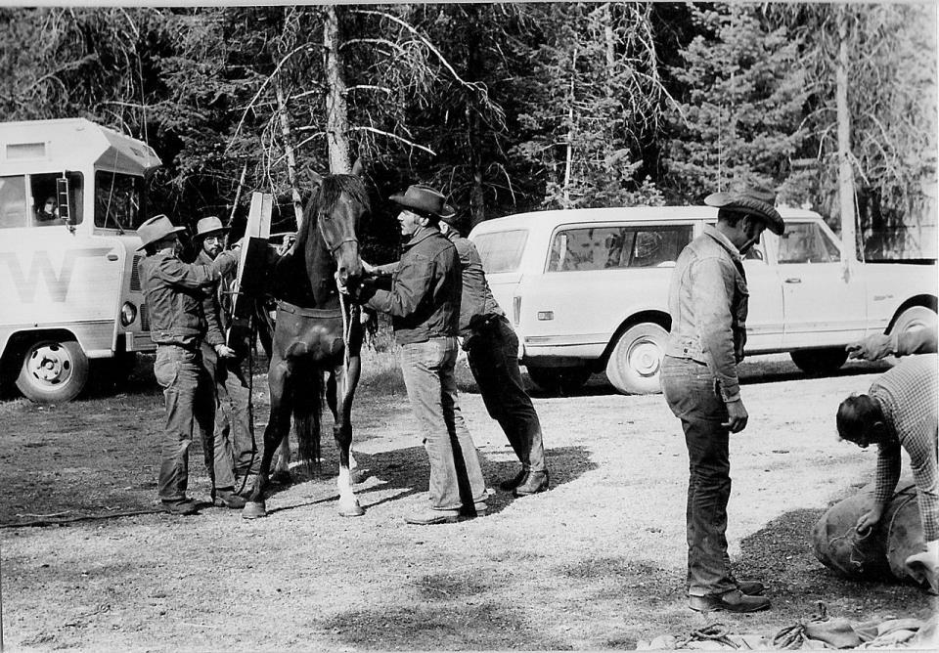
How Did We Get Here?
We've been making history and supporting trail work for over 40 years. Founding members are pictured working on one of our first projects – the Salmon Bridge in the Bob Marshall Wilderness, Montana.

Slide 10
Keeping America's trails open for over 40 years for all users
BCHA volunteers have the ability to take large amounts of supplies, camps, equipment and people deep into a Wilderness area where there are restrictions on the use of mechanized equipment. Hiking organizations – such as the Pacific Crest Trail, the Washington Trails, and the Partnership for the National Trails System – have found that they can't get much trail work done over three miles into anywhere (front country or back country). It’s too time consuming for hikers to go much further in and still get a day's work done. BCHA organizations are valuable partners. We haul their camp and gear into place. They hike in and work for a week or two. We go back in and pack the stuff out. Most of our riders also carry handsaws or axes on any ride. So if we come to a tree that we can handle we cut it out on the spot. With pack and saddle stock, BCHA is uniquely equipped to keep trails open for all users. If a trail is open to stock, it is open to everyone.
What Does it Take to Get the Job Done?

Slide 11
Partners in Public Lands Stewardship
“…WTA’s trail work relies heavily on our Back Country Horsemen…”
Karen Daubert, WTA
“The backbone of the USFS trails program is the Back Country Horsemen and the CCC.” Jon Sanstrom, Trails Manager, USFS
“The enthusiasm and passion brought to the trail by partners is essential.” Liz Bergeron, PCTA
“We knew the concept of working together was going to resonate with Congress…”
Lenise Lago, Assistant Budget Director, USFS, Washington, DC

Slide 12
Across the United States, hundreds of dedicated and committed volunteers provide millions of volunteer hours, equipment, pack and saddle stock, and transportation. In 2012 alone, the value of the work was $12.5 million and we cleared over 17,000 miles of trails. Since we began tracking the hours and the value in 1995, BCHA has contributed over $86 million to America’s trails. Our dollar value numbers are consistently underreported, understated, and growing. The work is endless and we continue to increase our commitments.

Slide 13
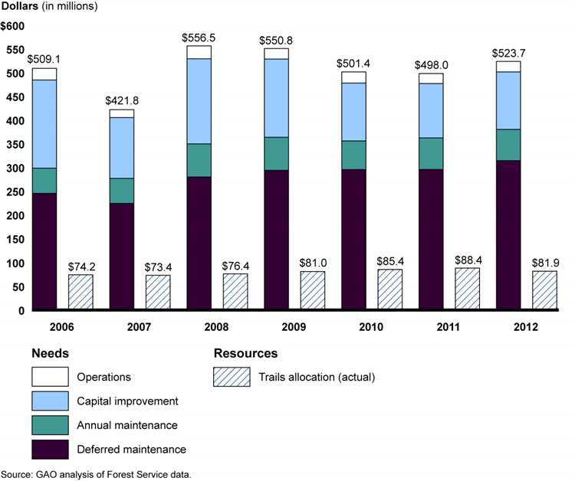
The work is never finished
Appropriated trail dollars are level and declining with inflation, but deferred annual maintenance is growing. A huge gap exists between what is maintained and what is needed – BCHA filled a $12.5m gap in 2012.
More is needed…

Slide 14
Lots of Land… 500 million acres

Slide 15
Our Plan for America’s Trails
Strategic Operating Plan for 2014-2018

Slide 16
Tomorrow’s leaders have access to back country and Wilderness – BCHA work parties travel many miles to clear and open trails.

Slide 17
Tomorrow’s leaders have access to
back country and Wilderness
Goal:
As individuals and groups, American youth will have access to back country and Wilderness experiences to enjoy and learn the value of public land stewardship.
Objective:
Leveraging partnerships with federal agencies and youth groups, BCHA will provide youth with education and opportunities to understand the importance of maintaining and preserving enjoyment of the back country and Wilderness.
Success Measure:
20 youth projects reaching 200 urban youth in all regions of the U.S. annually
“Using youth to get the job done gives youth opportunities to learn about themselves and the resources.”
– Jodi Sartori, Recreation Budget Coordinator, Washington Office, USDA Forest Service

Slide 18
Tomorrow’s leaders have access to back country and Wilderness
Strategies:
Coordination with conservation corps and youth groups, United States Forest Service, National Park Service, Bureau of Land Management to leverage opportunities to provide outdoor and Wilderness experiences
Work with other youth groups, including but not limited to, Boy Scouts of America, Girl Scouts of America, Future Farmers of America, 4-H, Northwest Youth Corps, Student Conservation Education Association
Host campouts, work parties, trail rides, and school events for the youth of America
Educate young people and their parents about gentle use of the land and protection of the Wilderness
Teach clinics on how to pack and ride safely
Fiscal impact:
BCHA, its youth partners, and other volunteers leverage trail dollars many times over in delivering substantial projects to clear and maintain trails.

Slide 19
BCHA provides people and horsepower to keep trails accessible…including clean up of local, urban park trails. Each mule can carry 150# of junk and garbage.

Slide 20
BCHA provides people and horsepower to keep trails accessible…for everyone

Slide 21
BCHA provides people plus pack and saddle stock
to keep trails accessible
Goal:
Americans, visitors, and recreating public will be able to access America’s local, state, and national trails.
Objectives:
Leveraging partnerships with other trail use organizations, the recreating public will have widespread participation in fair and safe trail use for all ages, abilities, and skill levels
Work with land managers and congressional delegations in Washington, D.C. to increase awareness of trails issues and ongoing needs to keep trails open
Americans who own horses for recreational use will have the benefit of trail use
Success Measures:
15,000 miles of trails cleared, maintained, or repaired annually
300,000 volunteer hours annually

Slide 22
Strategies:
Memoranda of Understanding with agencies
Coordination with states/units/chapters
Working with partners, such as the American Horse Council, The Wilderness Society and American Hiking Society, recreational horse and mule owners have a favorable trail use environment
Face-to-face meetings with the USFS, NPS, BLM, US Fish & Wildlife, and legislative staff in Washington D.C. to ensure preservation of trails for stock use
Face-to-face meetings with NGO trail partners such as American Horse Council, American Hiking Society, Rocky Mountain Elk Foundation, and The Wilderness Society to ensure recreational trail users know about our work to preserve and maintain trails, including the importance of our volunteer work on behalf of all trial users
Fiscal impact:
Costs are substantial to work, maintain, clear, log trails, in addition to delivering trail crews, camp supplies, food, tools, and materials to a work site. BCHA members have a significant capital investment in stock and equipment that we provide to help leverage limited trail maintenance dollars.
BCHA provides people plus pack and saddle stock to keep trails accessible

Slide 23
BCHA Member Leaders Have Accessible, Broad-Based Information and Knowledge
Current and Affiliate Members are located from coast to coast

Slide 24
BCHA member leaders have
accessible, broad-based information and knowledge
Goal:
BCHA’s member organizations will have access to needed information and tailored services to increase capacity to serve local and regional trails
Objectives:
To better meet current and future strategic needs, organized regional programs will build the capabilities of BCHA leaders
Accurate and timely information and tools for members’ organizations
Build capacity with states and local chapters
Success Measures:
Regional leaders identified and trained
One regional meeting in each region annually
Horse and mule owners’ trail use preserved

Slide 25
Strategies:
Educate chapter and state organizations on how to identify and successfully apply for grants; find alternative resources; develop partnerships with youth groups, donors, and sponsors
Regional leaders, state, and local groups know their area best: BCHA will help them leverage the knowledge and skills in each area to support the work
Regional leaders coordinate and connect with BCHA for agency and legislative assistance
Regional team meetings so members can exchange best practices, information, and skills training
Major ongoing, active advocacy efforts at chapter, state, and national level by all members
Education and safety training, including defensive horsemanship
Fiscal impacts:
National organization meeting costs are contained
Resources developed and distributed effectively
BCHA investment maximized
BCHA member leaders have
accessible, broad-based information and knowledge

Slide 26
Members will sustain and support the national organization – BCHA’s member organizations benefit from programs that bring together organizations like the USFS and Conservation Corps

Slide 27
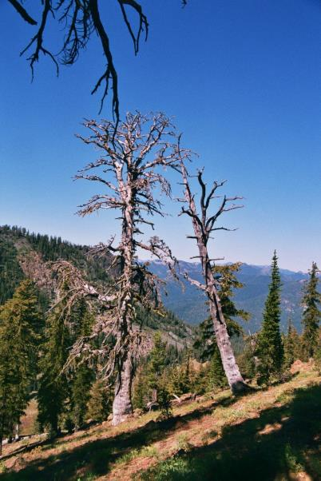
Members will sustain and
support the national organization
Goal:
Membership and fundraising will support costs to “be at the table” with agencies and like-minded organizations to support the right to ride on public lands and assist regional leaders. Responsible stewardship of the land means more than just doing good work—it means making the most out of every donation we receive. Some of our greatest challenges exist in some of the most scenic and remote areas that are difficult and costly to access.
Objectives:
Financially stable, growing membership base
Success Measure:
$100,000 in fundraising initiatives each year to leverage member dues.

Slide 28
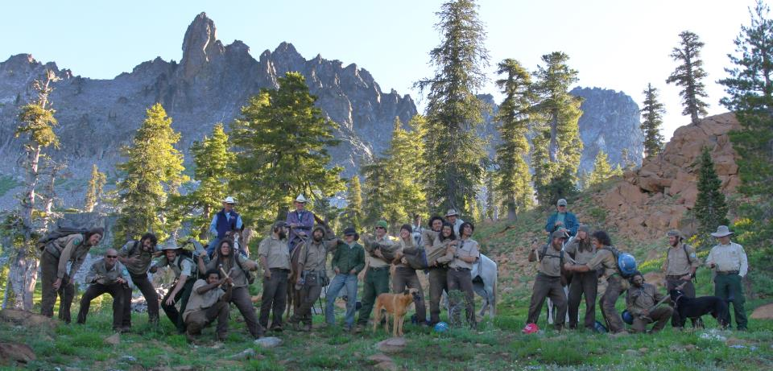
Members will sustain and
support the national organization
Strategies:
Annual fundraising plan
Fiscal impact:
At least $100,000 will be raised each year to build capacity and provide assistance through matching grants for state, affiliate, chapter, and unit members in their efforts to keep trails open and accessible.
“We’re like a big family working together to help get the job done.”
– Peter Lewis, California CCC Backcountry Manager

Slide 29
Our Mission is Fulfilled by Our Members and Your Support
We believe:
Responsible stewardship of the land means more than just doing good work—it means making the most out of every donation we receive
Common sense use and enjoyment of pack and saddle stock in America’s back country and Wilderness areas is part of America’s heritage and legacy
We have a job to ensure public lands remain open to recreational stock use for the benefit of all trail users, which includes our extensive national volunteer efforts to preserve and maintain trails
In our duty to assist the various government and private agencies in their maintenance and management of public lands trails and resources
We have a duty to educate, encourage, and invest in active participation by young leaders in the wise and sustainable use of the back country resource
We can fulfill our goals best by building capacity of existing and new Back Country Horsemen’s organizations

