Slide 1
The Effects of
Spectrum Decay and Displacement on the Equestrian Experience
(Recreation Management 201)

Slide 2
Managing for recreation quality means providing a choice of settings which will accommodate a variety of activities necessary to achieve desired outcomes or experiences …

Slide 3
Spectrum Decay
The manager manages the setting by:
  Providing the appropriate level of facility development, and
  Regulating use , and use impacts.

Slide 4
Semi Primitive Roaded
Primitive Non-motorized Motorized Natural Rural Urban
______________________________________________________________I_________
essentially unmodified substantially modified
natural environment natural environment
low levels of use (solitude) moderate to high use
few, lower standard trails more, higher standard trails
restrictions off site on site restriction

Slide 5
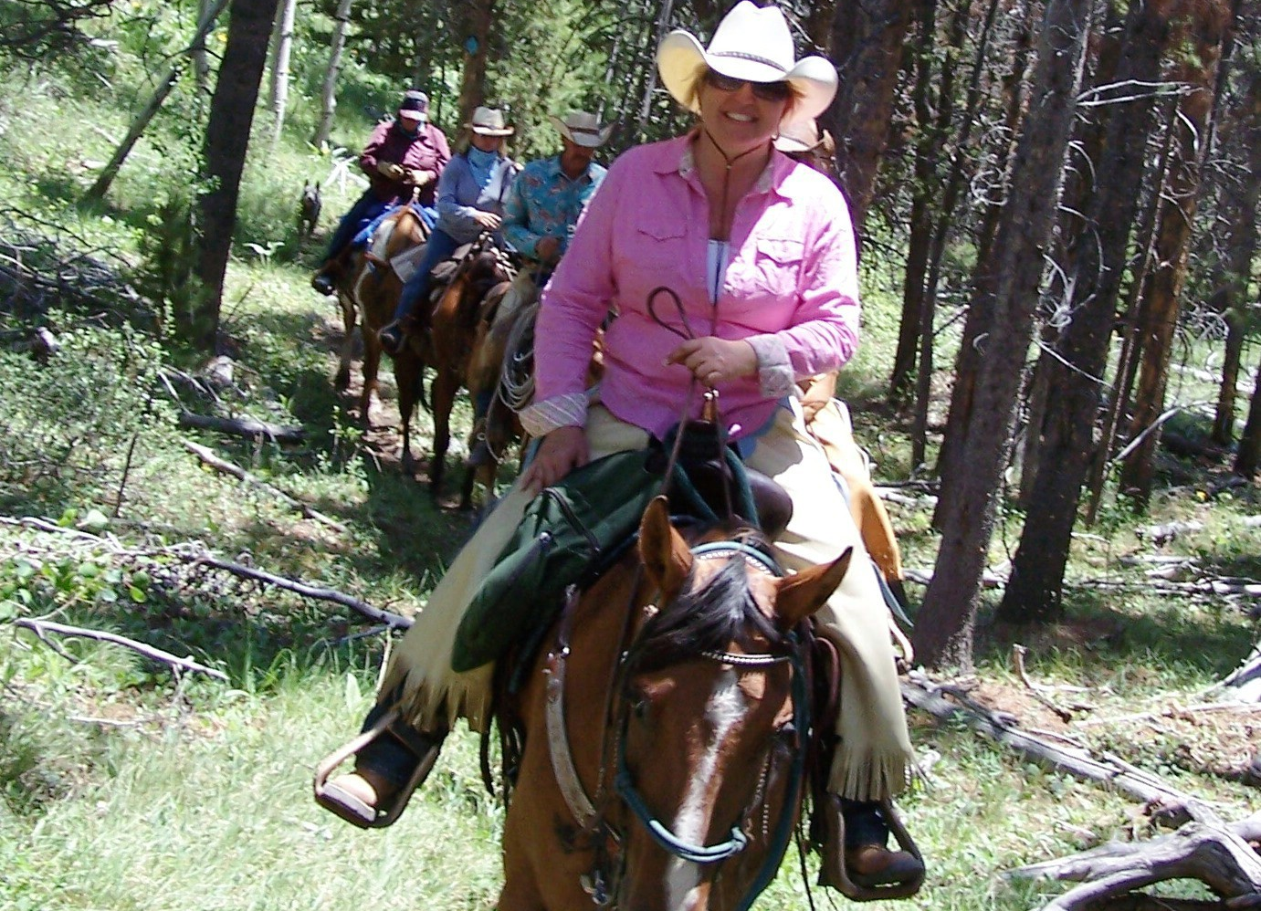
Use Level and Trail Standard for Primitive Portion of Spectrum

Slide 6
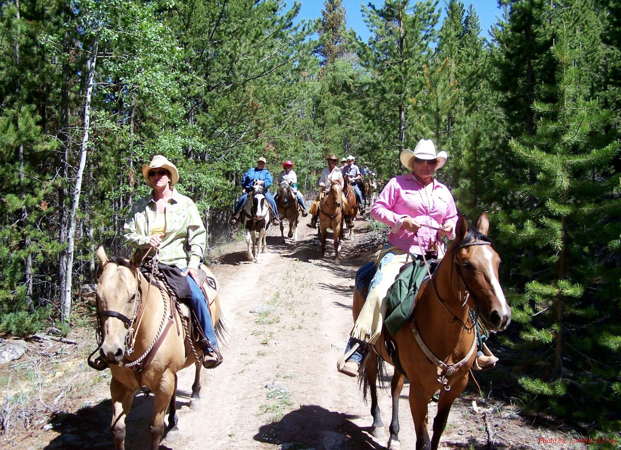
Use Level and Trail Standard for Developed Portion of Spectrum

Slide 7
So, what happens when recreation managers do not recognize the importance of providing the variety (or spectrum) of opportunities necessary to assure a quality recreation experience for a diverse recreation public? Or recognize the need in their strategic plans?
Concepts:
  Spectrum Decay
  User Displacement

Slide 8
Relationship of Recreation Use and Development Scale:
All recreation users cause impact (some more so than others).
The ‘knee jerk’ reaction to impact is often to add facilities, harden the site or increase the development scale.

Slide 9
The increase in development changes the setting and the experience it provides.
Increased recreation development →
      Spectrum Decay →
            Change in Experience! (Reduced Quality for those seeking a more natural and unmodified setting)!
          The new setting accommodates those who prefer or are more tolerant of a modified setting.

Slide 10
The alternative to development is restrictions on use!
Accommodating increased use without increasing development scale necessitates restricting use or user practices.
An unmanaged increase in recreation use →
    Spectrum Decay →
        Different Experience! (Reduced quality for those seeking an experience characterized by low levels of use)

Slide 11
Spectrum Decay:
As use levels and/or development in an area increases, recreation users are displaced to a setting that better meets their expectations.
The increased use in the new area causes increased impact leading to increased development, and users are displaced to the next new area that meets their expectations.
The pattern is repeated until there is no undeveloped, semi primitive or primitive settings available!

Slide 12
Limiting Use or User Practices to Preserve The Recreation Experience:
Practices that accommodate the greatest number with the least impact on recreation quality:
  Voluntary v Mandatory Restriction! LNT, or Tread Lightly -- voluntary change in behavioral practices to accommodate increased use.
  Restriction based on environmental expense or cost.

Slide 13
LNT & Tread Lightly:
←1950’s & 60’S = wall tents, woolen bed rolls, food wet-packed in glass jars, prepared on wood stoves. Large #s of horses/mules to pack it. Parties stayed a long time and left their camp in place for their friends.
    → 1960’s = light weight equipment.
      → restrictions on length of stay
        → limits on party size and # of stock
          → pack your own feed.
            → stay on the trail.
              → no campfires
                → pack out your human waste
                → pack out your horses waste
                → no camping with pack and saddle
                → ELIMINATE HORSES (NO!)

Slide 14
LNT is only part of the answer. There comes a point when voluntary restriction will no longer be effective.
LNT can only be successful in a management framework designed to preserve specific identified experiences.

Slide 15
  Restriction based on environmental expense or cost:
  A horseback rider causes more impact than a hiker (has a greater environmental cost), so
  Restricting horses means more higher levels of use can be sustained.
  Management’s response has been to restrict equestrian use in order to accommodate more hikers.

Slide 16
Horses have been prohibited from using wildernesses in some areas of the east.
Equestrians have been prohibited from camping in some wildernesses in the east.

Slide 17
The trend is not unique to the east, however.
In some of the more populated areas of the west, we are seeing similar attempts to restrict pack and saddle stock use from large portions of the wilderness– either directly or by limiting the development scale on access trails.

Slide 18
Best Management Practices to Minimize Horse Impact, Hoosier National Forest!
  Increasing development scale (hardening, gravel, etc.) to accommodate horse use.
Inyo-Sierra Law Suit & Three Wilderness Trails Management Plan!
  Anti-horse groups and managing agency attribute impact on trails to horse use.
  Trails Mgt plan proposed to reduce trail standards to a level that will not accommodate pack and saddle stock.

Slide 19
What do these examples have in common?

Slide 20
Both limit recreational stock to more highly developed trails and more heavily used areas, and deny equestrians the opportunity to enjoy a more natural setting and an opportunity to enjoy solitude.
Neither recognize the importance of preserving a variety or spectrum of choices for equestrians (the same choices that are available to hikers).

Slide 21
Both will impose a greater demand on the more highly developed settings as use is displaced from less developed settings:
-- resulting in additional impact and need for additional development, or
-- additional restriction or displacement to ????
As use of the more primitive settings increases -- whether it be Missouri or Montana -- we may see this same pattern of ‘displacement. ‘

Slide 22
What can we do?

Slide 23
Land managers implement law and policy.
If it isn’t established in law or policy, managers are free to use their own discretion.
The extent of that discretion is defined in Land Management Plans.
  Forest Plans (Land and Resource Management Plans) in the Forest Service.
  General Management Plans in the Park Service.
  Resource Management Plans in BLM.

Slide 24
Communicate our preferences and needs in ‘experiential terms,’ and insist that a ‘spectrum of choices’ for all users be included in Strategic Plans.
Unless the ‘desired condition’ for a given area, established through law or land management planning specifies that traditional and historic equestrian use be allowed to continue, equestrians will be crowded off of our public lands!

Slide 25
Consider approaches for addressing the use/impact problem:
  Insist that the agencies recognize “restricting use on the basis of environmental cost” for what it is – an allocation mechanism. The agencies are extending preferential treatment to some users and discriminating against others based on ‘impact.’

Slide 26
  If they are going to do that, the assessment of environmental cost should be based on the actual use and impact by ‘user type’ rather than theoretical impact established through research determining the relative impact one horse compared to one hiker, llama, bicycle, etc.
  Insist that volunteer contribution be recognized (at least in part) as payment of ‘environmental cost.’
  Reconsider BCHA’s position on payment of fees – use fees, bridle fees, trailer fees – to further offset environmental cost. $$$$ is a powerful incentive.

Slide 27
If the agency is going to use “impact” or “environmental cost” as an allocation mechanism, it is realistic to expect them to also consider other allocation methods --
Permits and Limitations on Use – based on:
  -- existing use?
  -- historic use (%age at some point in the past when the total use exceeded capacity)
  -- national demand (based on use surveys)
  -- local demand (based on use surveys)

Slide 28
Something to think about:
A hundred years ago, it was difficult for hunters and anglers to accept permits and bag limits.
Today, few responsible hunters and anglers could imagine not having them.
Preserving a variety of equestrian experiences may require the same measures – wouldn’t it be better than being crowded off of our public lands!

Slide 30
Frontcountry v Backcountry
“[B]ack country: A landscape that is remote from improved roads and modern human development. Primitive processes are the predominant modes of travel and camping. “
  (Recreational Horse Trails in Rural and Wildland Areas; Gene W. Wood)
This definition includes both “settings” and “activities” which are the components of “recreation experiences.”

Slide 31
Front country must mean an area that is not remote or removed from improved roads and modern human development. As such camping and travel may be of a more modern nature.

Slide 32
In reality there is not a clearly definable distinction between BACK COUNTRY AND FRONT COUNTRY! Remoteness and development and the manner in which we camp and travel change incrementally along a continuum from the paved to the primitive.
      Semi Primitive Roaded
Primitive Non-motorized Motorized Natural Rural Urban
______________________________________________________________I_________

Slide 33
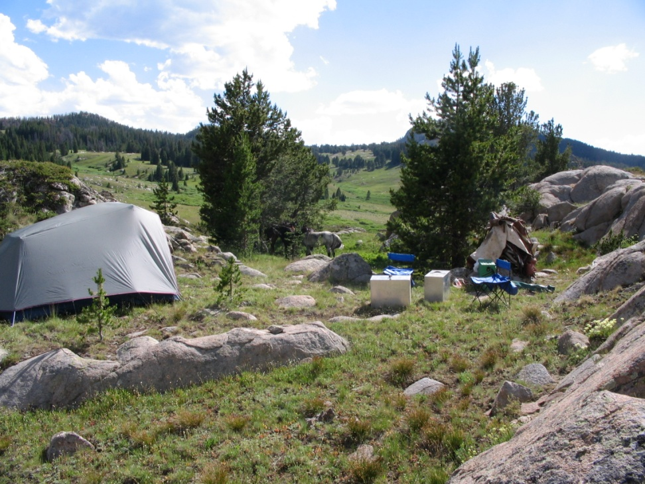
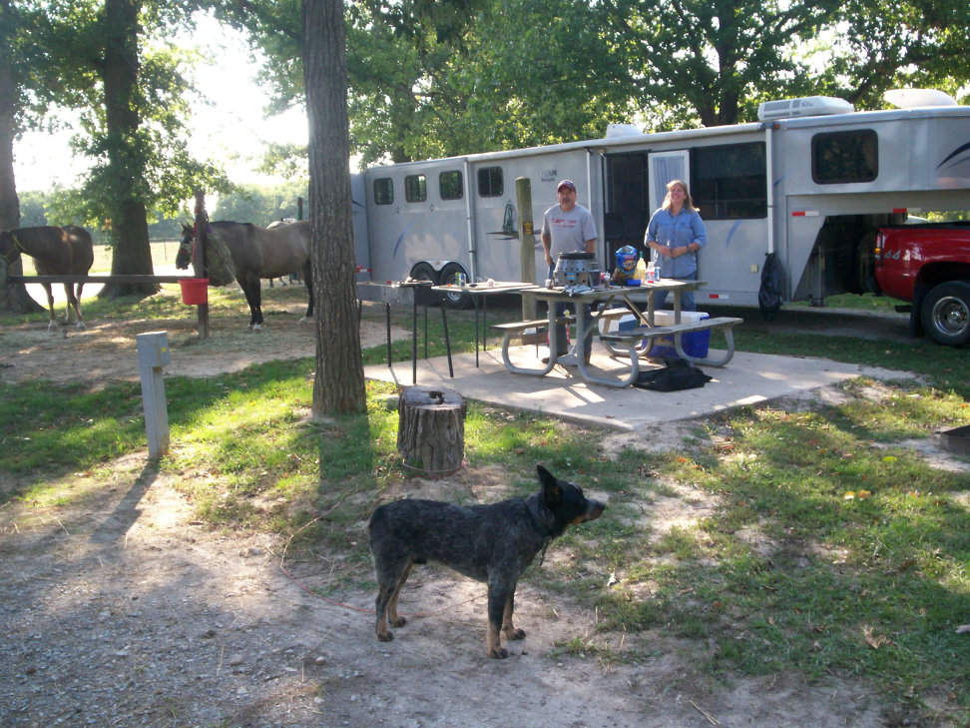
Semi Primitive Roaded
Primitive Non-motor Motorized Natural Rural Urban
___________________________________________________I___________
Backcountry – packing and camping
Frontcountry – Dayriding and camping at road-end

Slide 34
East v West
Differences in East & West = A function of supply and demand!
West = lots of public land with a greater percentage of undeveloped/primitive acreage
and fewer people!
East = comparatively little public land with very little undeveloped acreage
and lots of people!

Slide 35
This does not mean that equestrians in the west are not interested in dayriding! Most BCH chapters in the west have a large percentage of members that either do not prefer or do not have the stock and equipment to pack in, and
Dayriding and packing often take place on the same trails.
It also does not mean that equestrians in the east are not interested in packing and camping! It just means that the relative scarcity of ‘backcountry’ means those opportunities are more limited than in the west.

Slide 36
Viewing equestrian recreation as either Back Country or Front Country is on oversimplification that will inevitably result in ‘Spectrum Decay,’ ‘Displacement,’ and a reduction in our ‘Spectrum of Choice.’
Viewing our mission as preserving “trail opportunities” is too confining. The equestrian experience is more than that.

Slide 37
The purposes of Back Country Horsemen:
TO PERPETUATE the common sense use and enjoyment of horses in America’s back country and wilderness areas.
TO WORK to insure that public lands remain open to recreational stock use.

Slide 38
ARE “INCLUSIVE” -- meaning preserving the variety of opportunities that are currently available, and working to increase the variety of experiences where they are lacking,
which will provide quality recreation experiences on all our public lands – whether they be in the east or in the west!

Slide 39
Front Country and Back Country are institutionalized terms, but when we use them we need to think of them in the context of, and be able to describe them, as:
Settings + Activities = Experiences
And recognize that they are not “exclusive” worlds they exist as a continuum or spectrum.

