Slide 1

PUBLIC LANDS WORKSHOP
Back Country Horsemen of America
National Board Meeting, Branson, MO
April 20, 2010
dennis dailey, senior advisor
wilderness, recreation & trails

Slide 2
The operating approach our founders advocated (BCHA webpage):
“It was the original assumption that Back Country Horsemen would be a different type of organization, …
a service organization, doing work in the back country, would lend credibility to the group when it became involved in criticisms of agency management.”

Slide 3
“It was also recognized that some of the complaints against back country horse users were justified. Consequently, it was determined that an educational program should be a fundamental purpose of the group.
So, service and education joined a determination to protect our heritage as composites of our “purpose.”

Slide 4
BCH as Responsible Stewards!
Incorporate appropriate behavioral practices in our visits to our public lands.
    Leave No Trace.
    Tread Lightly.
    Gentle Use.

Slide 5
  Educate others in appropriate behavioral
  practices that will minimize their impact.

Slide 6
Accept that there is an “environmental cost” associated with ALL recreation use, and
Help the agencies mitigate that cost through our volunteer efforts.
  $6.7 million in 2008!!!!!!!!

Slide 7
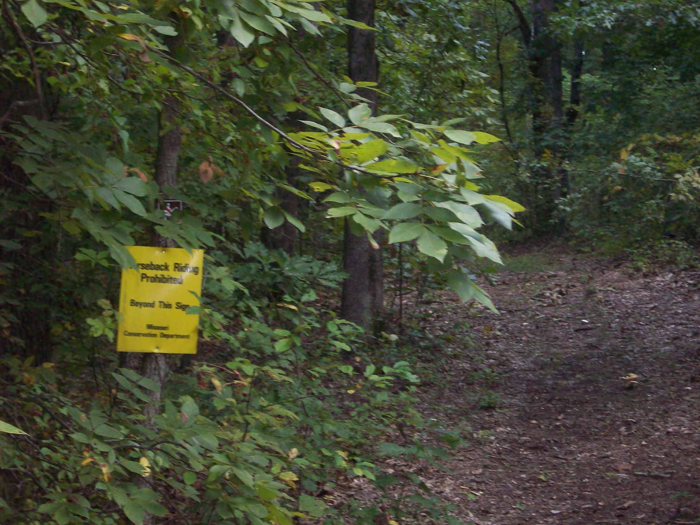
BUT, we seldom think about our role as responsible advocates until …

Slide 8
BCHA has a ‘start up’ kit to help organize a new chapter, but
What do we give the new chapter to help them organize their efforts to accomplish our advocacy responsibilities?

Slide 9
Objective of the presentation:
Provide a ‘START UP KIT’ for new chapters to help organize their activities to accomplish BCHA’s “PURPOSES!”

Slide 10
PURPOSES of Back Country Horsemen of America:
TO PERPETUATE the common sense use and enjoyment of horses in America’s back country and wilderness areas.
TO WORK to insure that public lands remain open to recreational stock use.
That is why BCHA was formed! It is what we do!

Slide 11
Unfortunately our approach has often been:
          REACTIVE!
responding to threats to our future use and the enjoyment of our public lands after the decision has been made.

Slide 12
The reactive approach:
  Isn’t usually effective! It is difficult to change a decision once it has been made. The best we can hope for is for them to back the process up and incorporate ‘THE CONCERNS’ that we neglected to provide when we were first asked.
  It hurts our relationship with the agency!
  It also hurts our relationship with other users!

Slide 13
We would be more effective taking a
PROACTIVE approach:
– participating in the agencies planning processes and helping them address the needs of horsemen in a framework that acknowledges the needs of all recreation users!
as PARTNERS IN PLANNING!

Slide 14
RESPONSIBLE ADVOCACY is a CONTINUING PROCESS:
Step 1: Inventory.
  Identify the areas that are important to you and your organization (the areas you’re currently using – year round).
  Identify other areas that would be valuable if they were opened or developed for equestrian use.
  Identify the agency and the managers or key staff members who are responsible for these areas.
  Prioritize the areas and assign a liaison.
  Establish and maintain communication with managers and/or key staff members.

Slide 15
Step 2 – Relationships, Relationships, Relationships!
Absolutely VITAL for accomplishing our mission!
  With your members, and your neighbors. One consistent message!
  With managers (Mary Hanson’s Relationships 101)
  With other organizations.
  With legislators.
  With the media.

Slide 16
Communications -- suggestions to help develop and preserve a relationship:
  Diplomatic and polite – ALWAYS!
  Make an appointment!
  Ask about his/her timeframe and stick to it!
  Stay on message!
  If it’s important, IT NEEDS TO BE IN WRITING!
  If it has been 6 months since you’ve communicated, you’ve been forgotten!

Slide 17
Your most effective tool for building a relationship!
Volunteerism! Sweat Equity! There is no substitute as a relationship builder!
(Inadequate budget is a universal problem that all agencies and all managers struggle with!)
Without volunteerism we’re just one more problem that the manager needs to deal with!

Slide 18
Step 3 – Educate Ourselves about the planning and decision processes:
How are planning decisions made, what is the timeframe for the planning processes, and how can we insure that we have an opportunity to comment?

Slide 19
Step 2 (continued)
Are there any specific problems or conditions that are out of compliance with existing strategic plans that could potentially result in additional restriction of equestrian use?
How are these conditions being monitored, and can equestrians be involved?
What can we do to help bring those conditions back into compliance?

Slide 20
Partners in Planning:
The manager is the expert on their process. They will help us be involved if we ask.
BCH is the expert on the needs of recreational saddle or pack and saddle stock users! We need to help them understand our needs.
The planning process should not be a confrontation!

Slide 21
Step 3 – Educate Managers.
  What is important to horsemen – the activities and settings necessary for a quality equestrian experience! Do managers understand what horsemen are looking for in a recreation experience? Have we told them?
  Do managers understand how their decisions affect our experience? Have we told them?
  Do managers understand why their specific area is important to equestrians?
      Supply of opportunities that are available.
      Substitutability.
      Historic or symbolic significance of their area.
    (more later)

Slide 22
Step 4 -- Be Your Own Champion:
  “The Forest Service or Park Service is proposing to … what is BCHA going to do about it?”

Slide 23
BCHA can help, but you’ve got to do the work!
  BCHA can help you understand the process the agency may use, and make suggestions about when and how to be involved.
  We can get you in touch with subject matter experts.
  We can provide general comments supporting the local organization, conveying the interest of a national organization.

Slide 24
But we do not know the local issues, use patterns, problems, the capabilities or limitations of the land, and what is important to you – what changes that you can live with, and those that you cannot!
If it’s important to you, you’ve got to
BE YOUR OWN CHAMPION!

Slide 26
Part 2 – The Planning Process
Types of Plans:
  Strategic Plans (big picture)
  Implementation Plans (project/site specific)
  Annual Operating Plans (no public involvement required)

Slide 27
Steps of a Typical Planning Process:
1. Identify the need for plan or project/develop a project proposal.
2. Public scoping/Notice of Intent/Request for comment.
3. Identify significant issues and develop a range of alternatives.
4. Analysis of alternatives.
5. Disclose analysis and identify a preferred alternative for public review and comment.
6. Decision (Decision Memo or Record of Decision).
7. Objections or Appeals.
8. Implement → Monitor → Evaluate → Revise.

Slide 28
Steps of a typical planning process:
1. Statement of Need (the reason for the plan):
  The managing agency will identify a need based on:
    An evaluation of monitoring data.
    A legislated requirement.
    A request from another entity (project level)
  Internal scoping,based on monitoring data or other indicators of unacceptable conditions, precedes issuing a statement of need!

Slide 29
  Anticipate! How good is your relationship?
By the time Statement of need is established, the agency has already identified a problem or need and started to formulate solutions.
Are we the problem? Or part of the solution?

Slide 30
2. Scoping/Notice of Intent/Request for Comment /Notification of Public Meeting):
The agency solicits public comment on the proposal to help define the “scope” of the planning effort, and
To help in the formulation of alternatives for resolving the resource or social problem identified in the Statement of Need

Slide 31
If you choose not to comment:
  Your concerns and preferences may not be reflected in the alternatives,
  You are allowing others to define the issues that will drive the formulation and analysis of alternatives and ultimately the final decision!
  And you might not be happy with the OUTCOME!

Slide 32
Define the experience(s) that you prefer and the attributes and settings necessary to achieve a satisfying/quality experience .
    Be Specific!
    Get Personal!
    (more in the next segment).
Identify conditions that limit or interfere with your ability to enjoy a satisfactory experience!

Slide 33
You also might want to consider:
  Requesting to see the comments of others to determine the range of concerns that will be addressed. It will give you an indication of what actions might be imposed that will affect equestrians.

Slide 34
3. Formulation of Alternatives (driven by the issues generated during scoping, and conditions previously identified by agency employees).
  In accordance with NEPA, a reasonable range of alternatives must be considered.
  The range of alternatives typically starts with the existing situation (required by law) and becomes progressively more restrictive.
  If we can, we need to expand the range of alternatives to include alternatives that are less restrictive.

Slide 35
4. Analysis of Alternatives.
  Be alert for ‘flat earth’ statements (from other groups or from interdisciplinary team members):
    … If you sail out to far you’ll fall off the edge …
    Horses cause the spread of invasive plants.
    Equestrian use harasses wildlife.
    Equestrian use causes more impact to trails than pedestrian use.
  What science was used in making the determination, and how does the science relate to monitoring data (why do you attribute the impact to equestrians)?

Slide 36
5. Disclose the analysis and identify a preferred alternative for public review (draft of the decision – identifies comment period):
          State why you feel the decision was not responsive to the information you provided during scoping.
          State how the decision effects you or horse users in general.
          Specify the change that you would like to see (and that you feel would address the Statement of Need).
6. Final Record of Decision or Decision Memo.

Slide 37
7. What do we do if we don’t agree with the decision?
  Administrative process:
    Appeals!
    Objections!
  Law Suits!
  Legislative Intervention!
  RESPECT THE RELATIONSHIP!
  Talk with the deciding officer! Disagree without being disagreeable!
  Keep it professional and diplomatic! ALWAYS!

