Slide 1
The Equestrian Experience
Prologue: Prior to the Good Roads Act of the early twentieth century and innovations in recreational equipment following WWII, horses and mules were the dominant form of recreation access on our public lands. Increases in backpacking, and the rapidly increasing popularity of ATVs and mountain bikes threaten to displace recreational riding and packing in many wilderness and backcountry areas.

Slide 2
As recently as the mid-1970s, horse users outnumbered all other trail users in many areas.
Horse use has increased modestly since that time, and, in some areas, it has actually declined.
However, total use has increased many times over.

Slide 3
Yet, horse users commonly bear the burden of restrictions more so than other types of users!
How many times have we heard: “we have a conflict between horse users and other users, so we need to reduce horse use.” Why horse use, and not the other users, or both?
Notes:
In spite of the fact that the primary increase in use is attributable to backpacking, horse use is most commonly more heavily regulated.

Slide 4
Before we point our finger, we need to ask if we’re doing our advocacy job effectively.
It is our responsibility to educate managers about the activities and settings necessary for equestrians to enjoy a QUALITY RECREATION EXPERIENCE!

Slide 5
Back Country Horsemen of America
Purposes:
Means:
TO PERPETUATE the common sense use and enjoyment of horses in America’s back country and wilderness.
TO WORK to insure that public lands remain open to recreational stock use.
“perpetuating common sense use and enjoyment” of
all of our “public lands”
as necessary to:
Preserve Quality Recreation Experiences for equestrians!

Slide 6
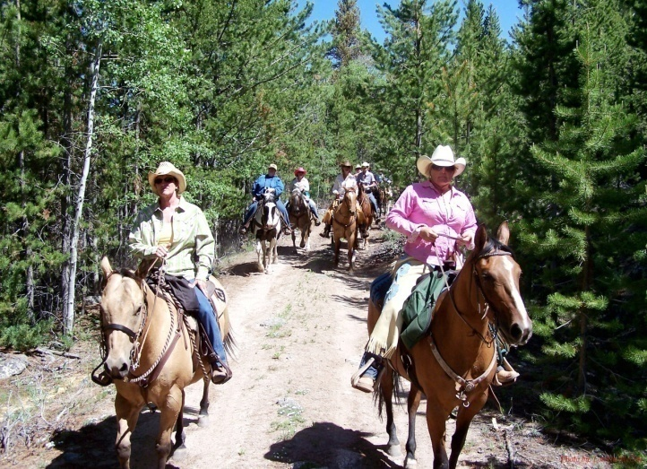
A group ride on a highly developed trail?
In a setting that might be shared with other trail users:
  Mountain bikers
  Hikers/backpackers

Slide 7
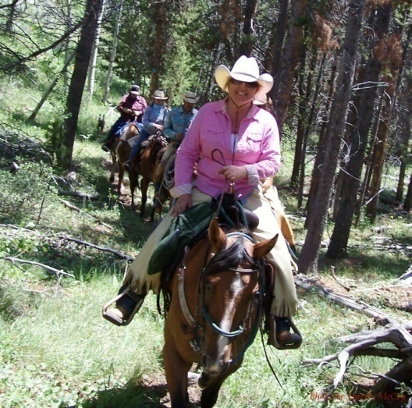
Perhaps sharing an experience with friends or family on a more primitive trail?

Slide 8
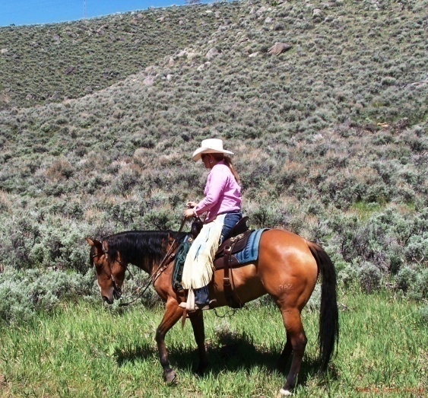
Possibly riding ‘off trail’ away from all other users.

Slide 9
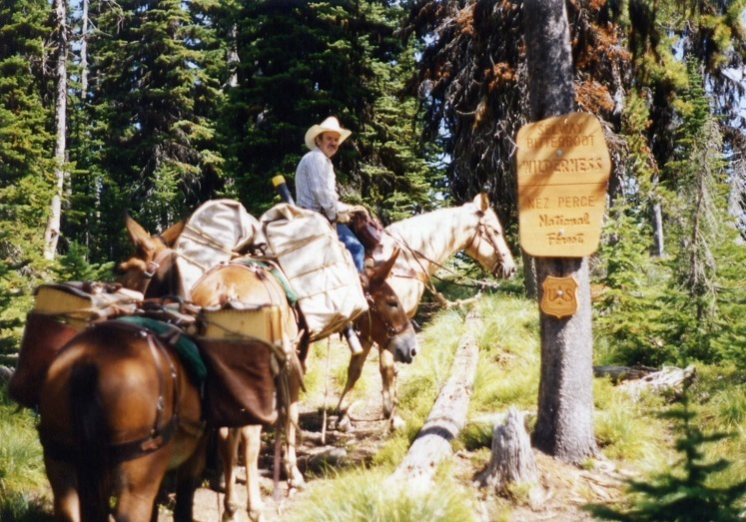
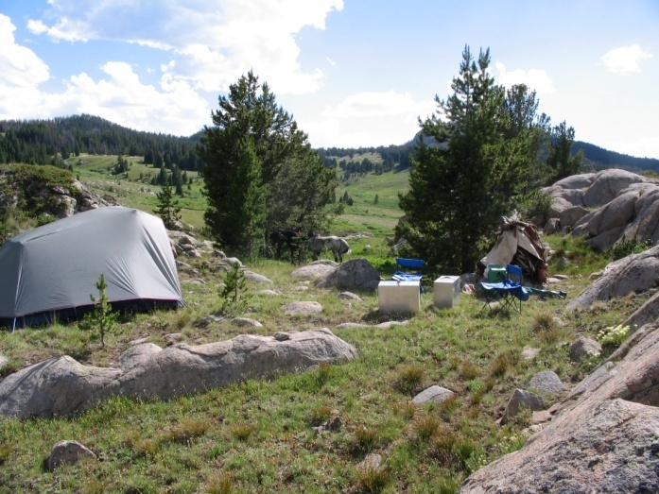
Or maybe it’s packing in with horses and mules for an extended stay in the wilderness or backcounty.

Slide 10
Of course there are a multitude of possible scenarios including many that I didn’t mention.
All have different ‘attributes’ that require different management.
Notes:
Unless we describe the attributes that are important to us, how can we expect the agency to accommodate us?

Slide 11
So, which of those experiences provides the highest measure of
RECREATION QUALITY?

Slide 12
Could a quality experience mean different things to different people?
Could a quality experience for one be unappealing or even frightening to another?
Notes:
Every one of us, would probably have a different definition of what QUALITY means to us!

Slide 13
Do we prefer different experiences on different outings?
If so,
Would that mean we want a ‘quality experience’ on some outings and a ‘less than’ experience on others?

Slide 14
Recreation Quality
Recreation quality is defined as the extent to which a given situation satisfies the desires of a particular recreationist.
The ‘challenge’ of recreation management is providing opportunities for a national public with vastly dissimilar cultural, educational and ethnic backgrounds.
Notes:
Of course when we go out for an outing, we all want a QUALITY EXPERIENCE!

Slide 15
Managing for Recreation Quality
means providing a choice or settings which will accommodate a variety of activities necessary to achieve desired outcomes or experiences!
Notes:
It requires providing a MENU of opportunities that we can select from.

Slide 16
Recreationists participate in preferred activities in preferred settings to achieve desired outcomes or experiences.
Our public lands provide a variety of settings which in turn provide opportunities for recreation experiences.

Slide 17
Recreation Quality and
The Equestrian Experience
The equestrian experience is more than just the physical act(ivity) of -- riding!
Either consciously or unconsciously, we select a setting that enables us to achieve the experience (outcome) we desire.

Slide 18
The outcome or experience will be very different in different settings.
  For example: gaming in an arena is a very different experience than trail riding, and
  Trail riding on a highly developed trail is a very different experience than packing into the wilderness on a primitive trail.

Slide 19
All of them can be quality experiences if they meet our expectations for that specific outing!

Slide 20
BUT,
If all you’re telling the recreation manager is that you want to ride in his park or forest you’re leaving out a lot of details that he needs in order to provide you with the opportunity to enjoy a quality experience!

Slide 21
Equestrian Experience
Preferred Activity +
      Preferred Setting =
        QUALITY EXPERIENCE

Slide 22
Or does it?
  The recreation experience often involves ‘multiple’ activities!
      Riding and fishing
      Riding and hunting
      Riding and camping
      Riding, camping and viewing scenery

Slide 23
And the desired outcome or experience might also have a social component.
  Sharing the experience with family and friends, or
  Being alone, and enjoying the solitude of the forest.

Slide 24
Equestrian Experience
Preferred Activity +
Complimentary Activity(s) +
      Preferred Setting(s) =
        QUALITY EXPERIENCE

Slide 25
If we overlook complimentary activities we might find our primary activity is no longer attractive to us!

Slide 26
For example: Backcountry Hunters
  Their recreational “identity” is that of a hunter.
  Many own horses and mules to help them access the areas where they prefer to hunt and to pack out their trophy.
  However, without a trail system managed to accommodate horses, and campsites open to horses, their preferred activity might not be as attractive.

Slide 27
Recreation Opportunity Planning
Recreation experiences, activity opportunities and settings can be displayed along a continuum or spectrum from the primeval to the highly developed.
For convenience, the spectrum has been divided into six classes:
Semi Primitive Roaded
Primitive Non-motorized Motorized Natural Rural Urban
______________________________________________________________I_________
Recreation Opportunity Spectrum

Slide 28
Attributes of the Setting:
Semi Primitive Roaded
Primitive Non-motorized Motorized Natural Rural Urban
______________________________________________________________I_________
essentially unmodified substantially modified
natural environment natural environment
low levels of use (solitude) moderate to high levels of use
primitive or low standard facilities facilities of a standard adequate
to sustain higher levels of use
Notes:
Managers have greater flexibility to manage use in the modified portion of the spectrum.
Unless you specify an unmodified setting, your equestrians can more easily be accommodated in the modified portion.

Slide 29
The manager influences the recreation experience by managing ‘attributes’ of the setting:
  Number and development scale of facilities provided, and
  Limits on the amount and type of use that is permitted.
Notes:
So if you want to influence his/her decision, you will be more effective if you organize your comments around these attributes.

Slide 30
Facilities/Access
facilities and structures to accommodate recreationists (campgrounds, trailheads, trails, bridges, signs).
  Presence of facilities creates a sense of safety and security and provides opportunity for social interaction.
  Absence of facilities enhances feelings of solitude, challenge, self-reliance and independence.

Slide 31
Social Encounters
Increasing the number of encounters with other users, changes the experience offered.
  Many seek low levels of use to enjoy a feeling of solitude. For some, even the expectation of meeting others diminishes the quality of the experience.
  Others feel that the experience is enhanced by sharing the experience.
  Tolerance will vary with individual expectations.

Slide 32
What does all this mean to you when responding to requests for comment -- SCOPING?

Slide 33
The Quality Equestrian Experience
More than just ‘riding!’
It is engaging in preferred activities, and complementary activities,
        in our preferred settings.

Slide 34
BE SPECIFIC! It’s more than just riding, it’s:
Riding in a natural appearing environment.
Riding in an area near my community that I can enjoy in the evenings and on weekends.
Riding in an area where I can get help if I have a medical problem (special facilities).
Riding on a well developed trail -- wide enough to ride two abreast and enjoy visiting with a friend.
Riding a primitive trail or a trail where I will not see many other people.

Slide 35
It’s more than just riding, it’s the:
Opportunity to see wildlife
Opportunity to view wild flowers
Opportunity to fish lakes or streams
Opportunity to hunt for trophy deer, elk, etc.
Opportunity to camp
  At trailhead –campsites with horse facilities, parking for long rigs, etc.
  In the backcountry – availability of grazing, campfires, be away from other campers, etc.

Slide 36
It’s more than just riding, its:
Riding with a large group of friends, or
Riding with a small group of friends or family and enjoying the solitude of the forest
Away from motorized vehicles, bicycles, etc.

Slide 37
It’s more than just riding, it’s:
The opportunity to reap the rewards of hours spent training and developing the abilities of our equine partners.
The opportunity to develop the natural abilities and athleticism of a unique breed of animal.
The opportunity to use primitive skills in traveling and subsisting in a backcountry environment.

Slide 38
Don’t forget to include:
  Unique attributes of the area.
  Only opportunity to do whatever within xxx miles
  Only place with certain attributes
  Historical significance (and the role that equines played):
  Lewis and Clark Trail
  Emigrant Trail

Slide 39
And your acceptance or tolerance of management practices such:
  Permits.
  Party size limits or limits on number of stock.
  Management presence.
And conditions under which you would accept them:
  If determined necessary to preserve specific opportunities.
  If applied equitably among all users.

Slide 40
GET PERSONAL!
  How will the decision affect me!
  What hole will it leave in my life if the opportunity is not available!

Slide 41
The MISSION of BCHA includes preserving the variety of recreational opportunities for equestrians that we currently have available on our public lands – both backcountry and frontcountry, and working to expand that variety when opportunities are lacking.

Slide 42
The Equestrian Experience
IT’S MORE THAN JUST RIDING !
It’s our WAY OF LIFE – we live it 365 days out of every year.
We can not expect managers to know if we don’t tell them!

