Slide 1
Back Country Horsemen of America
Trail Classification Assistance Program
Goal
Assist the Forest Service in properly establishing the correct Management Objectives for the trails in our National Forests

Slide 2
Part 2
Understanding
The
Key Trail Fundamentals

Slide 4
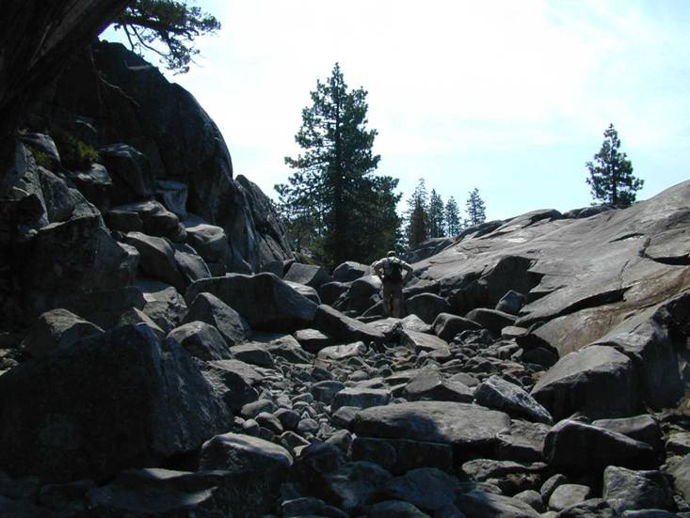
TMO can/cannot be based on existing conditions
e

Slide 5
Court Standard
The managed and designed use of a trail are
established by individual forest staffs…with the
publics active assistance, and any changes require
public involvement process and land management
planning determinations, including appropriate
(NEPA )review.

Slide 6
TRAIL FUNDAMENTALS
Trail Fundamentals are five concepts that are the cornerstones of Forest Service trail management:
Trail Type
Trail Class
Designed Use
Design Parameters
Managed Use
Trail Fundamentals 1
Notes:
Look at form and list other sections. The final Trail Management Objectives will be based upon the conclusions reached from the Trail Fundamentals.

Slide 7
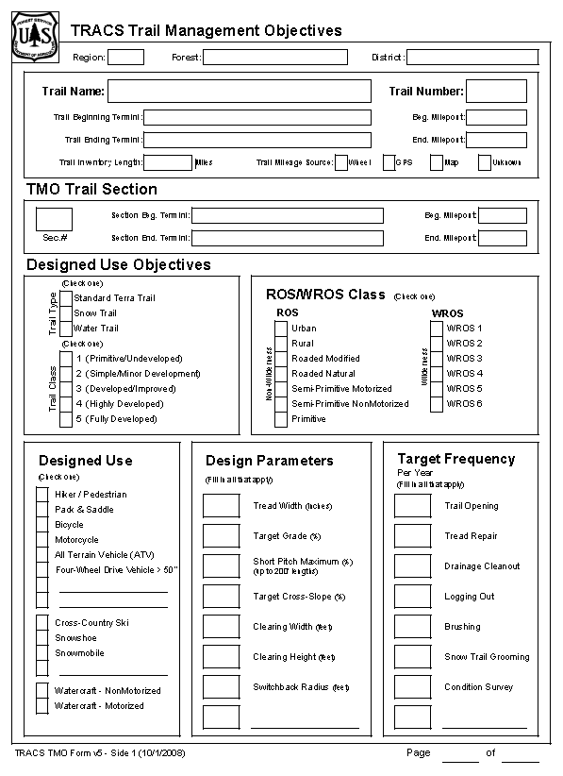

Slide 8
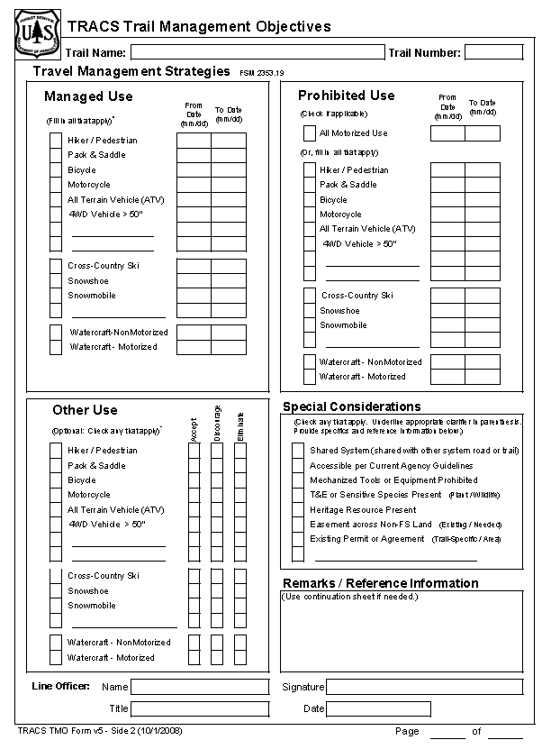

Slide 9
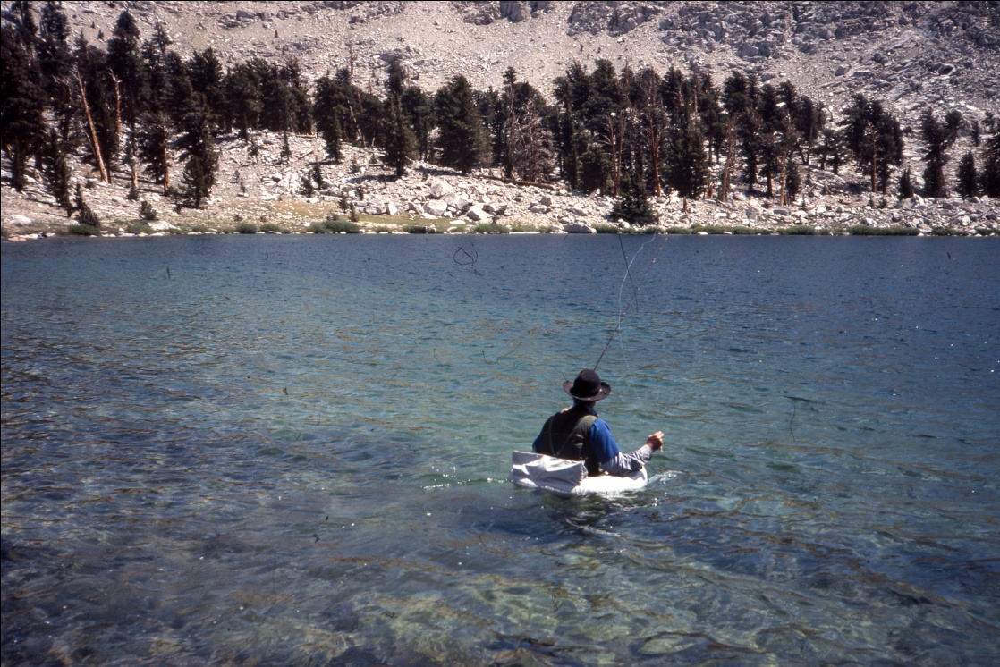
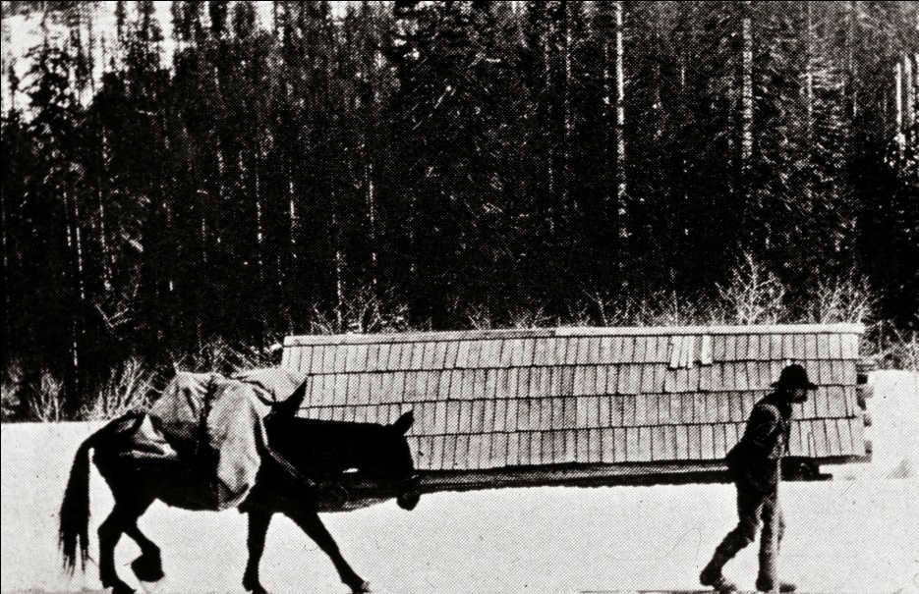
Trail Type
Standard Terra Trail
Snow
Water

Slide 10
Trail Class
Trail Class 1: Minimally Developed
Trail Class 2: Moderately Developed } Way
Trail Class 3: Developed } Secondary
Trail Class 4: Highly Developed} Mainline/ Primary
Trail Class 5: Fully Developed
Notes:
There are five Trail Classes, ranging from the least developed (Trail Class 1) to the most
developed (Trail Class 5):

Slide 11
Trail Class Communicates the scale or level
of development, not the type of use the trail
will accommodate.
Tread and traffic flow
Obstacles
Construction features and trail elements
Signs
Typical recreation environs and experience

Slide 12
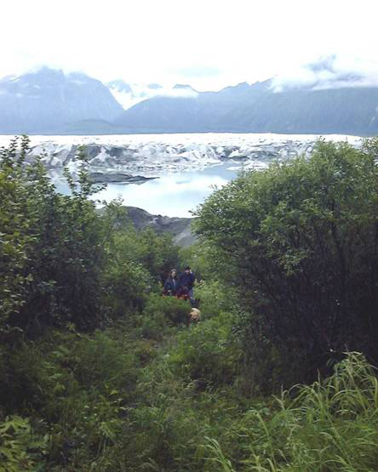
Trail Class 1: Minimally Developed
There are no design parameters
for pack and saddle stock use

Slide 13
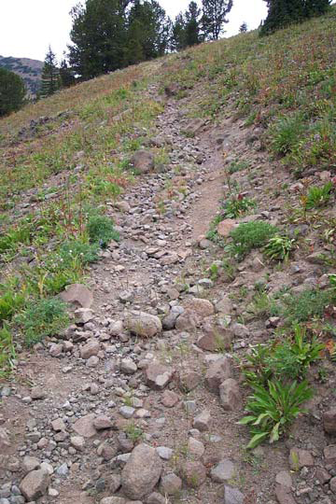
Trail Class 2: Moderately Developed } Way
The minimum development scale
intended to sustain pack and
saddle stock use.

Slide 14
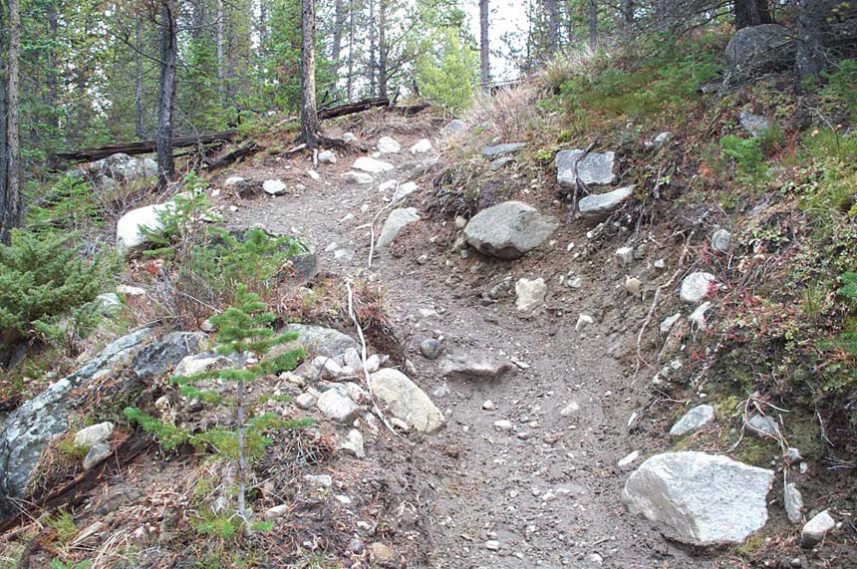
Trail Class 3: Developed } Secondary
The fully developed Trail intended to accommodate
the type and level of use typically found in a backcountry
and wilderness environ.

Slide 15
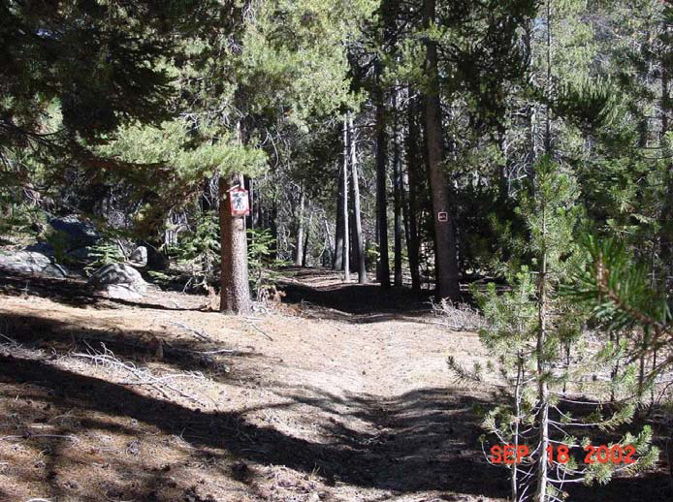
Trail Class 4: Highly Developed } Mainline/ Primary
Accommodations for passing
and double lane when necessary

Slide 16
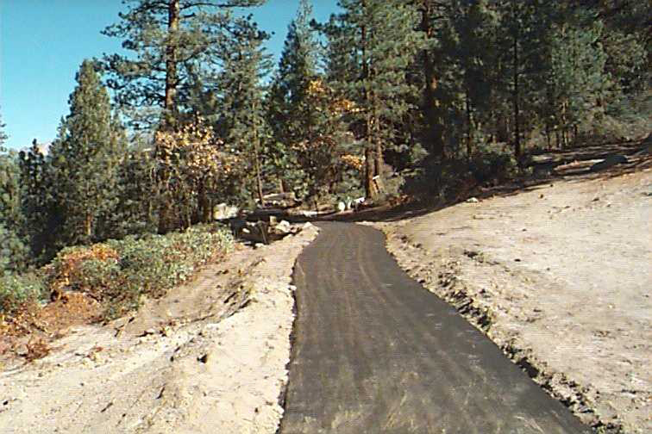
Trail Class 5: Fully Developed
Visitor Centers
High use Recreation sites
Hardened or asphalt surface
There are no design parameters for pack and saddle stock use

Slide 17
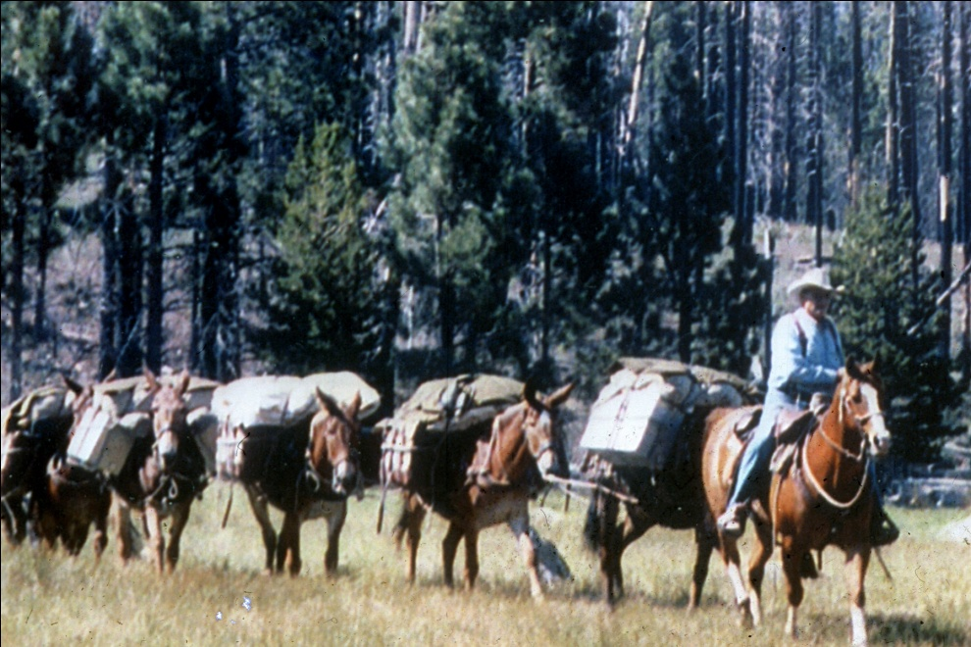
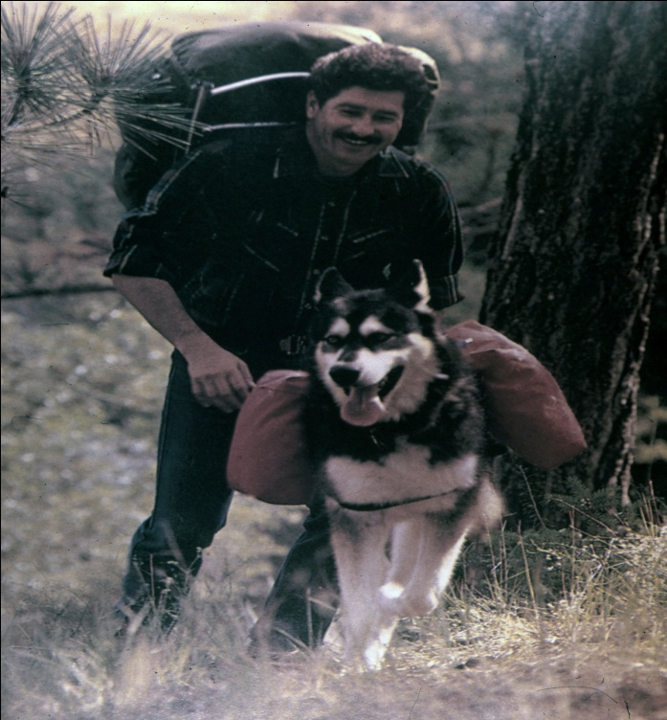
Managed Use
The modes of travel actively managed
and appropriate on a trail.
There may be more than one mode.
Example:
Hiking and pack and saddle

Slide 18
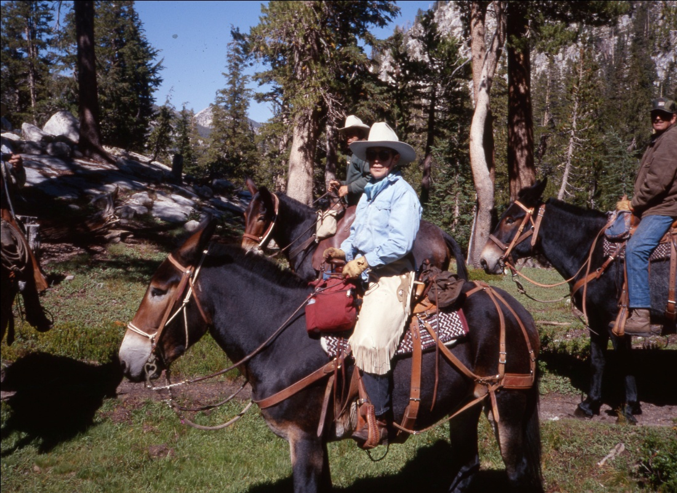
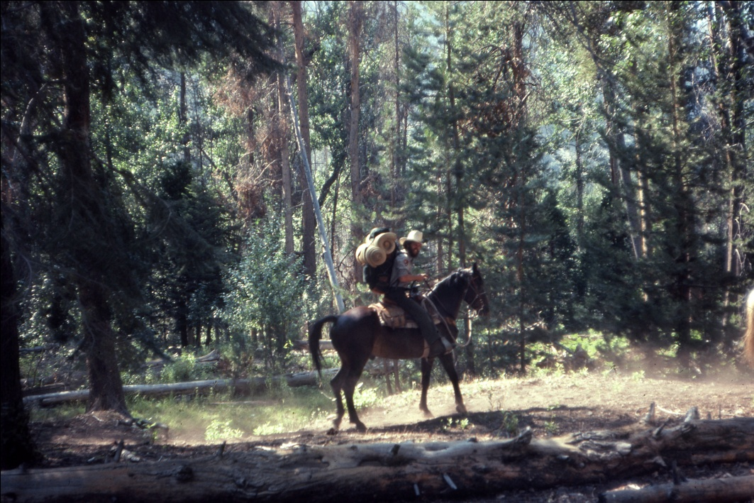
Managed use as determined by applicable
Land management plan, travel plan , or
trail specific decision.
A specific document that has involved
the public and undergone appropriate
public NEPA review.

Slide 19
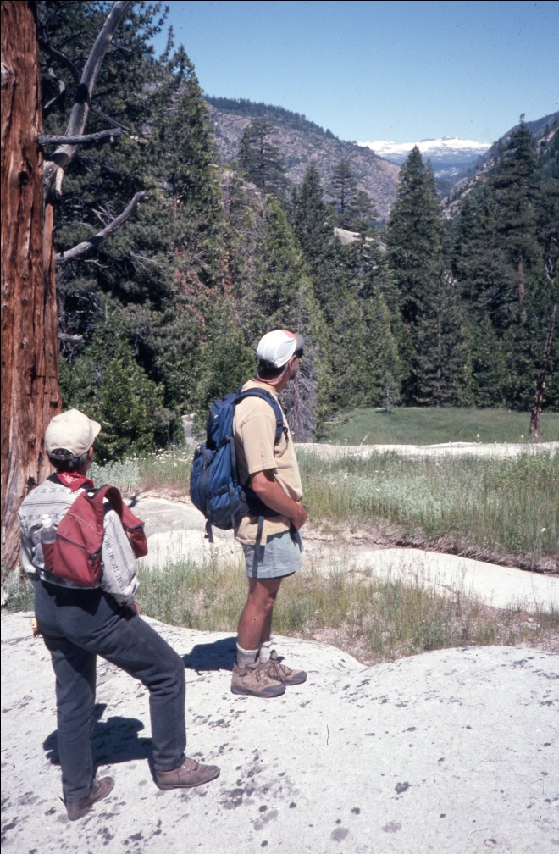
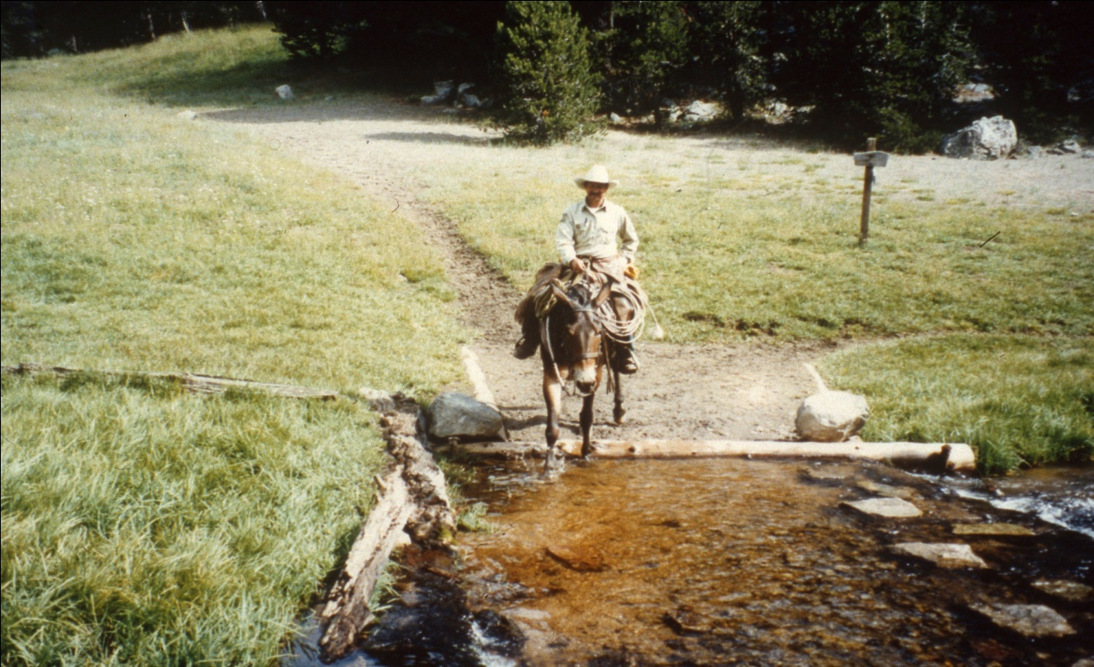
Designed Use
The managed use that requires the
most demanding design, construction
and maintenance parameters.
There can only be one designed
use per trail or trail segment.

Slide 20
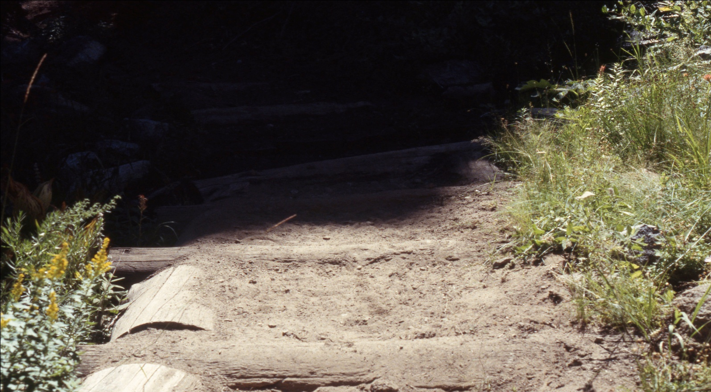
Design Parameter
The technical guidelines for the survey,
design, construction, maintenance and
assessment of a trail based on its designed
use and trail class.

Slide 22
Most important to us
Managed Use
and
Designed use
Will give an indication of whether the trail will accommodate the type and level of use that was historically accommodated before implementation of the new system.

Slide 23
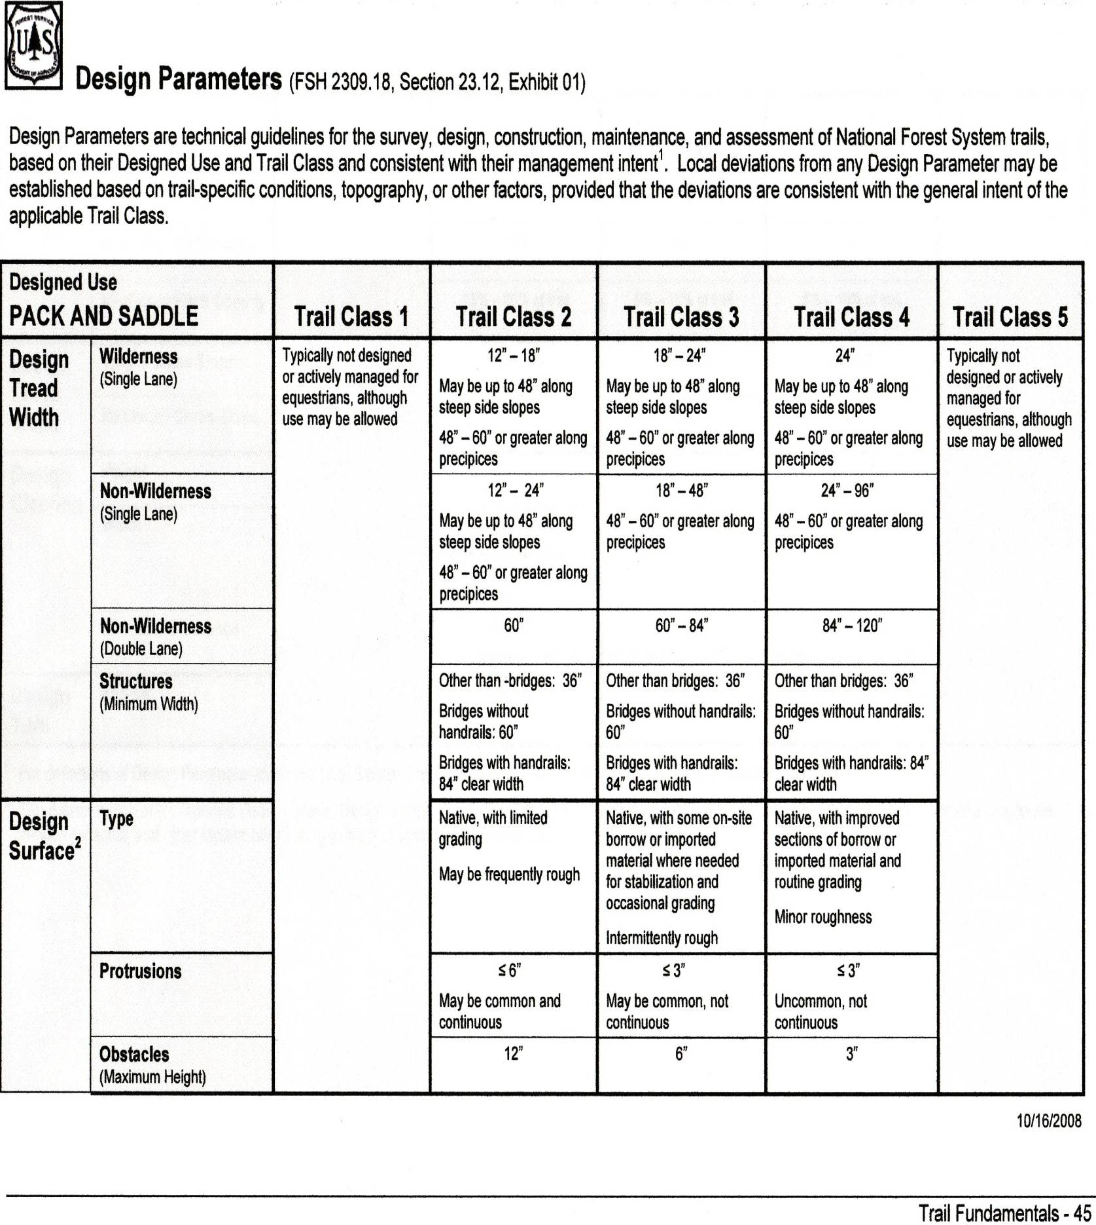
Notes:
Designed use. Trail Class. (level of development ) Parameters based on designed use and trail class.

Slide 24
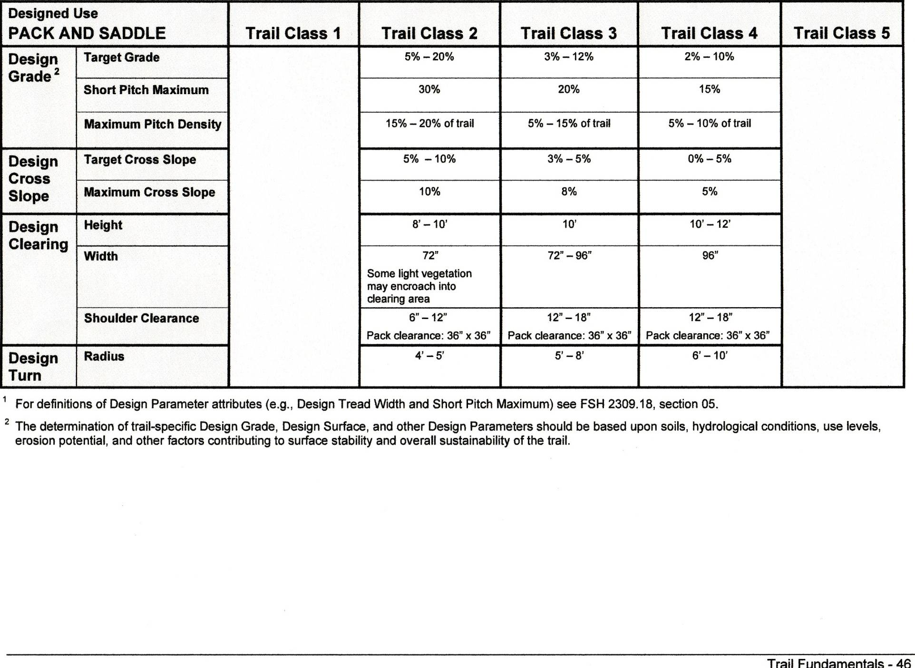
The specific clearing height and width parameters will give an indication
Whether or not the trail is adequate for pack and saddle stock.

Slide 25
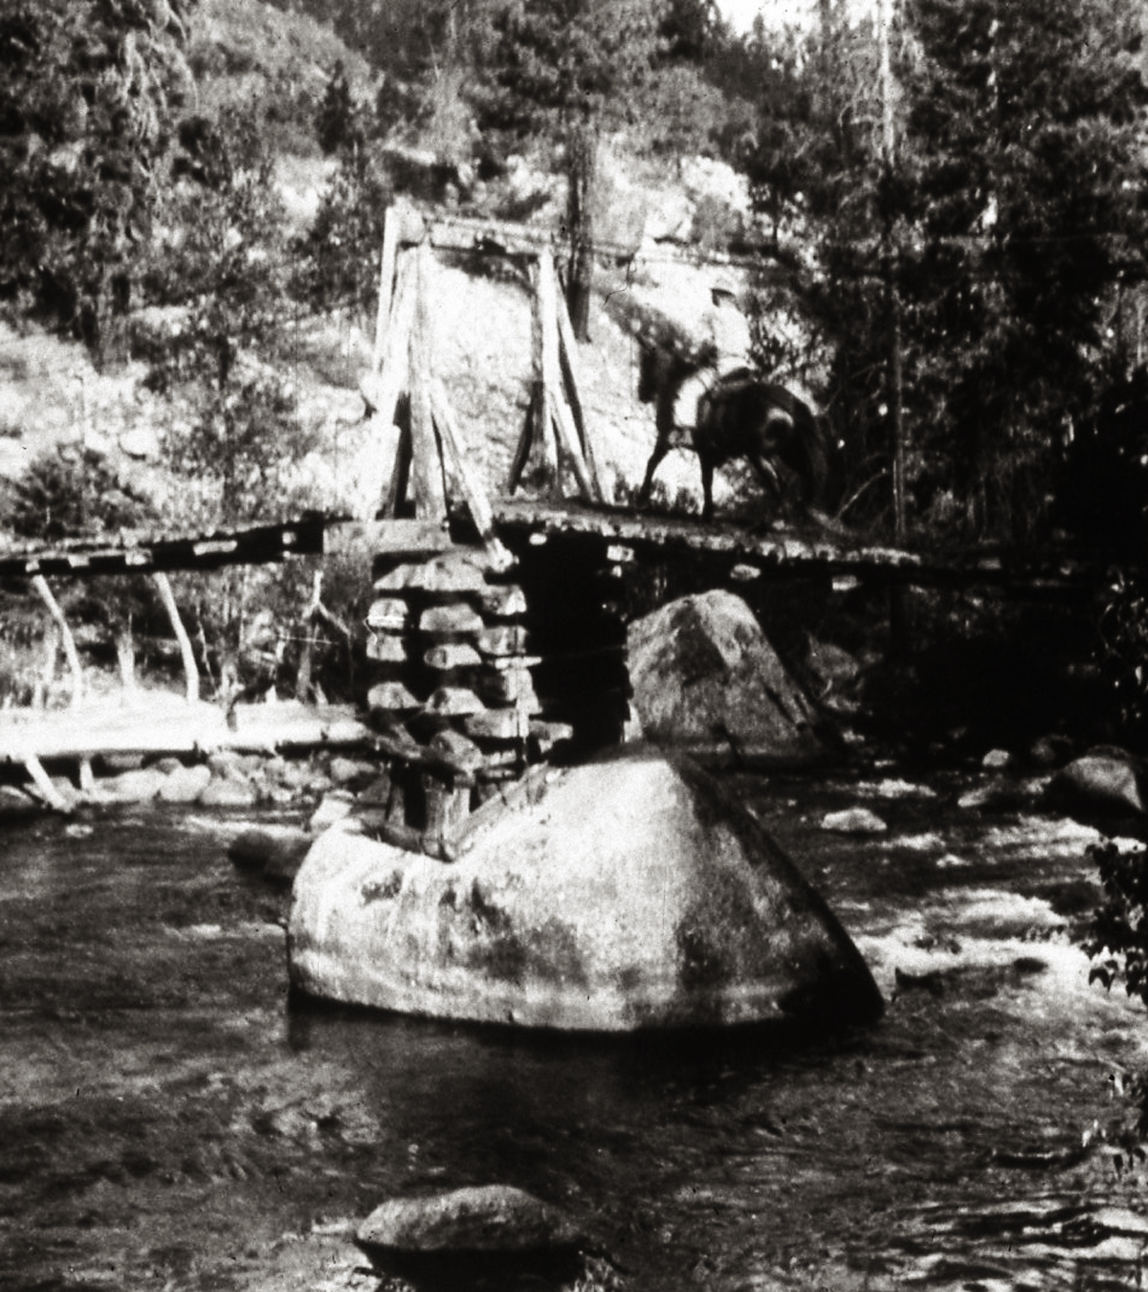
If the trail was historically a Pack and Saddle
Stock Trail but has been changed.
How was it changed
Does the change meet the court standard

Slide 26
Court Standard
The managed and designed use of a trail are
established by individual forest staffs…with
the publics active assistance, and any changes
require public involvement process and land
management planning determinations, including
appropriate (NEPA )review.

