Slide 1
Back Country Horsemen of America
Trail Classification Assistance Program
Goal
Assist the Forest Service in properly
establishing the correct Management Objectives for the trails in our National Forests
Notes:
What is the Correct Trail Type, Trail Class, Designed Use, Design Parameters and Managed Use

Slide 2
PART 1
WHY WE NEED TO BE CONCERNED
PART 2
UNDERSTANDING THE KEY
TRAILFUNDAMENTALS
PART 3
SUGGESTED APPROACHES FOR
OBTAINING AND VALIDATING
DATA
PART 4
EXAMPLES OF RATIONALE THAT
WE MAY RECEIVE IN RESPONSE TOO OUR INQUIRES

Slide 4
PART 1
WHY WE NEED TO BE CONCERNED

Slide 5
1935
Forest Service Handbook Classified Trails
Primary
Secondary
Way
Forest Trails handbook
Notes:
Provide safe and unobstructed passage of loaded animals and foot travelers at a walking gait and in single file.
Durability designed to meet expected use and liability of damage from natural causes.

Slide 6
Objective
Provide safe and unobstructed passage
of loaded animals and foot travelers
at a walking gait and in single file.
Durability designed to meet expected
use and liability of damage from
natural causes.

Slide 7
1991
Changed
Primary/mainline. . .easy
Secondary. . .more difficult
Way. . .most difficult
Notes:
Transportation
Reasonable access.

Slide 8
All Would accommodate equestrian use
Mainline and secondary would
accommodate both pack and
saddle stock
Way would accommodate saddle
stock

Slide 9
June 15, 2001
Instituted five class system
Primary
Secondary To
Way
Trail Class 1: Minimally Developed
Trail Class 2: Moderately Developed
Trail Class 3: Developed
Trail Class 4: Highly Developed
Trail Class 5: Fully Developed

Slide 10
On May 13, 2005,
The Backcountry Horsemen of America
filed a lawsuit against the Forest Service
challenging revision of the TCS
without public notice and comment.

Slide 11
Court Standard for management intent
was established.
The managed and designed use of a trail are established by individual forest staffs…with the publics active assistance, and any changes require public involvement process and land management planning determinations, including appropriate (NEPA )review.

Slide 12
2009 FOREST SERVICE DATA
TRAILS MANAGED FOR
PACK AND SADDLE STOCK
40%

Slide 13
TRAILS DESIGNED FOR
PACK AND SADDLE STOCK
41%

Slide 14
59% OF THE TRAIL SYSTEM
IS NOT DESIGNED FOR, AND
MAY NOT, IN THE FUTURE,
ACCOMMODATE PACK AND
SADDLE STOCK USE

Slide 15
Forest Service
“It is preliminary data and may be changed
As the quality of information improves”

Slide 16
WE HAVE AN OPPORTUNITY, CONSISTENT
WITH THE COURT’S DECISION, TO HELP
THEM IMPROVE THE QUALITY OF THAT
DATA.

Slide 17
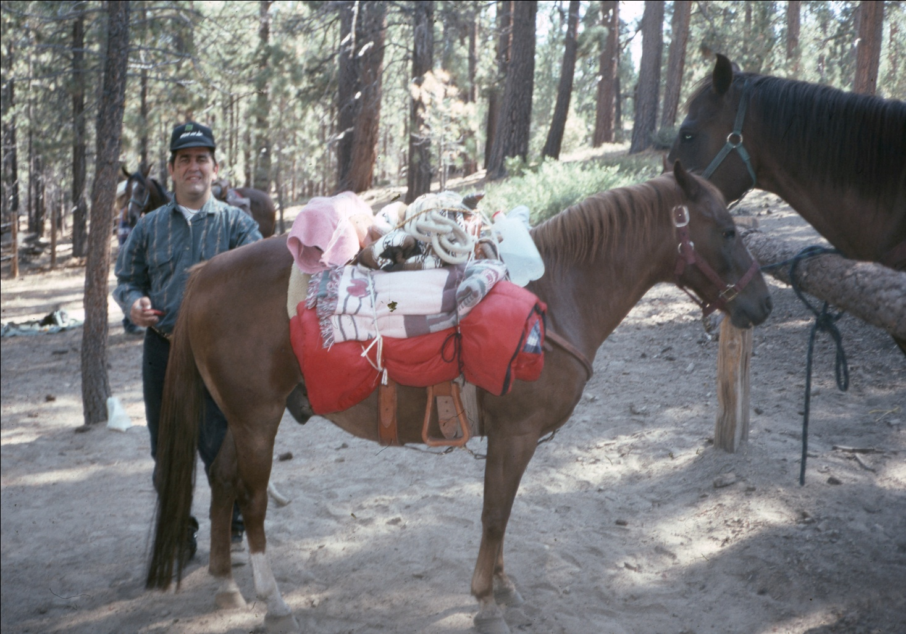
OUR CHOICE
OUR RESONSIBILITY

Slide 18
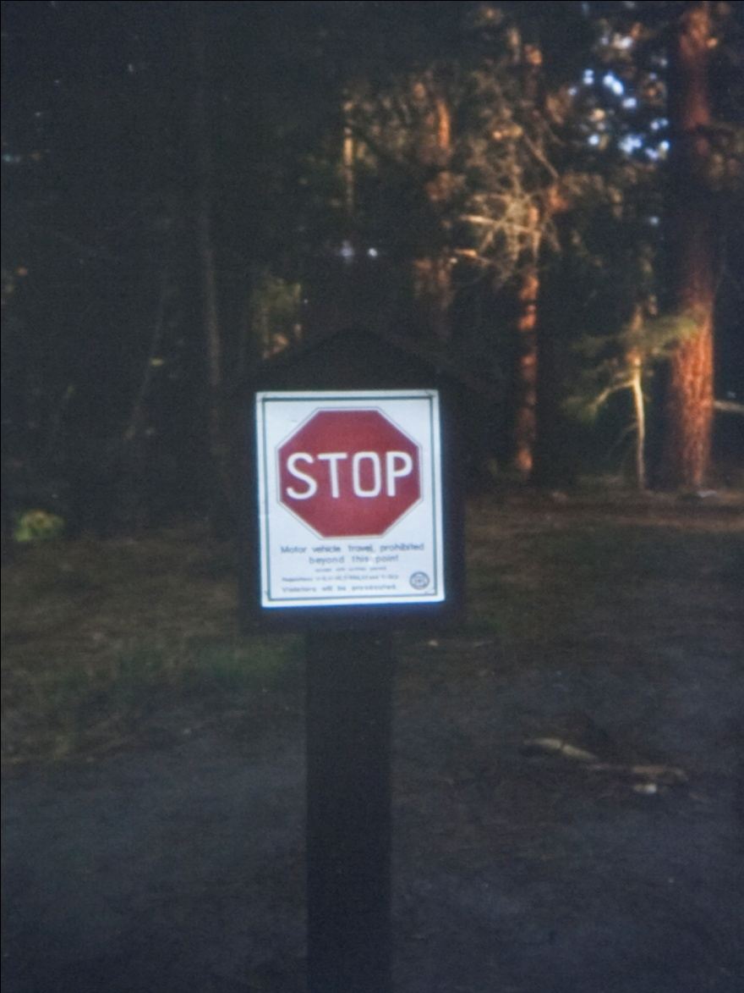
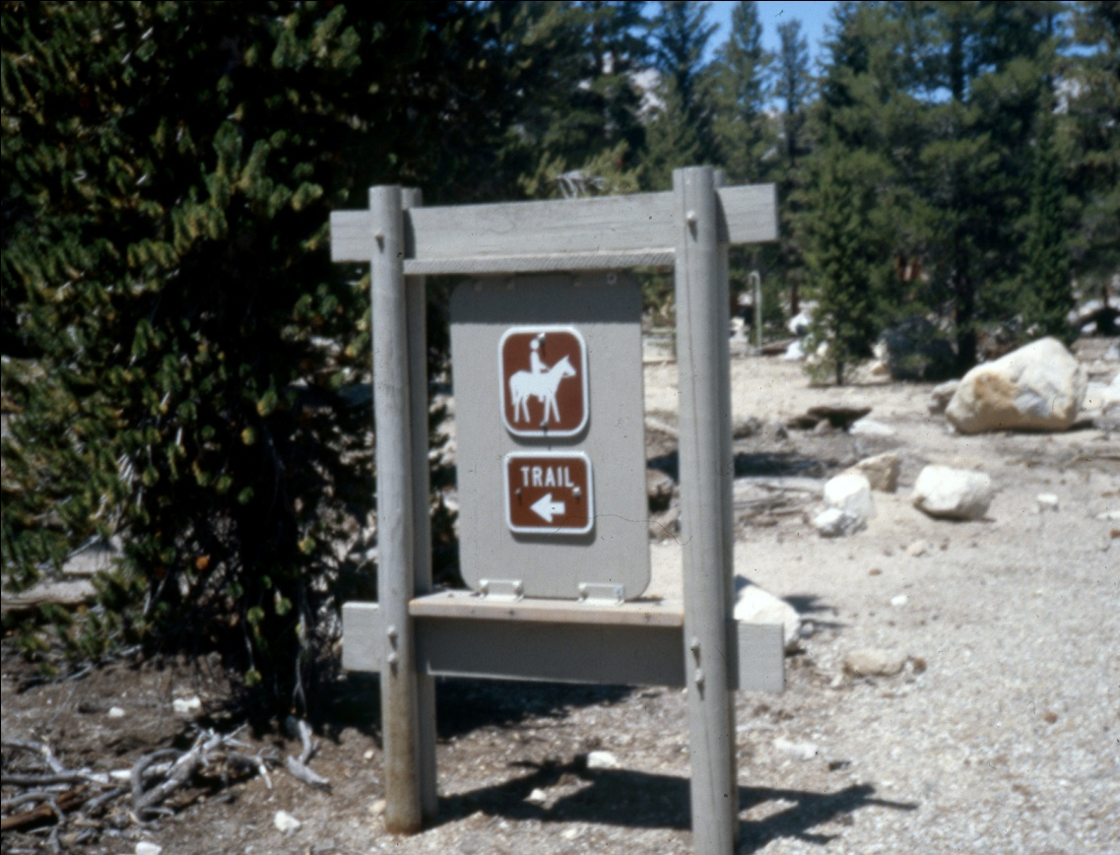
If we choose not to, we may find
That our favorite trails are no longer managed for our use.
Notes:
That our favorite trails are no longer managed for our use

